Slide 1

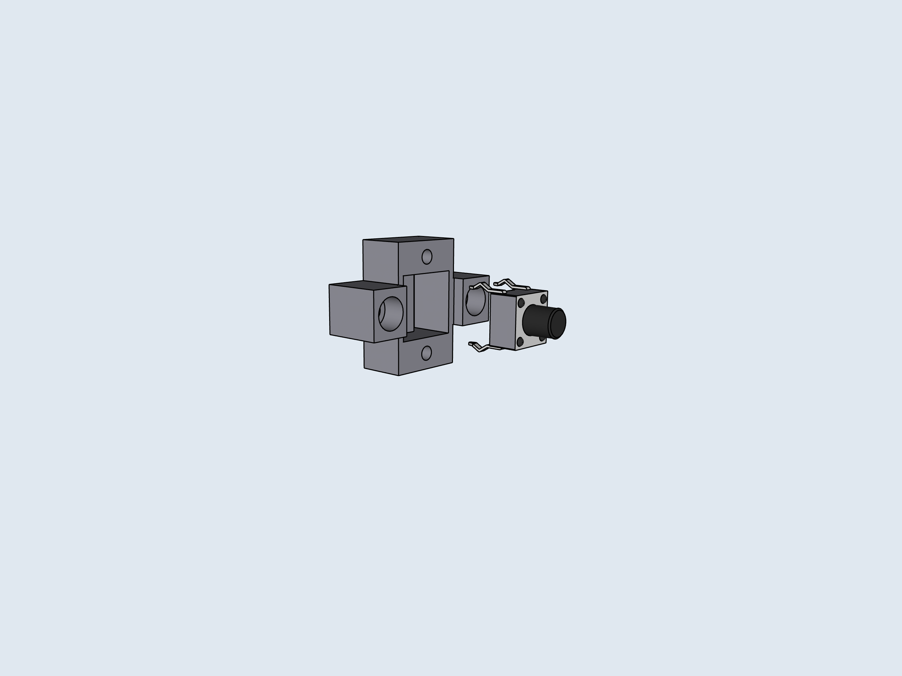
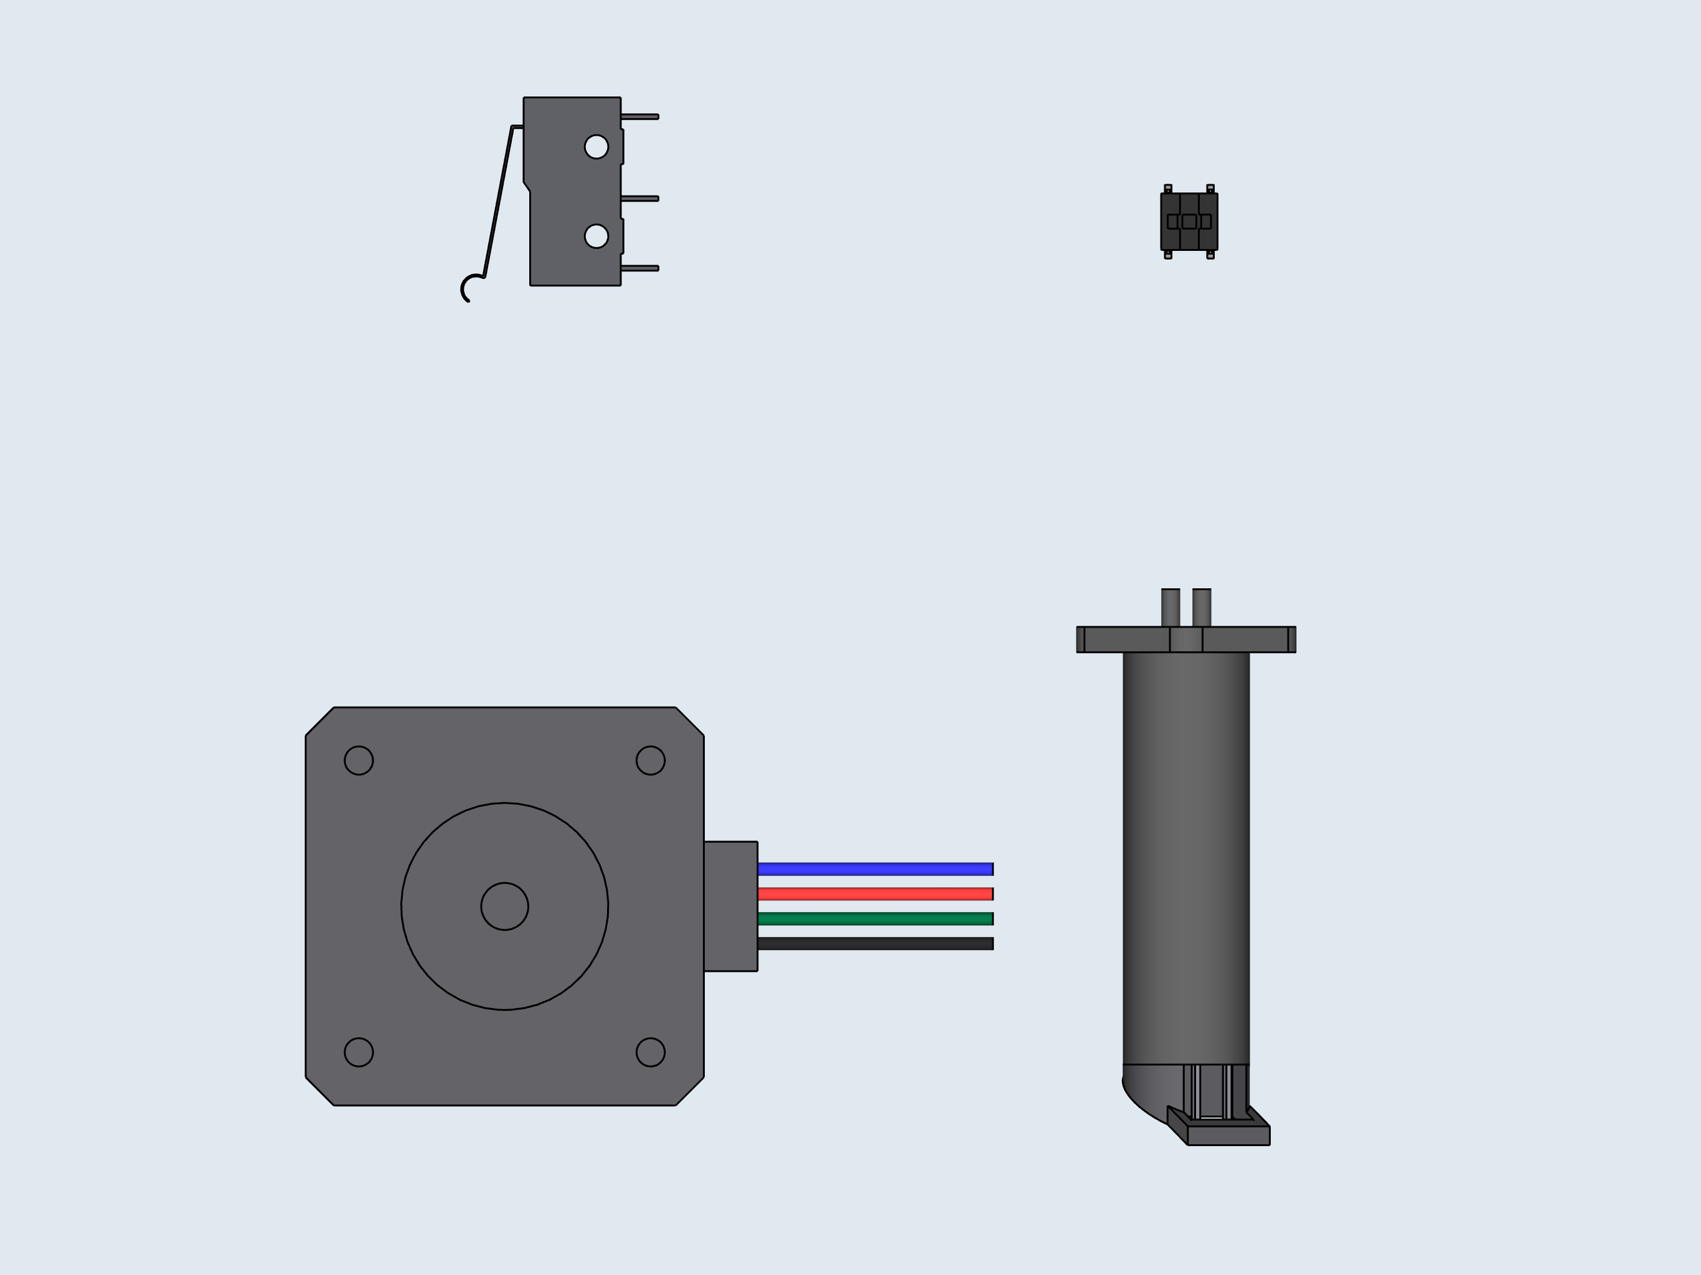
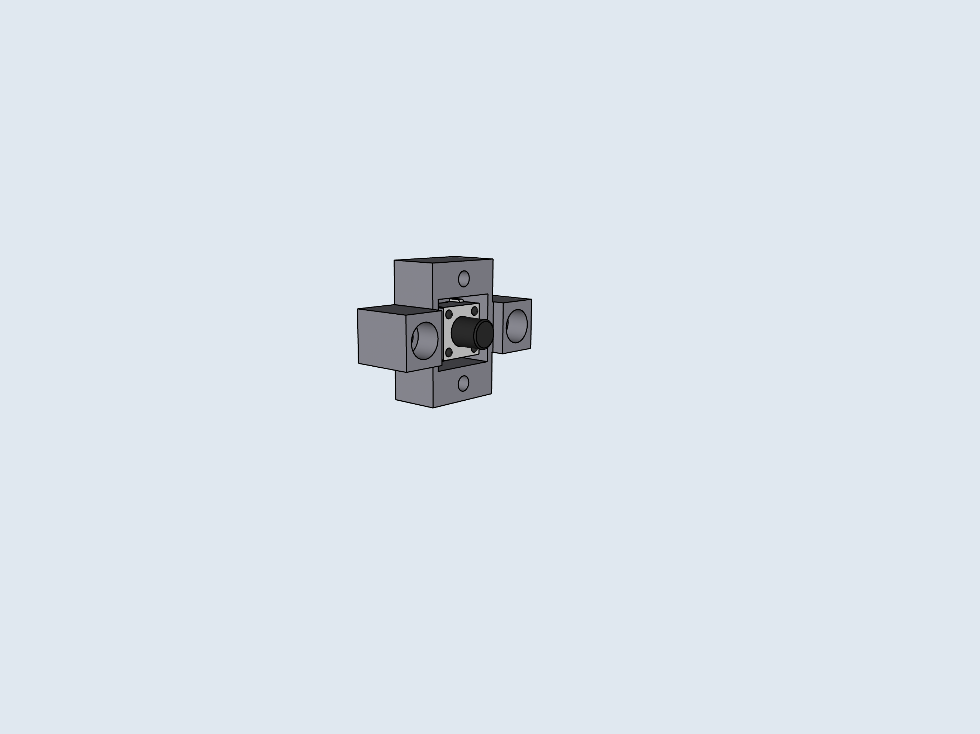
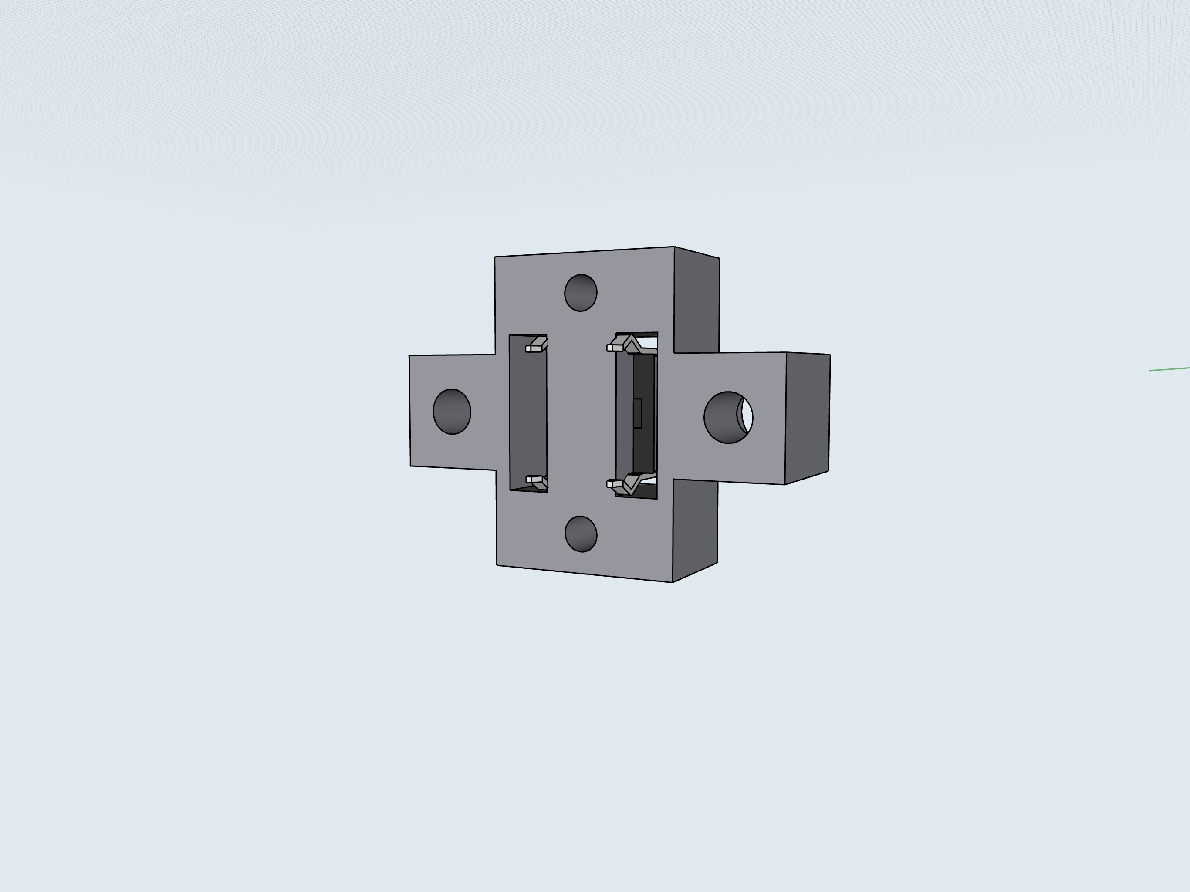
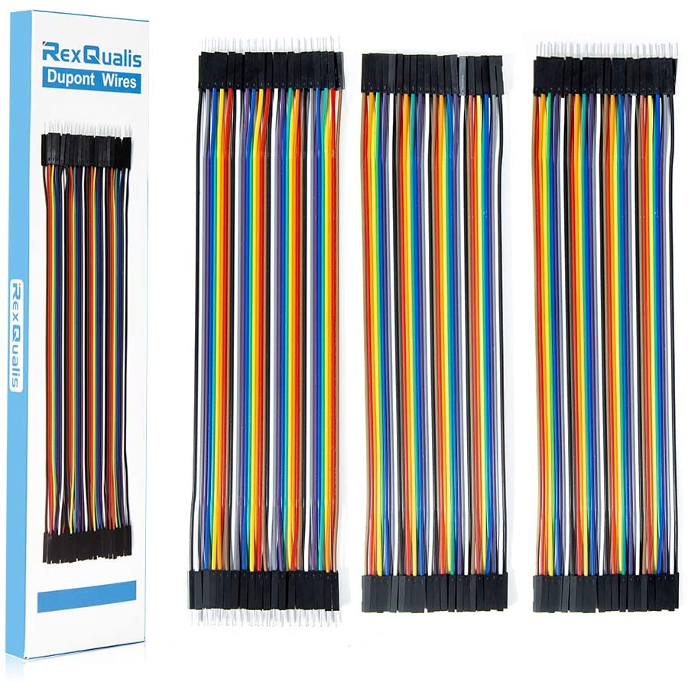

2
4
5
A: Preliminary
Wiring
1
3
Cut one of the ends from the Dupont connectors, then strip the ends to expose the bare wire. Use these stripped wires for steps 1-3. Be sure to match the wire colors in the diagram. This will allow you to easily follow the instructions for connecting the cables into the PCB.

Slide 2
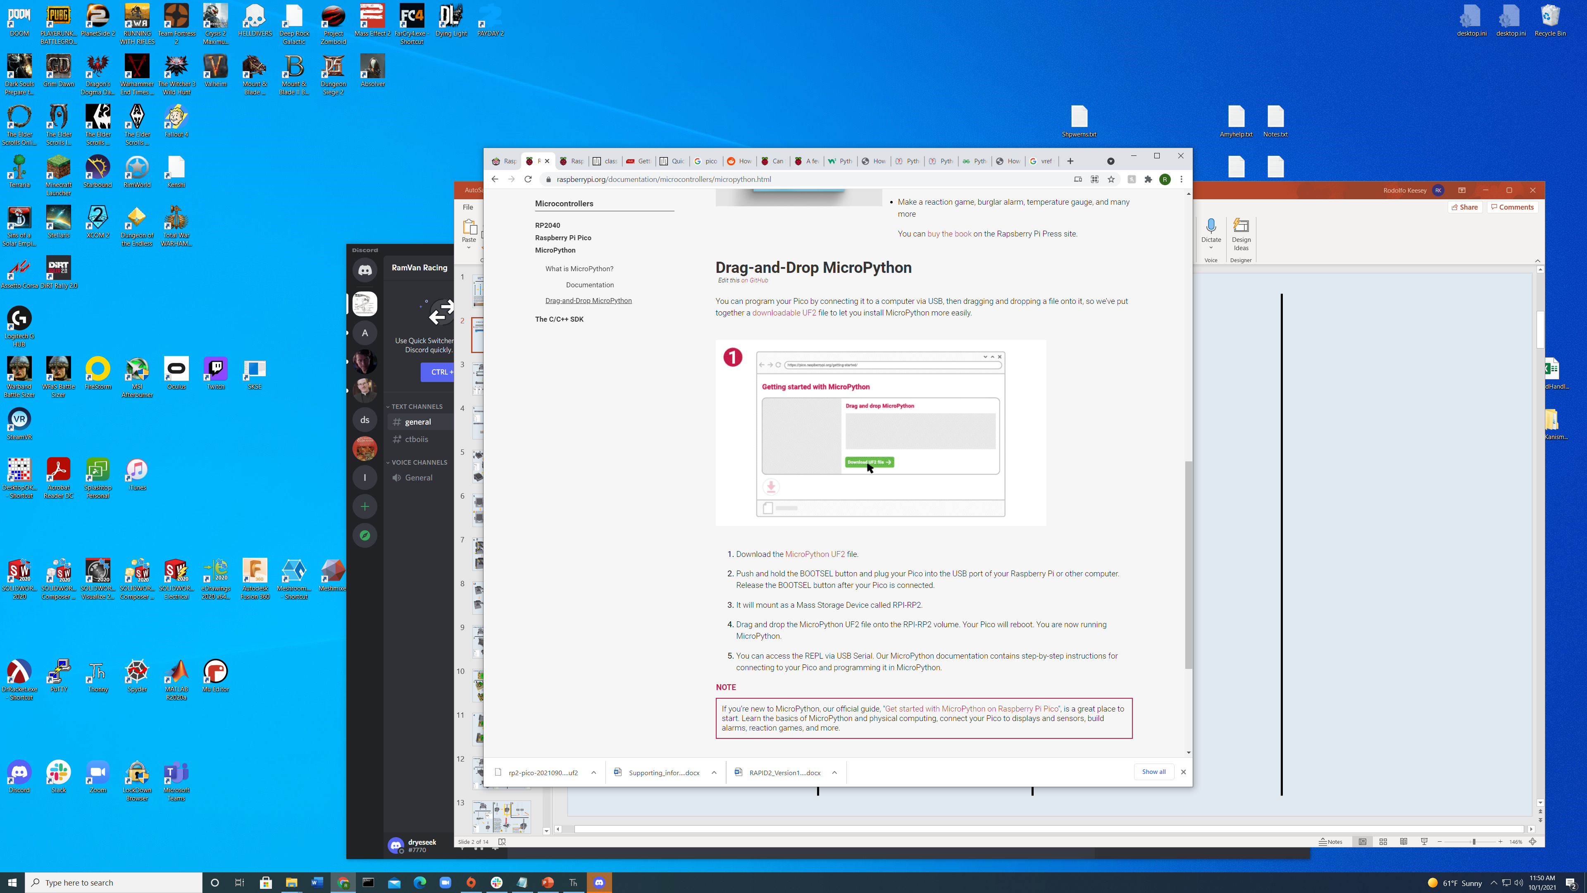
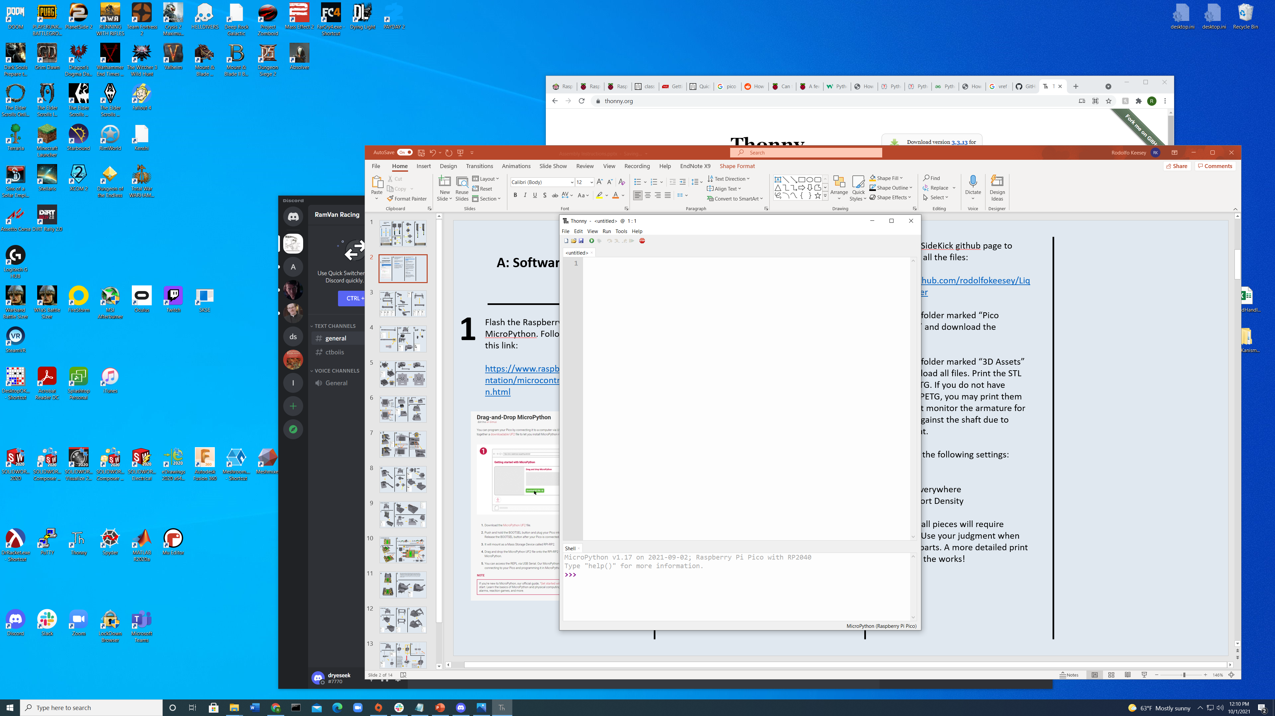
2
After flashing MicroPython onto the Pico, we need to upload the SideKick’s code to the microcontroller.
Download the Thonny IDE. This will be used to load the provided code onto the Pico.
https://thonny.org/
Once downloaded, install and follow the prompts for set up with MicroPython and the Raspberry Pi Pico. Once finished, your Thonny should look like this:
Go to the SideKick github page to download all the files:
https://github.com/rodolfokeesey/Liquid-Handler
Go to the folder marked “Pico Snapshot” and download the contents.
Now return to Thonny. Navigate to View -> Files. A window should appear labeled Files.
The top of this window allows
Go to the folder marked “3D Assets” and download all files. Print the STL files in PETG. If you do not have access to PETG, you may print them in PLA, but monitor the armature for slippage against the shaft due to motor heat.
Print with the following settings:
15% Infill
Support Everywhere
15% Support Density
Note, not all pieces will require supports. For now, use your judgment when orienting parts to mitigate their use. A more detailed print guide is in the works!
A: Software Set Up
1
Flash the Raspberry Pi Pico with MicroPython. Follow the directions in this link:
https://www.raspberrypi.org/documentation/microcontrollers/micropython.html

Slide 3
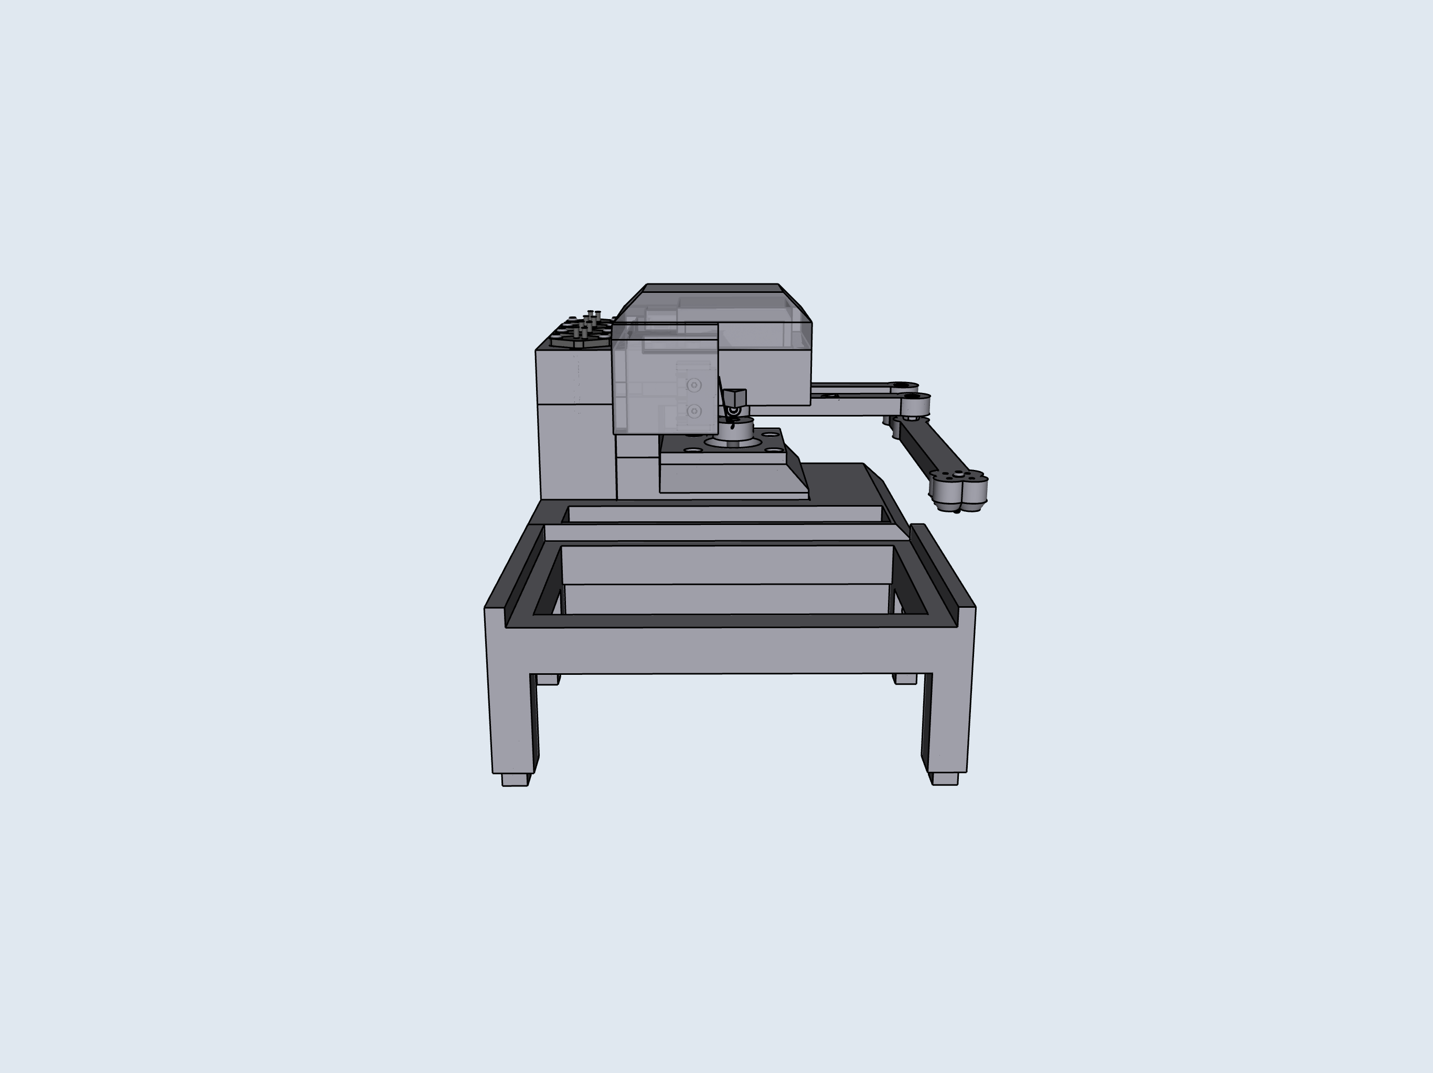
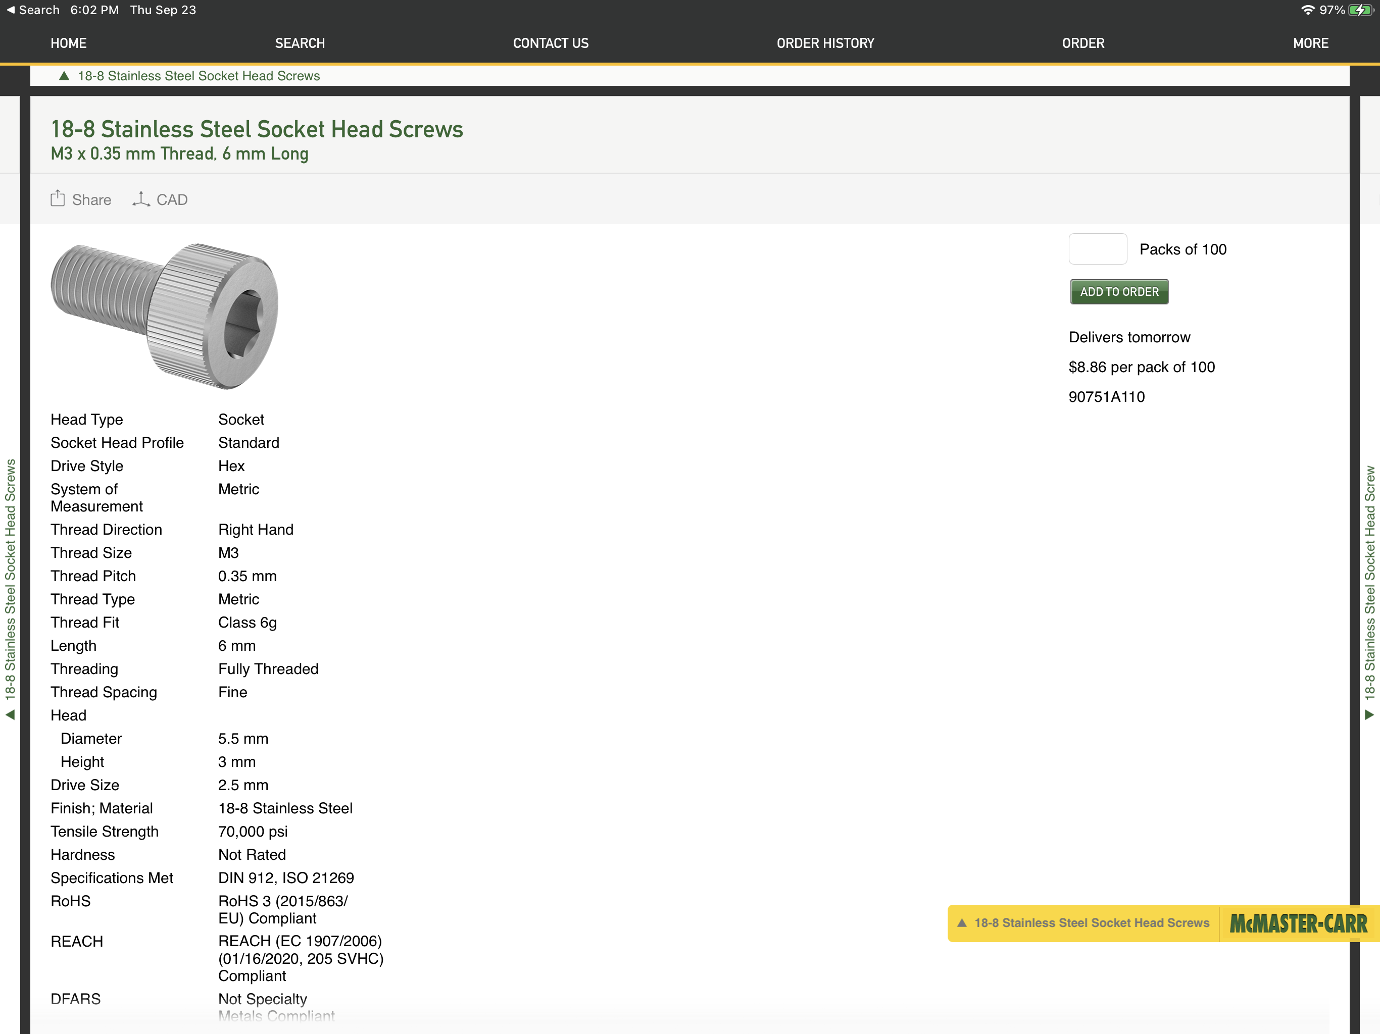
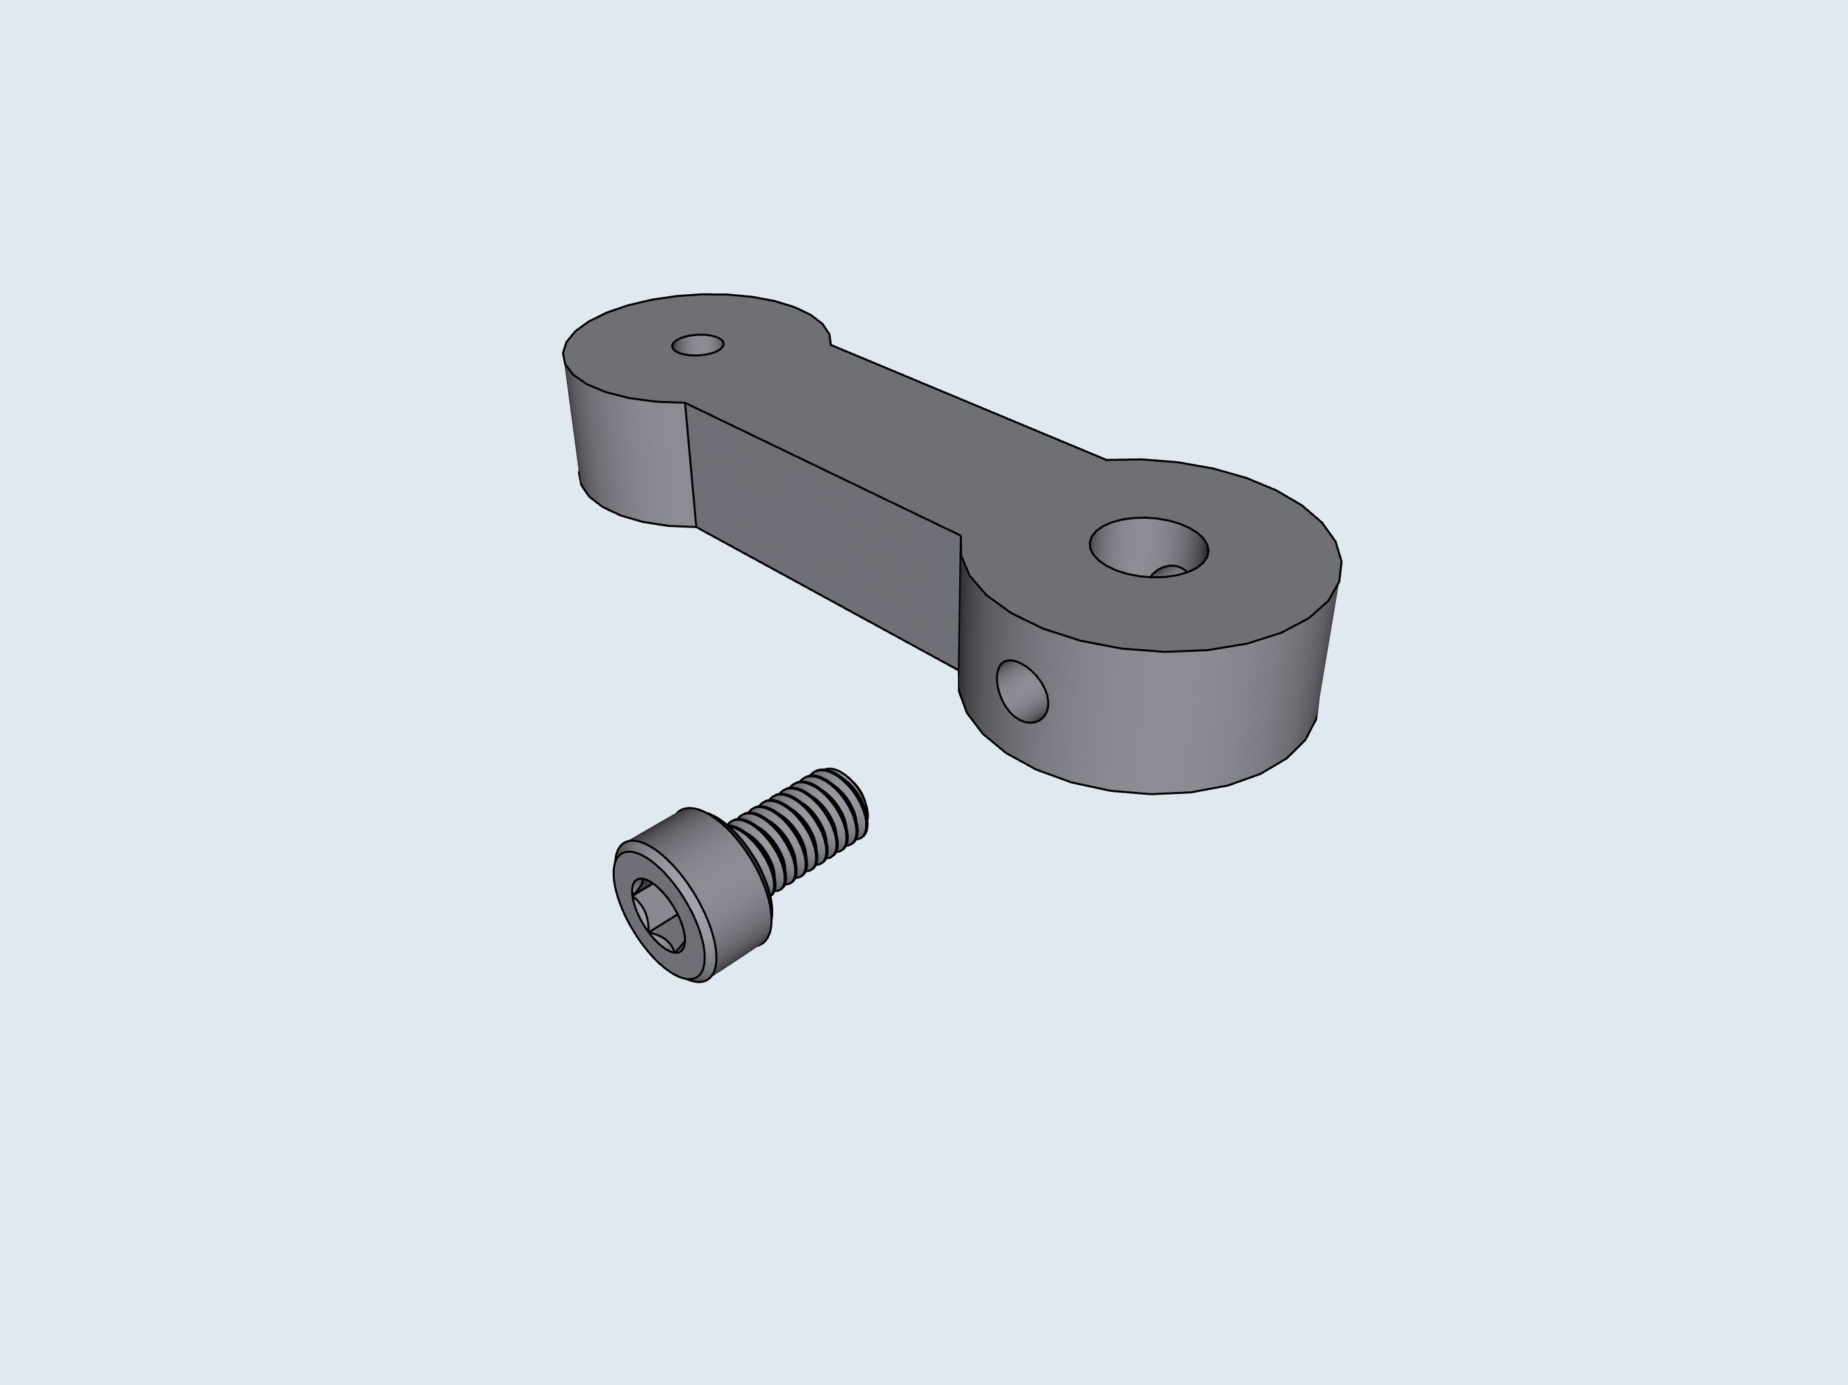
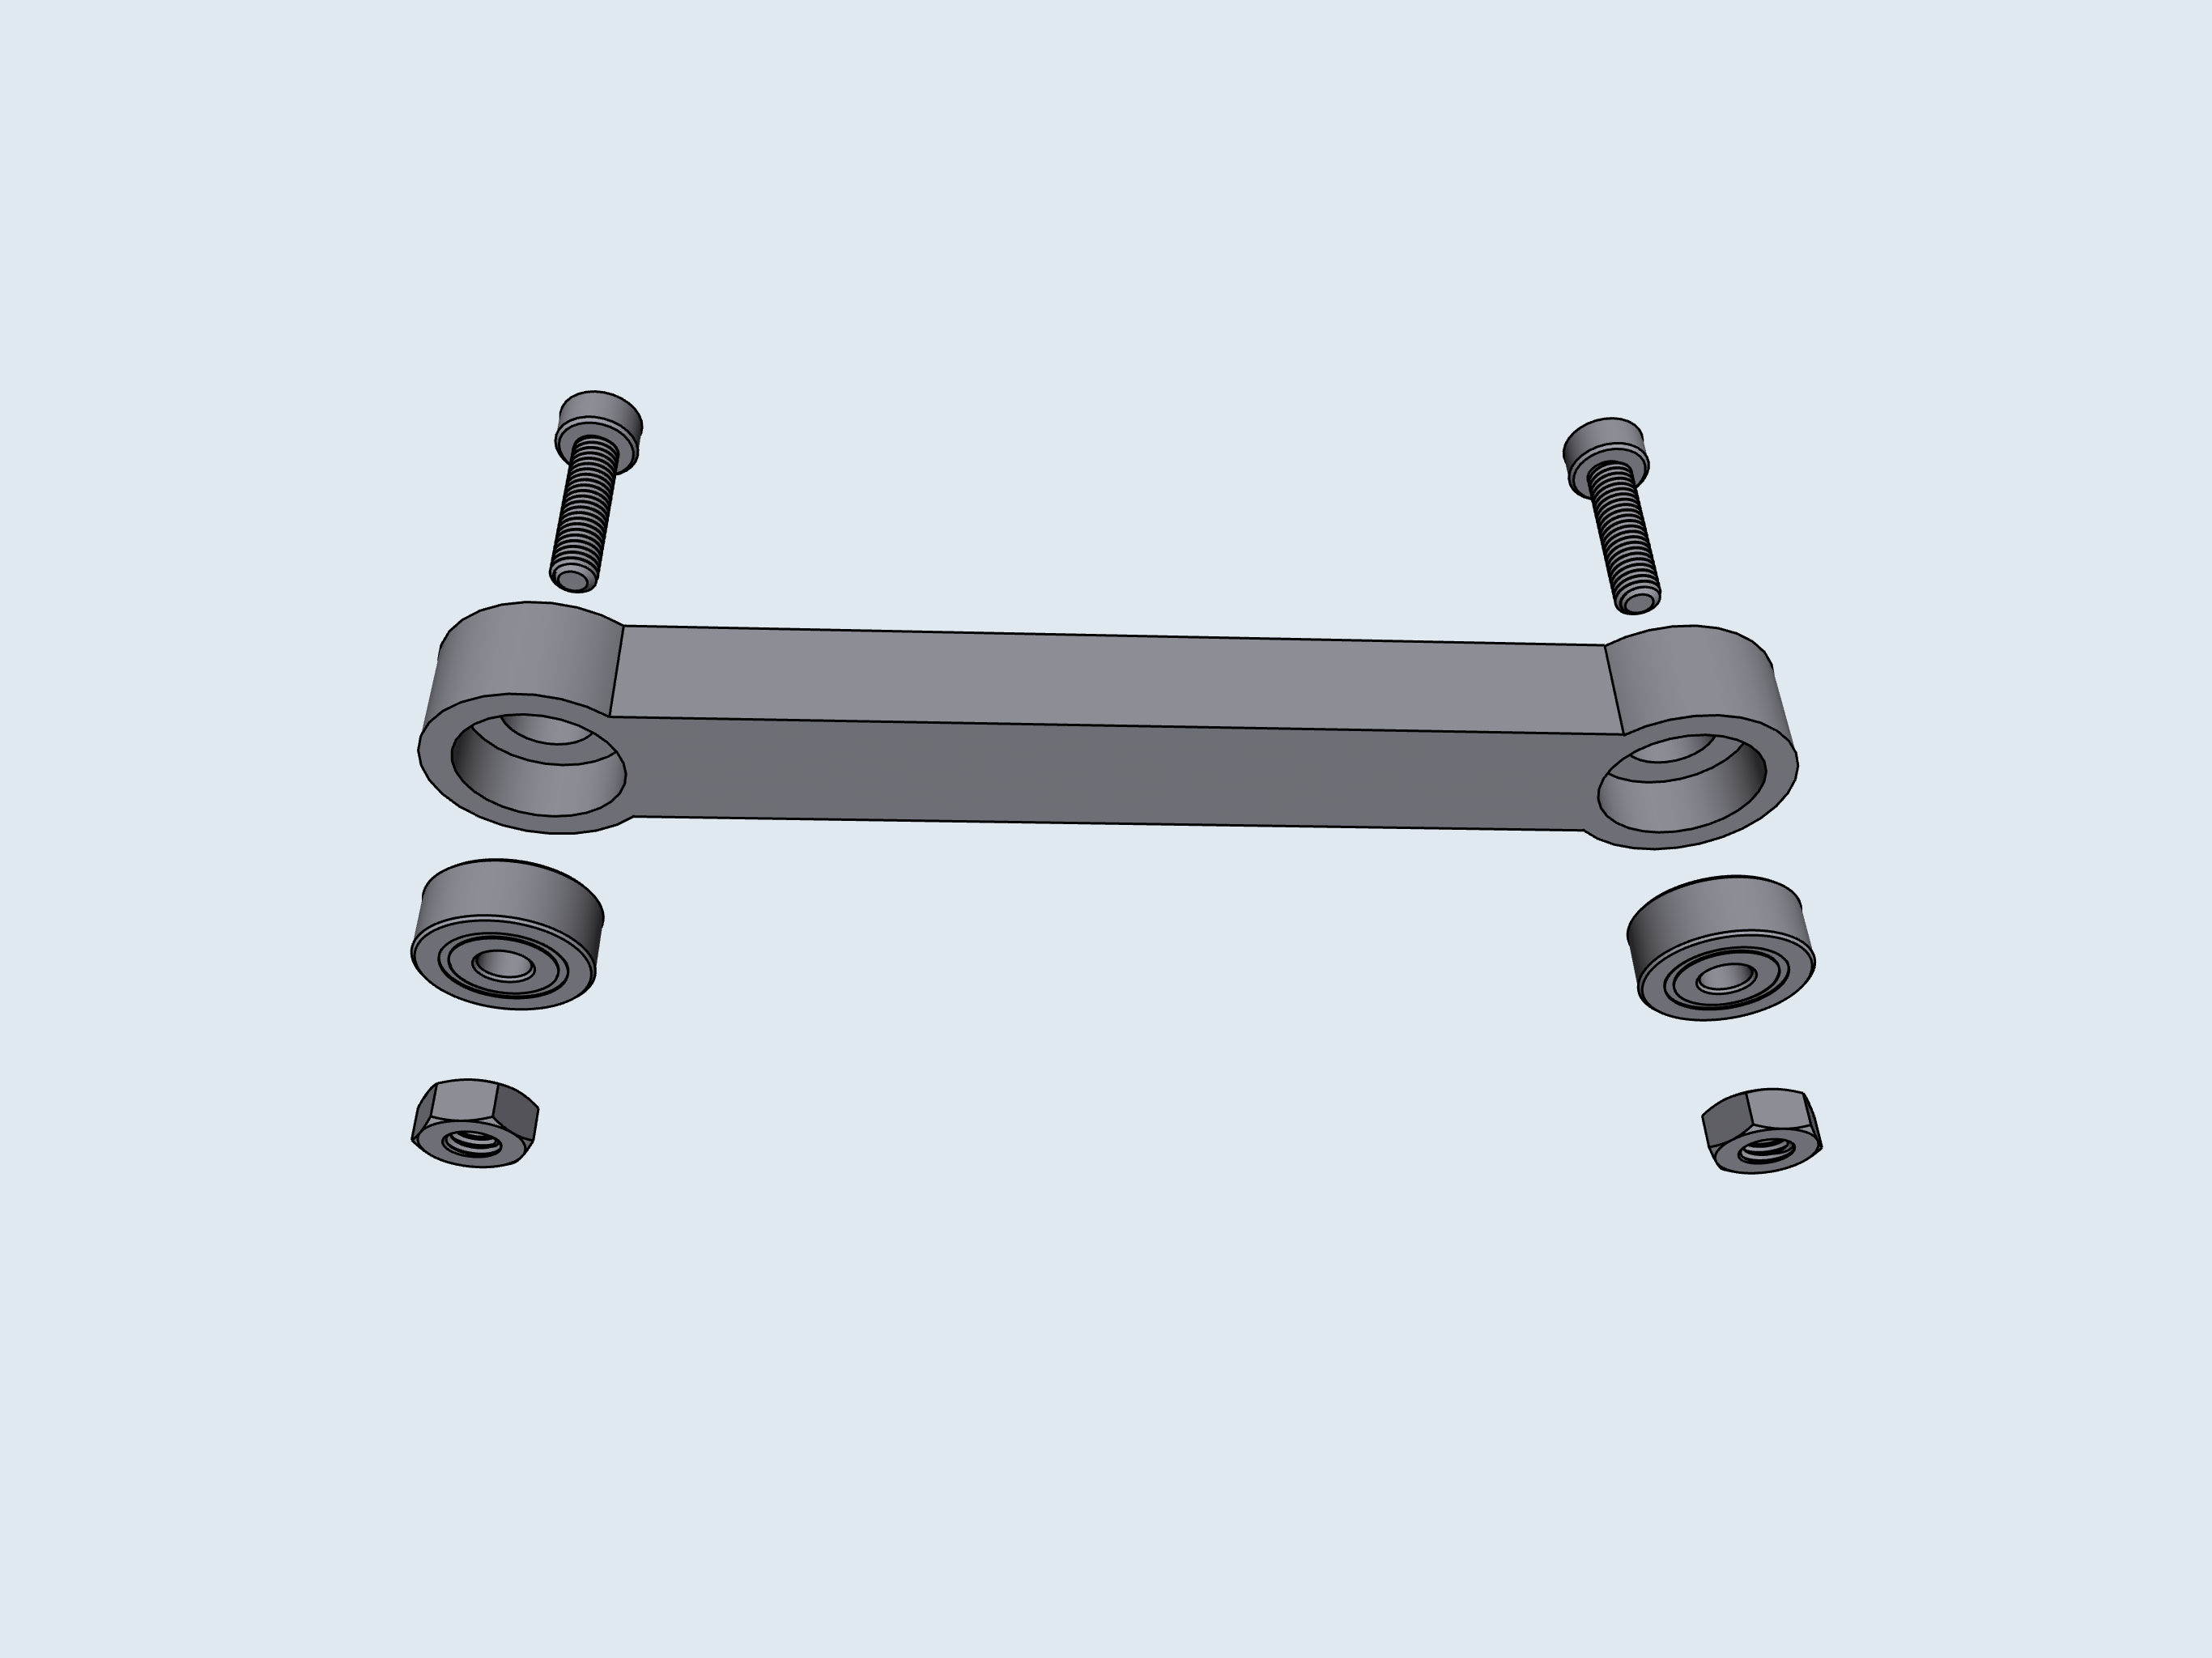
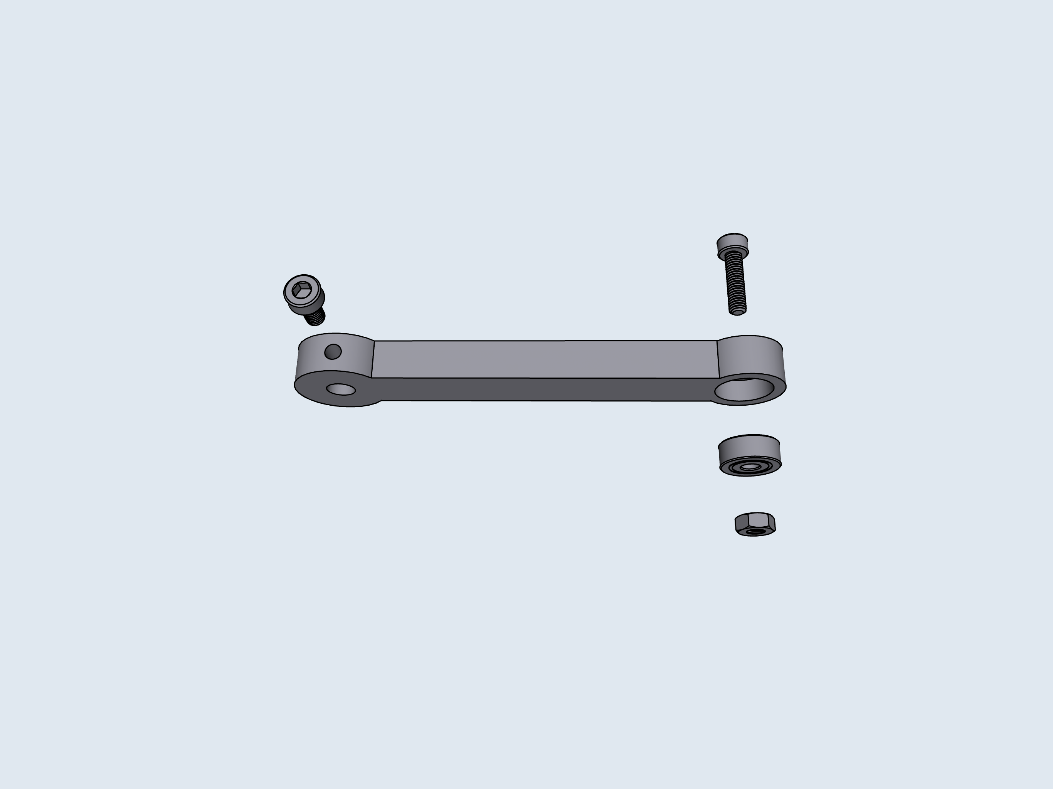
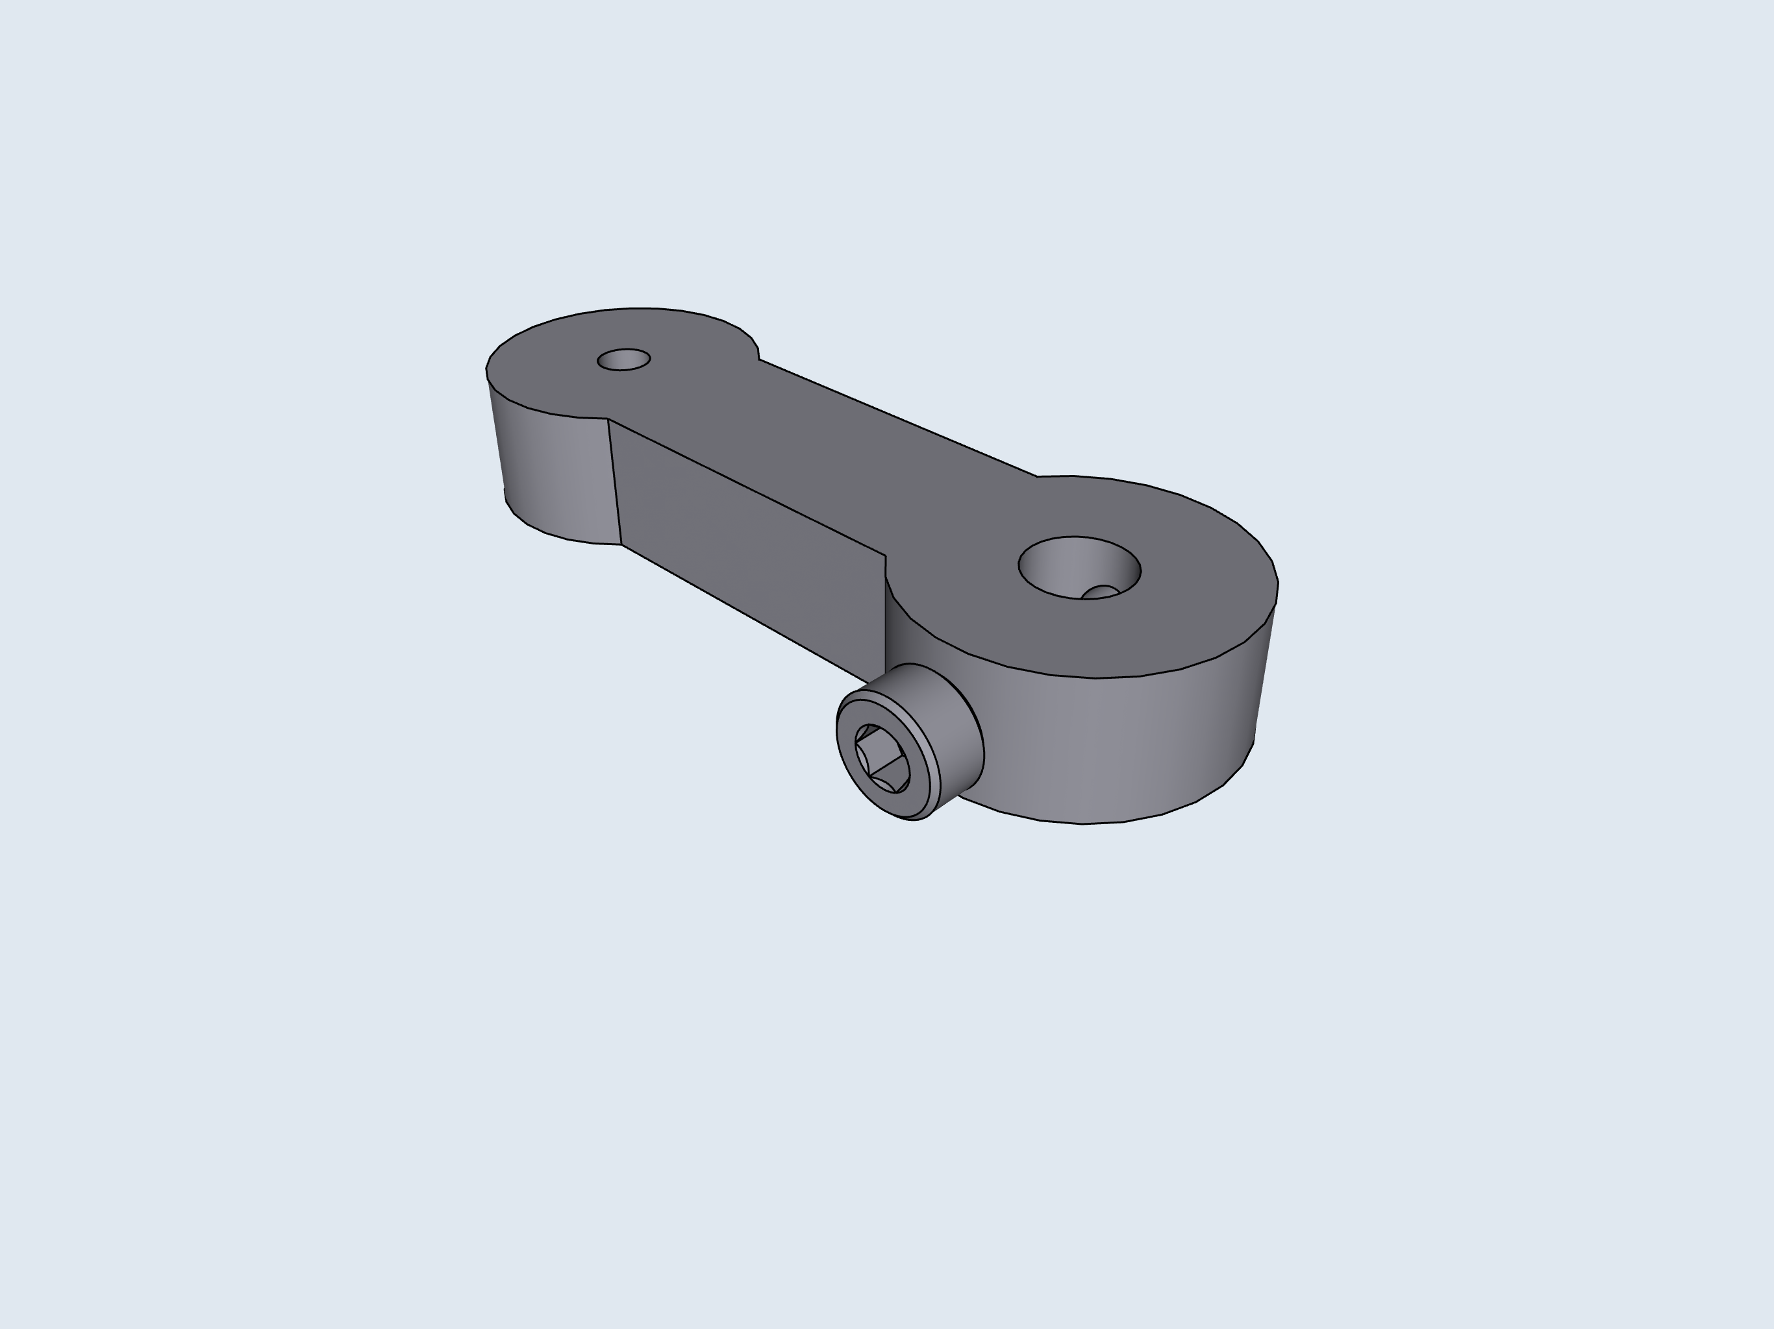
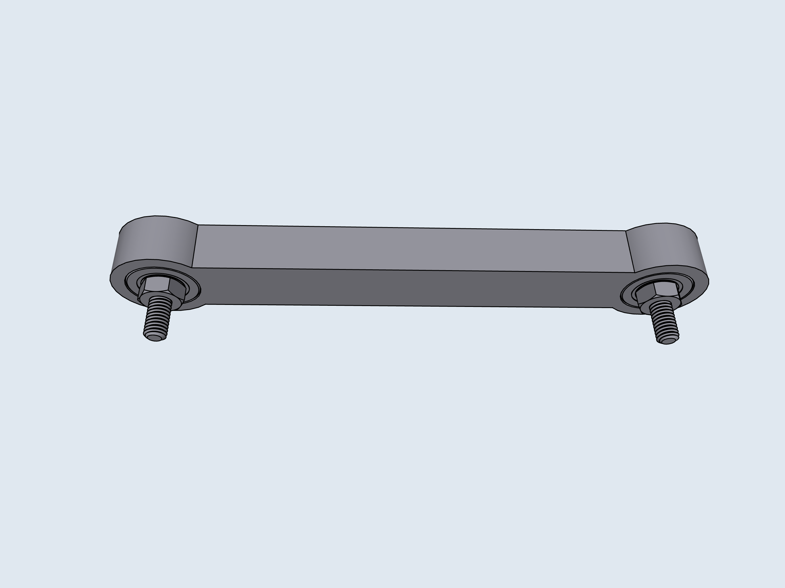
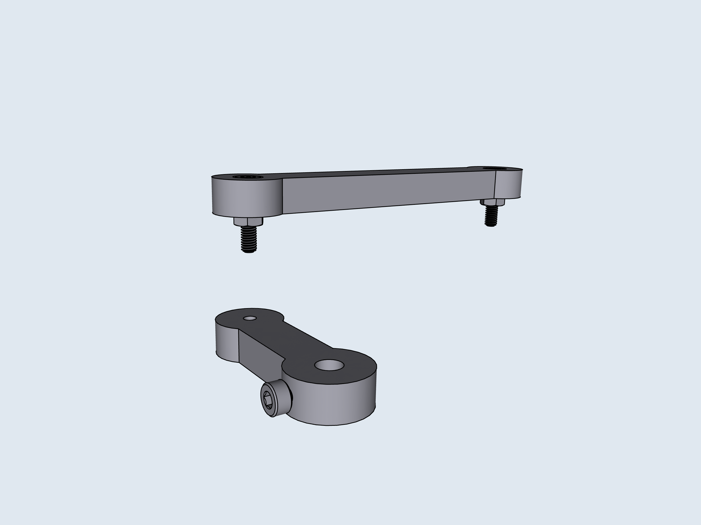
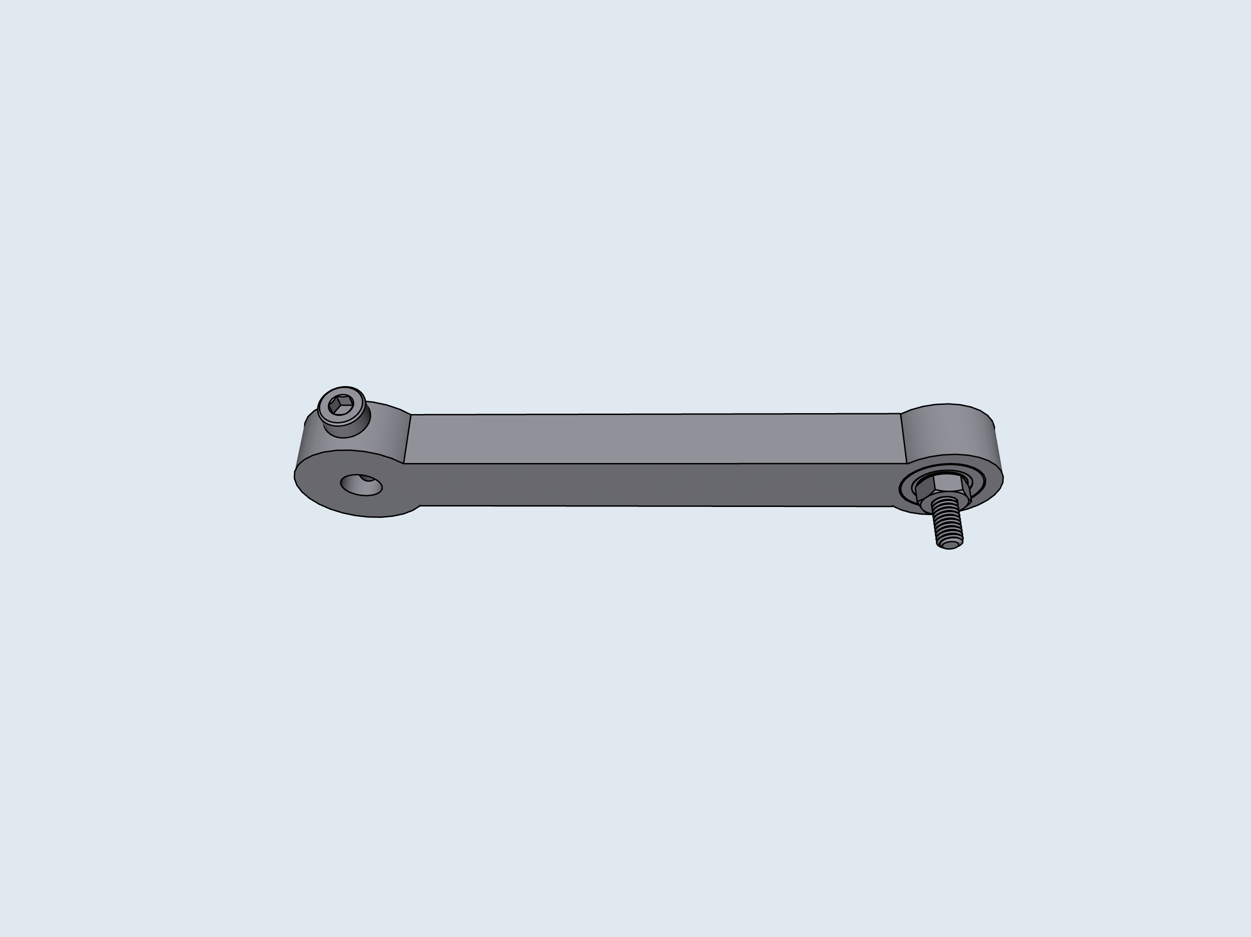
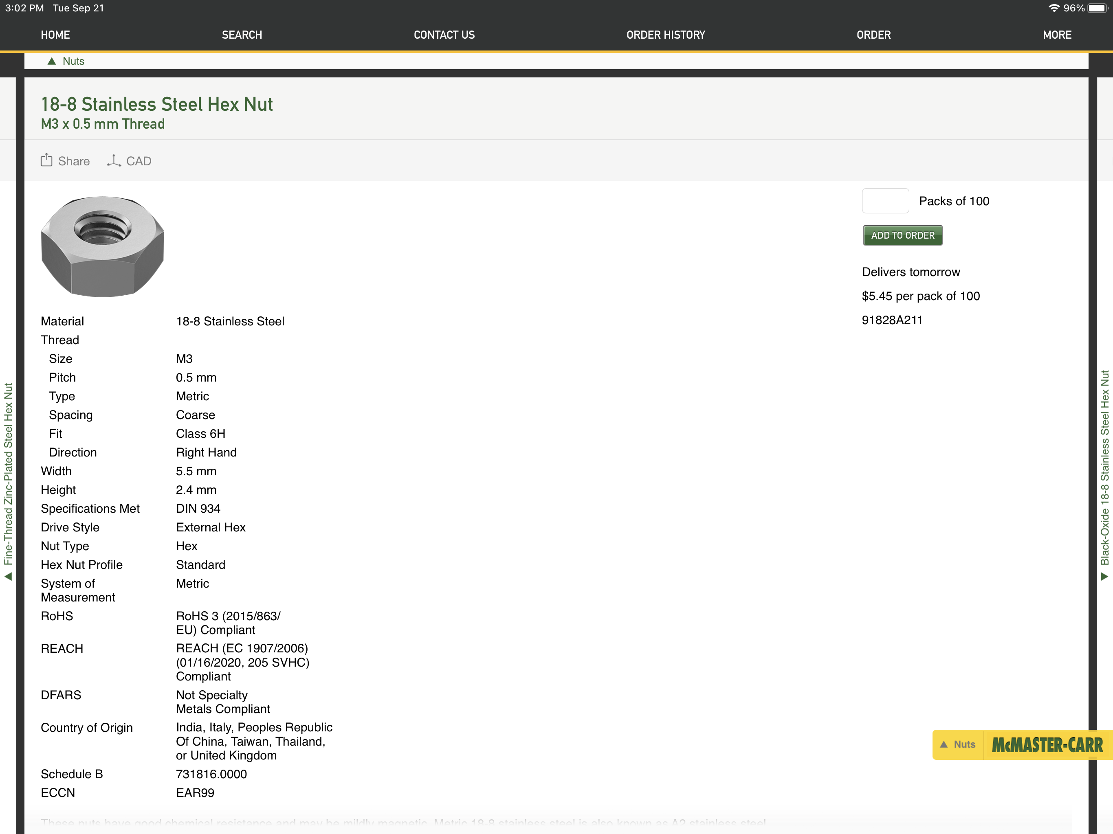
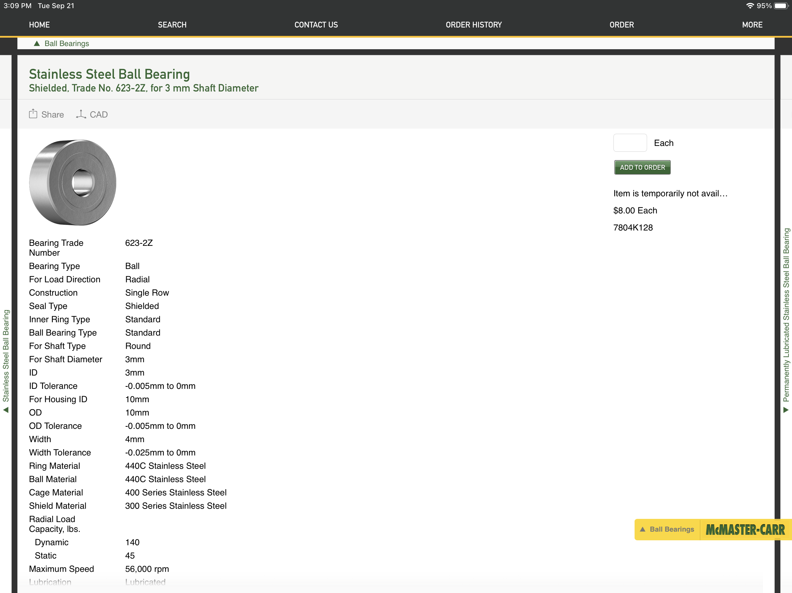
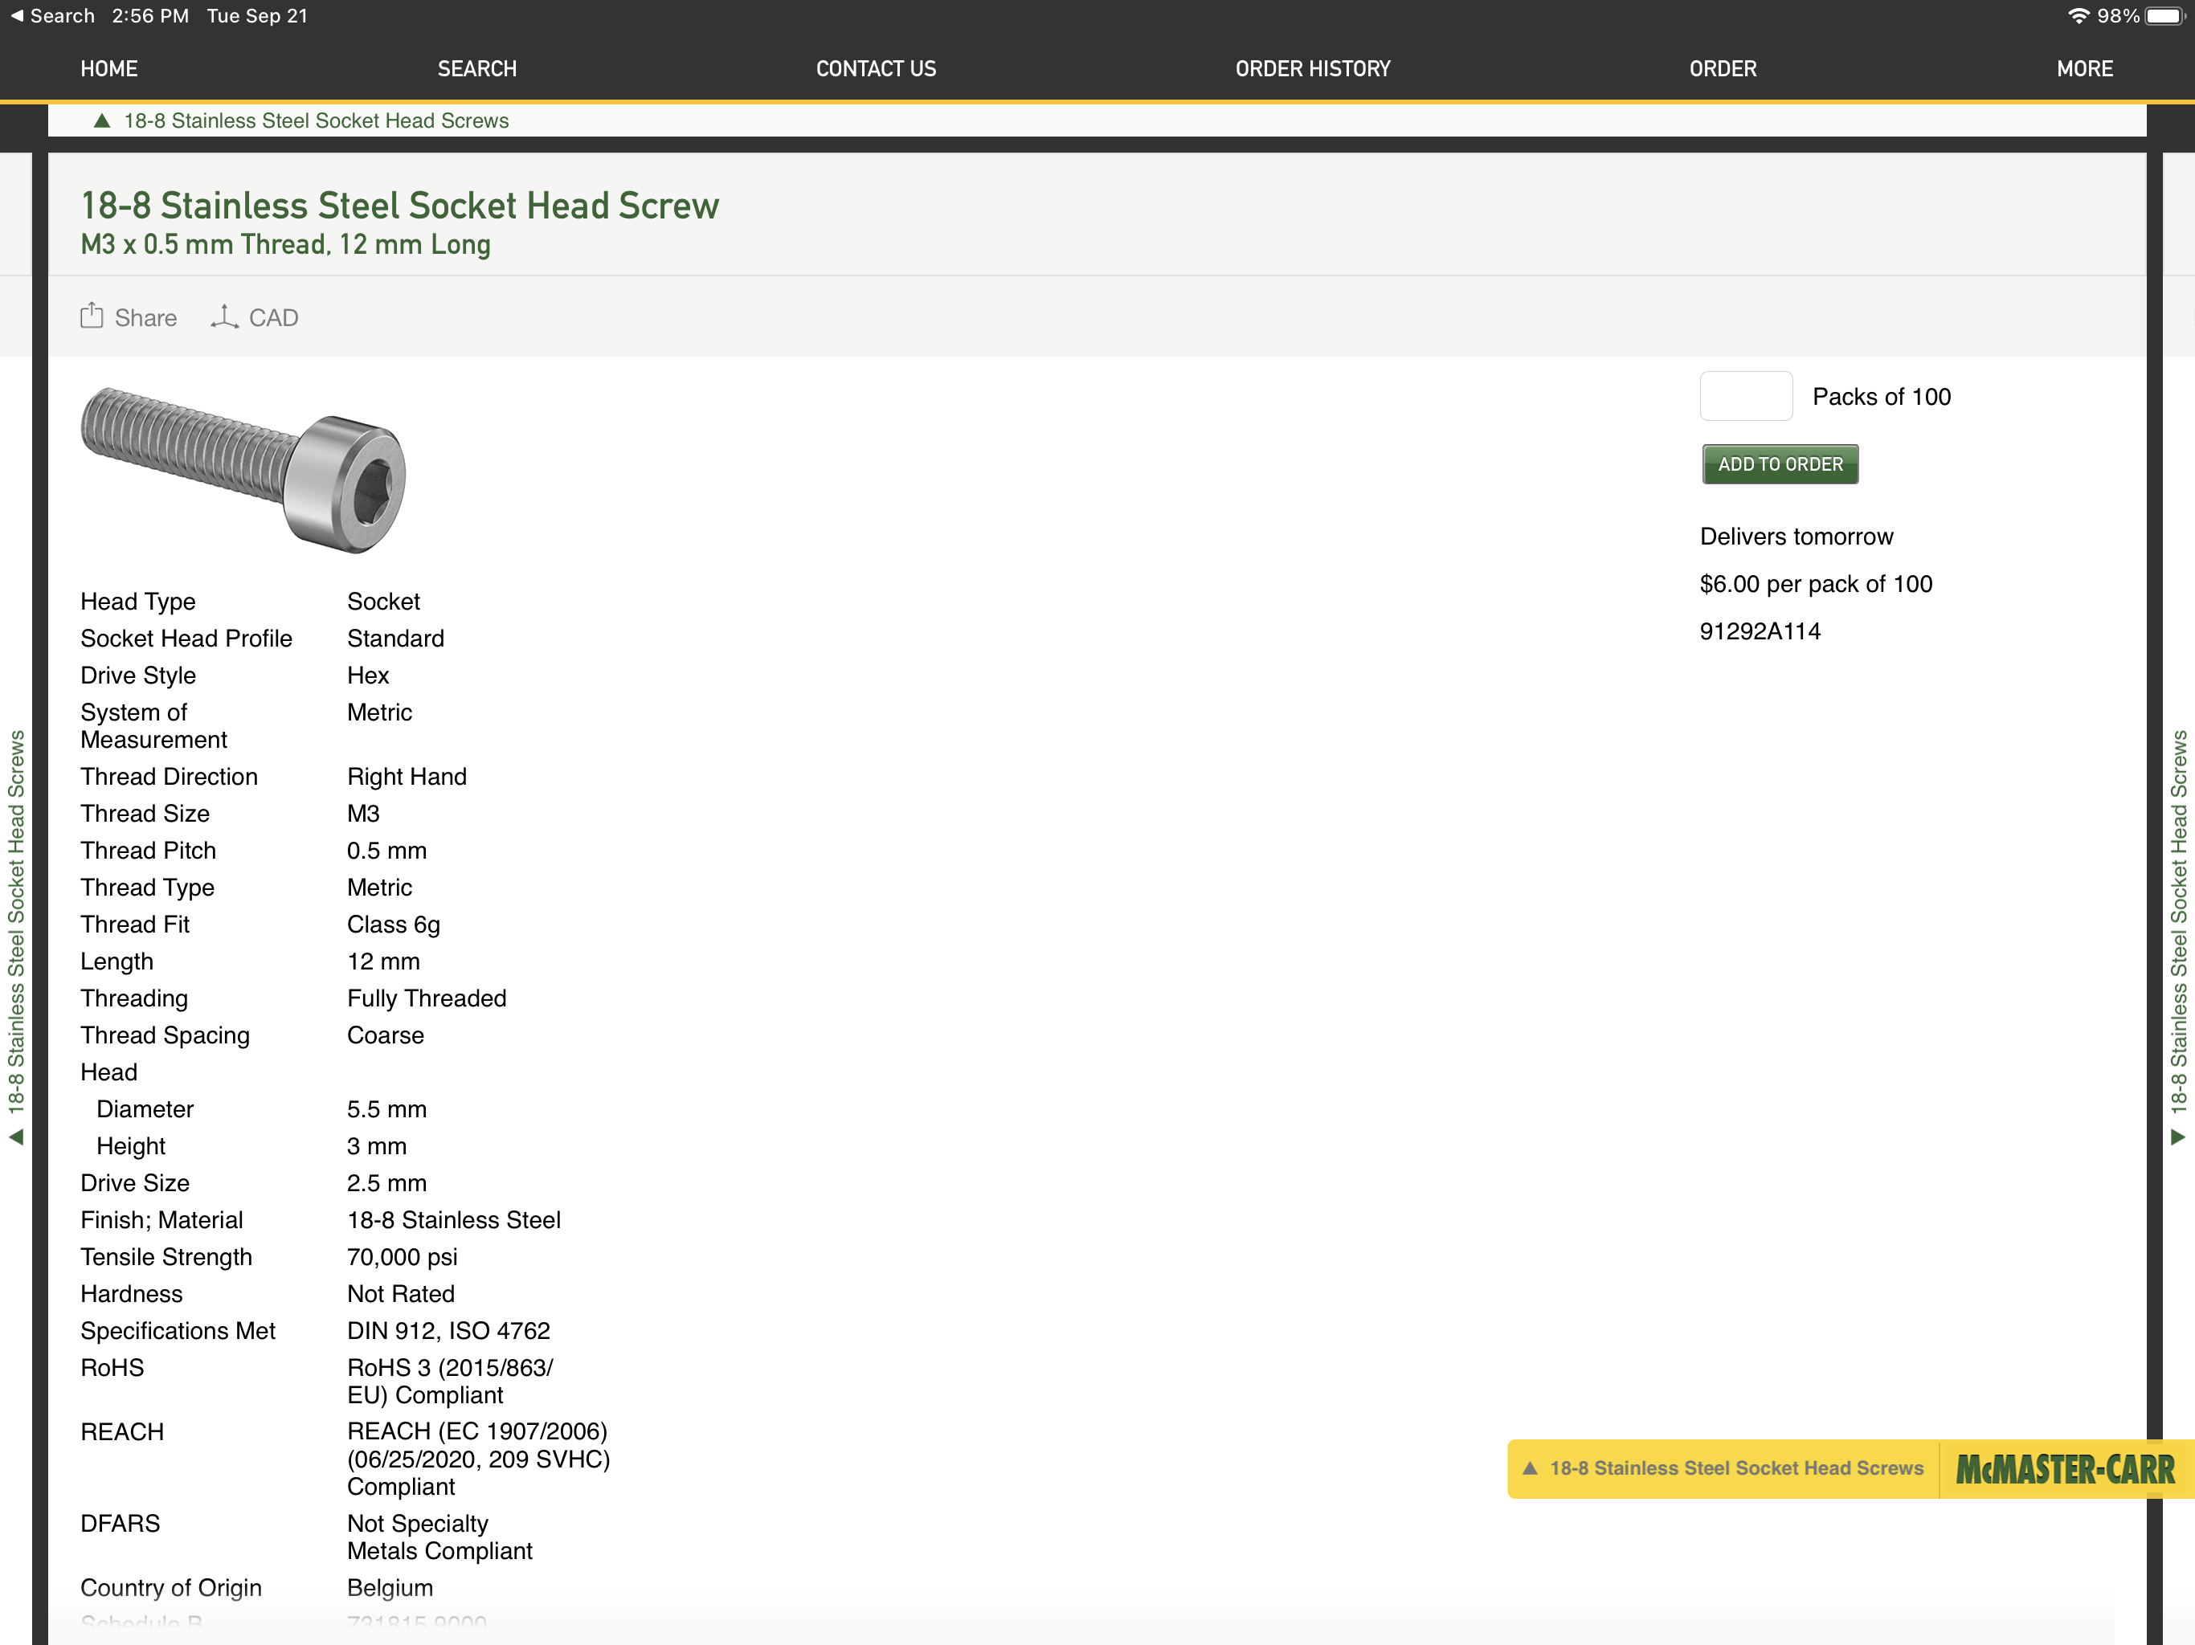
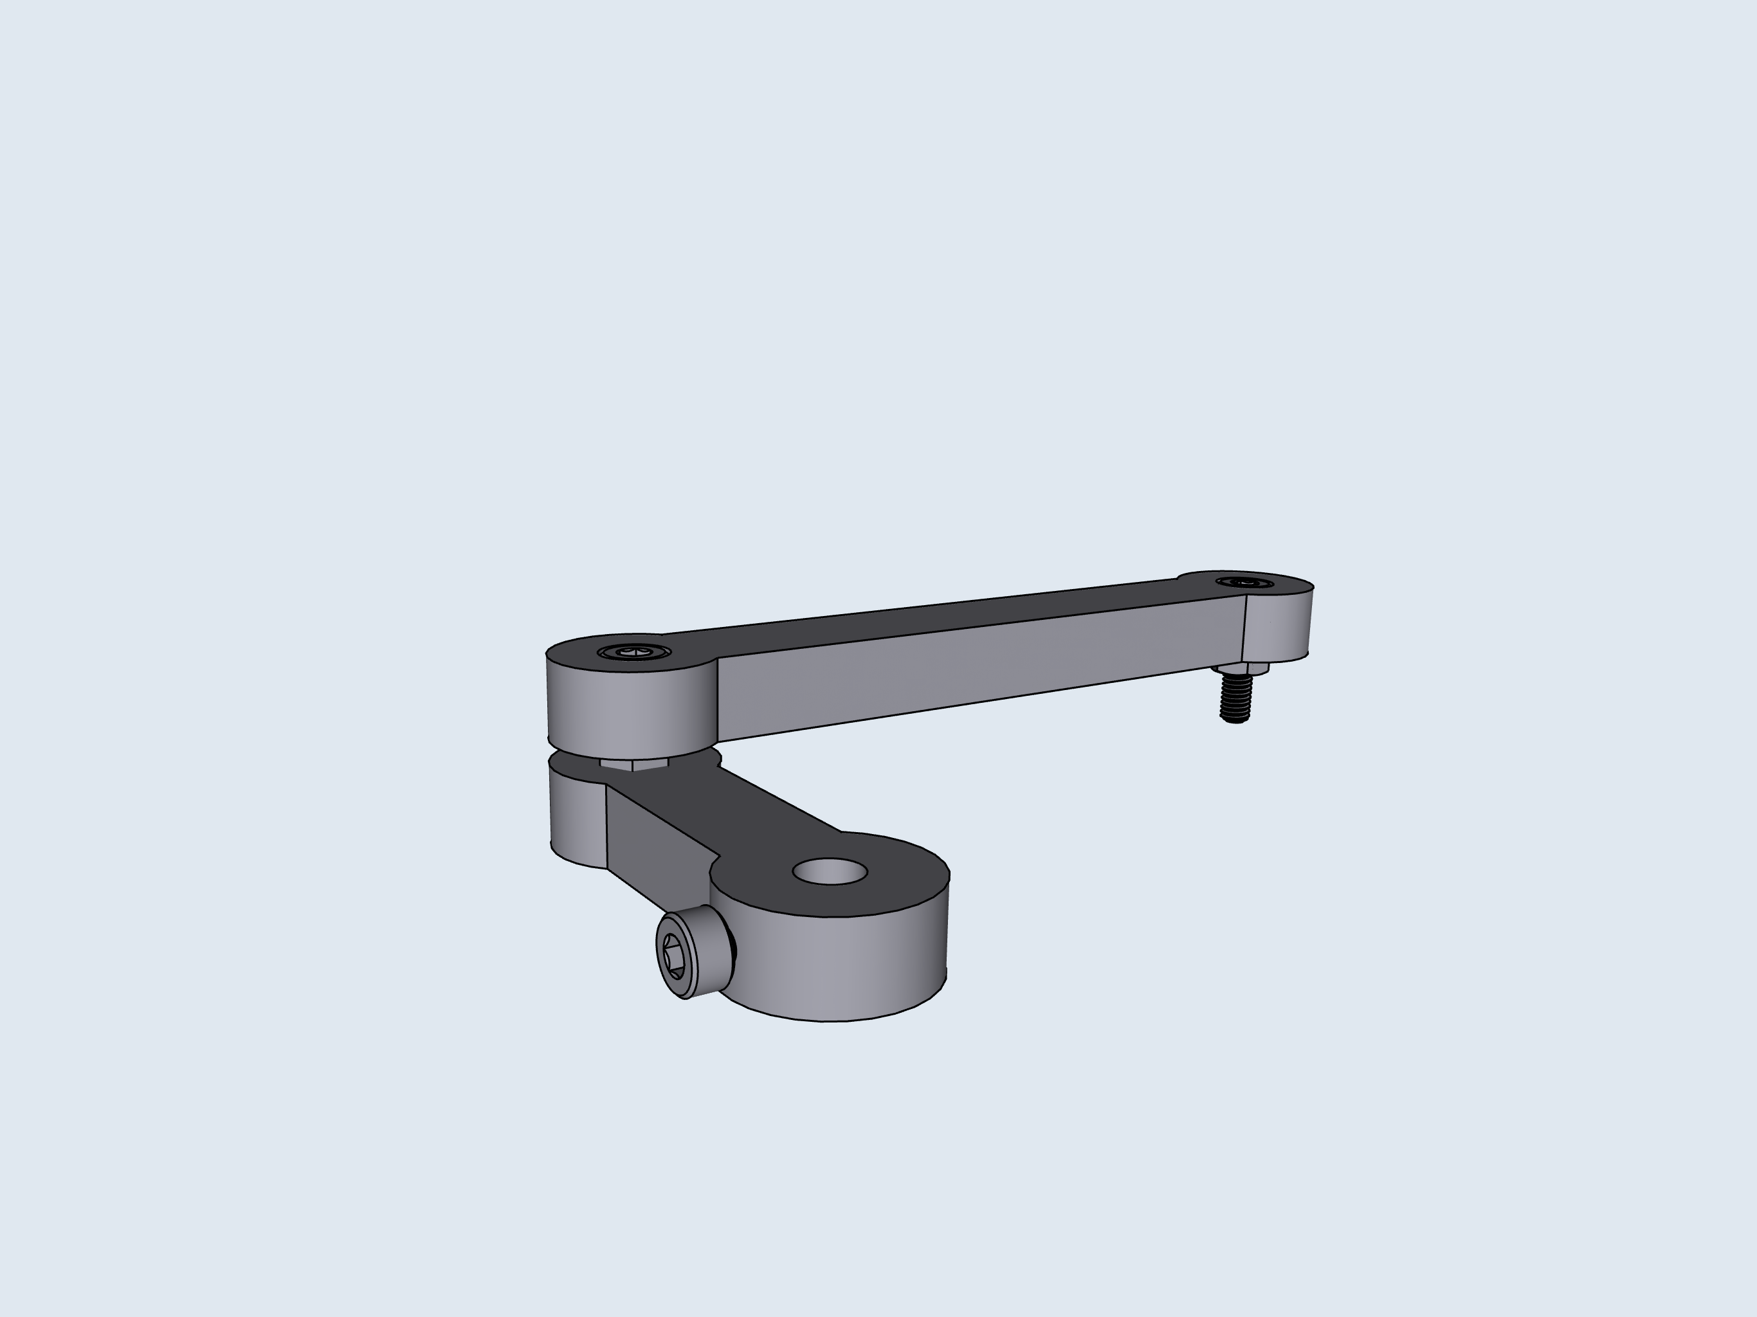
2
3
B: Armature
A
A
B
B
1
A
B
C
C
C
D
4
A
B
C
D
A
B
C

Slide 4
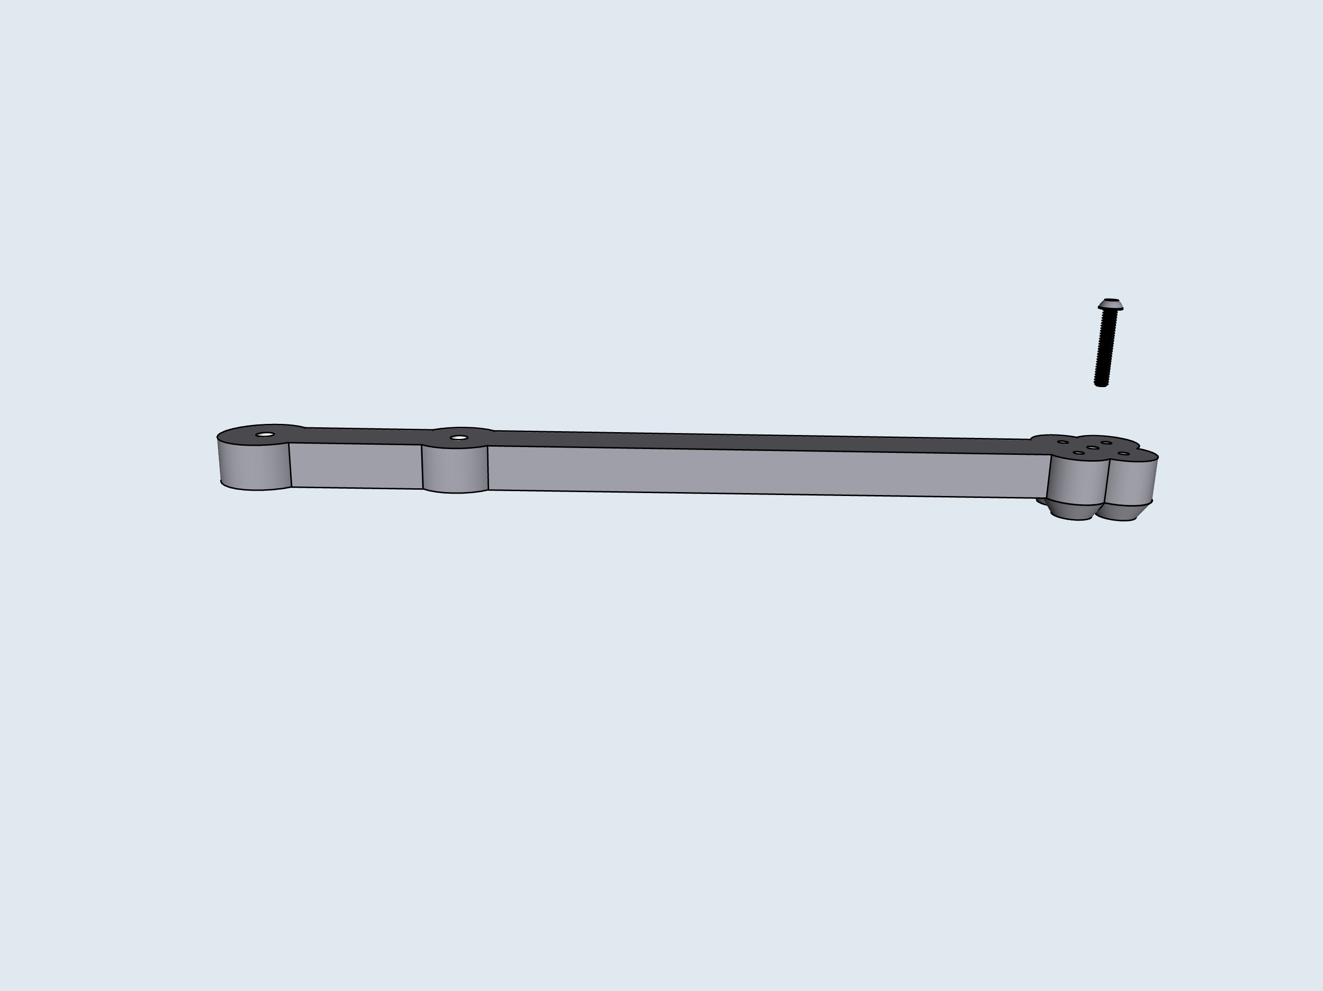
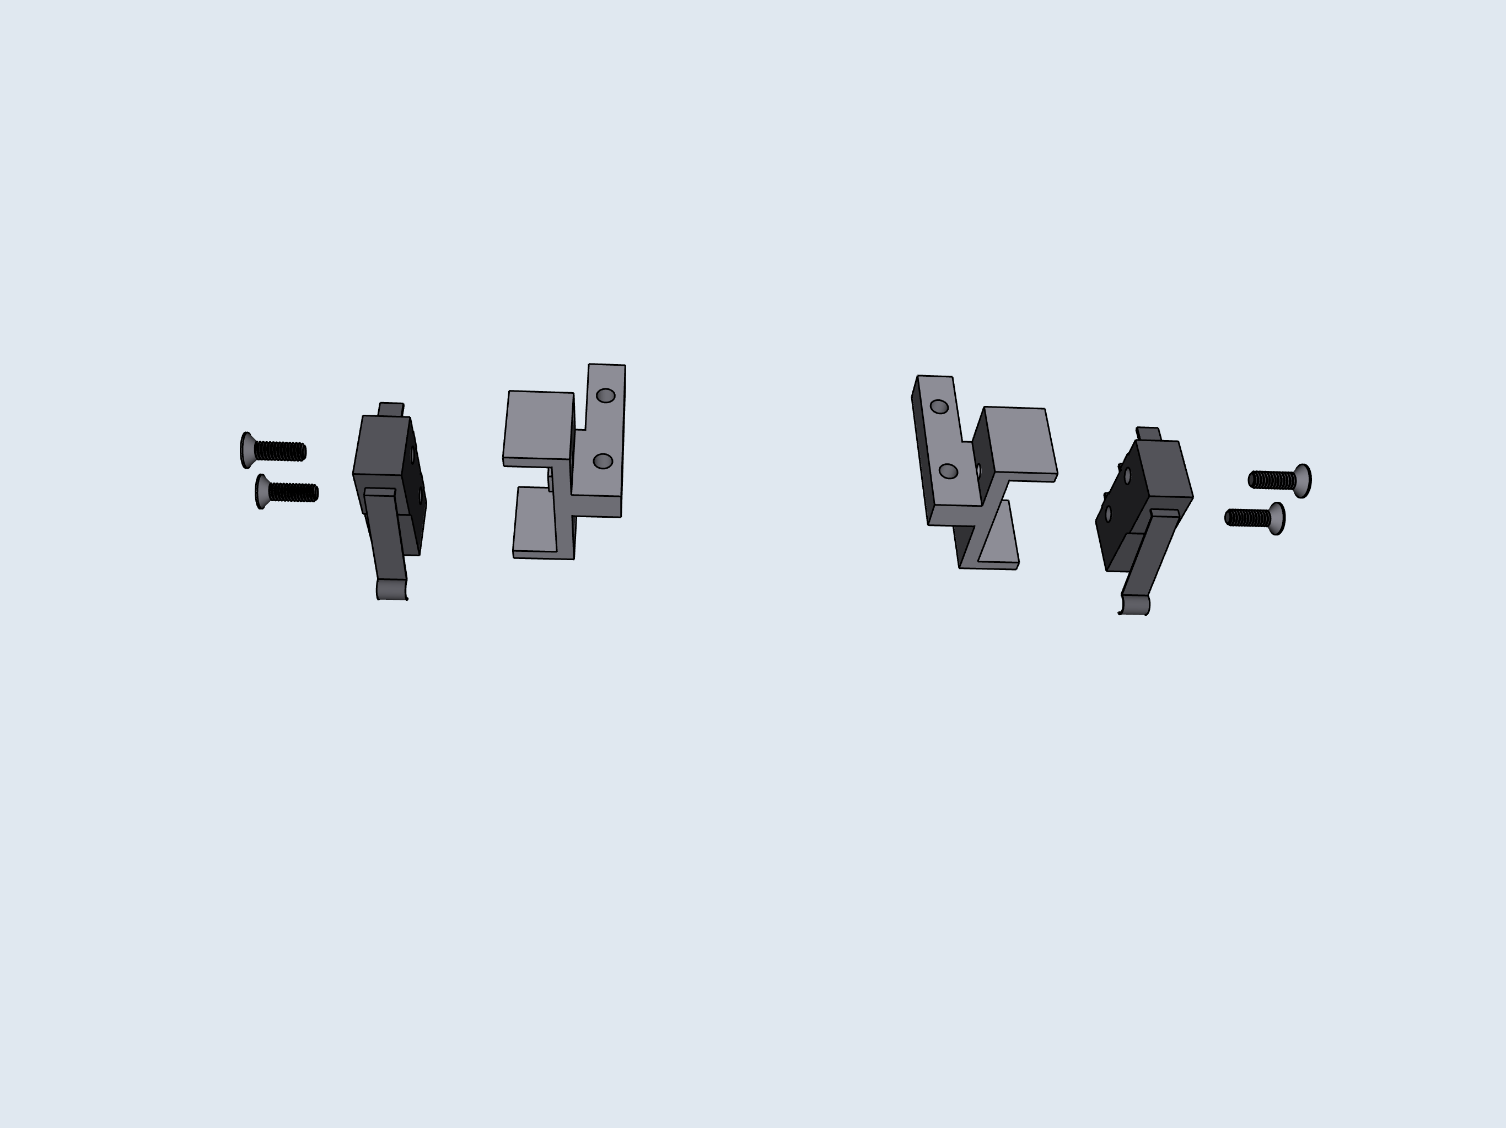
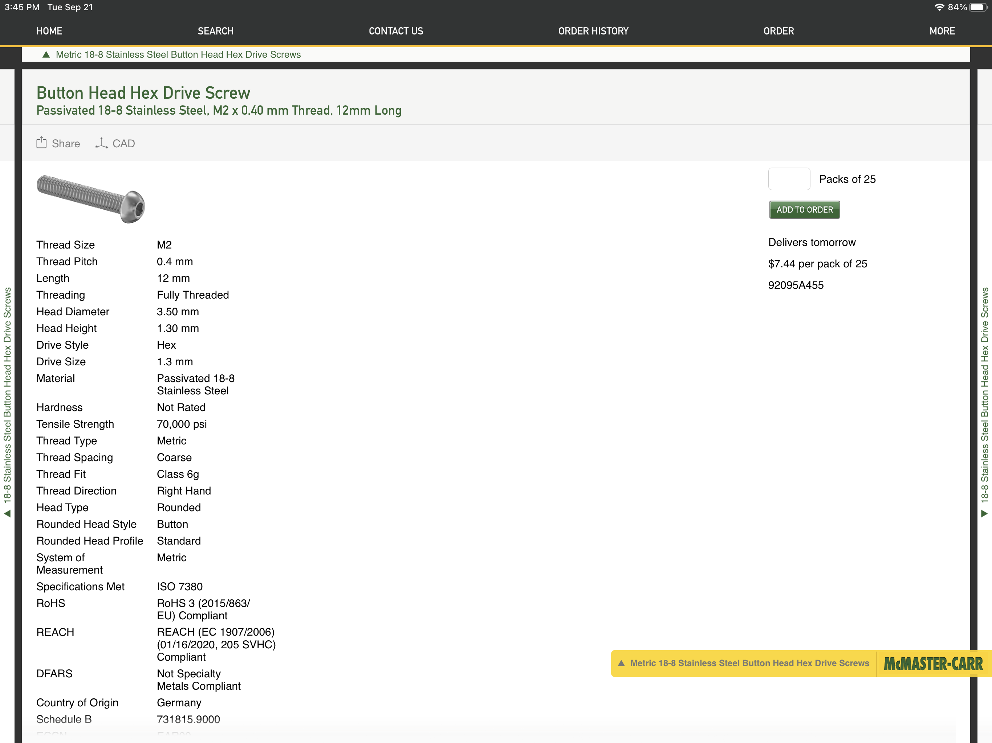
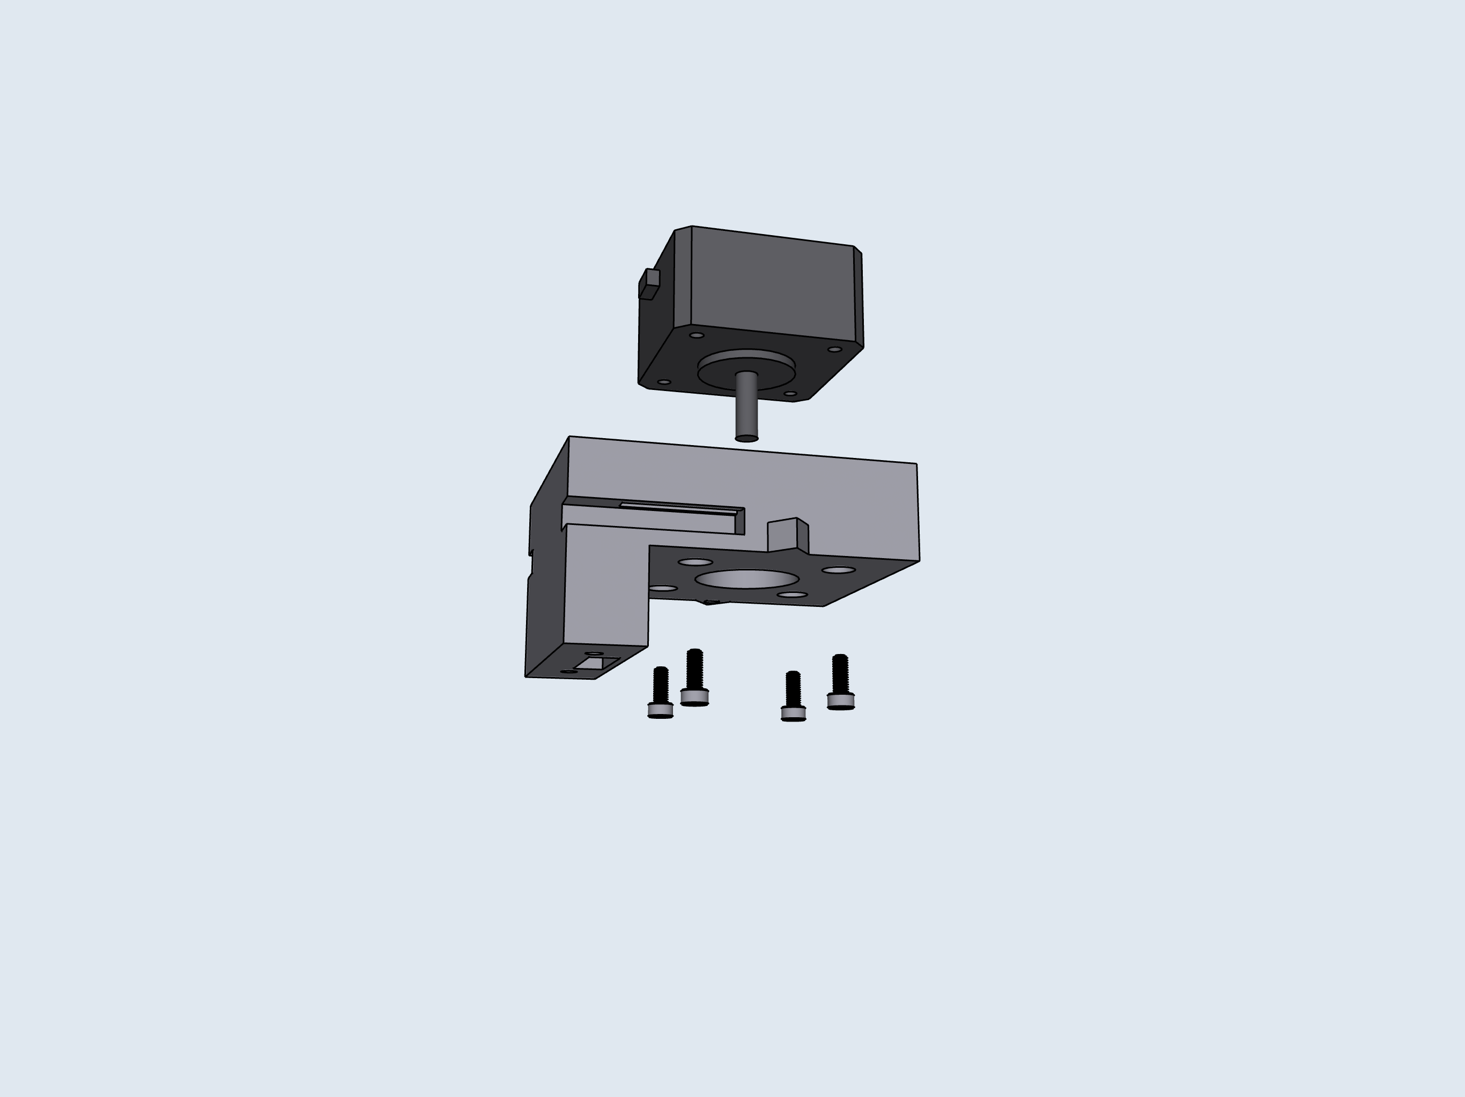
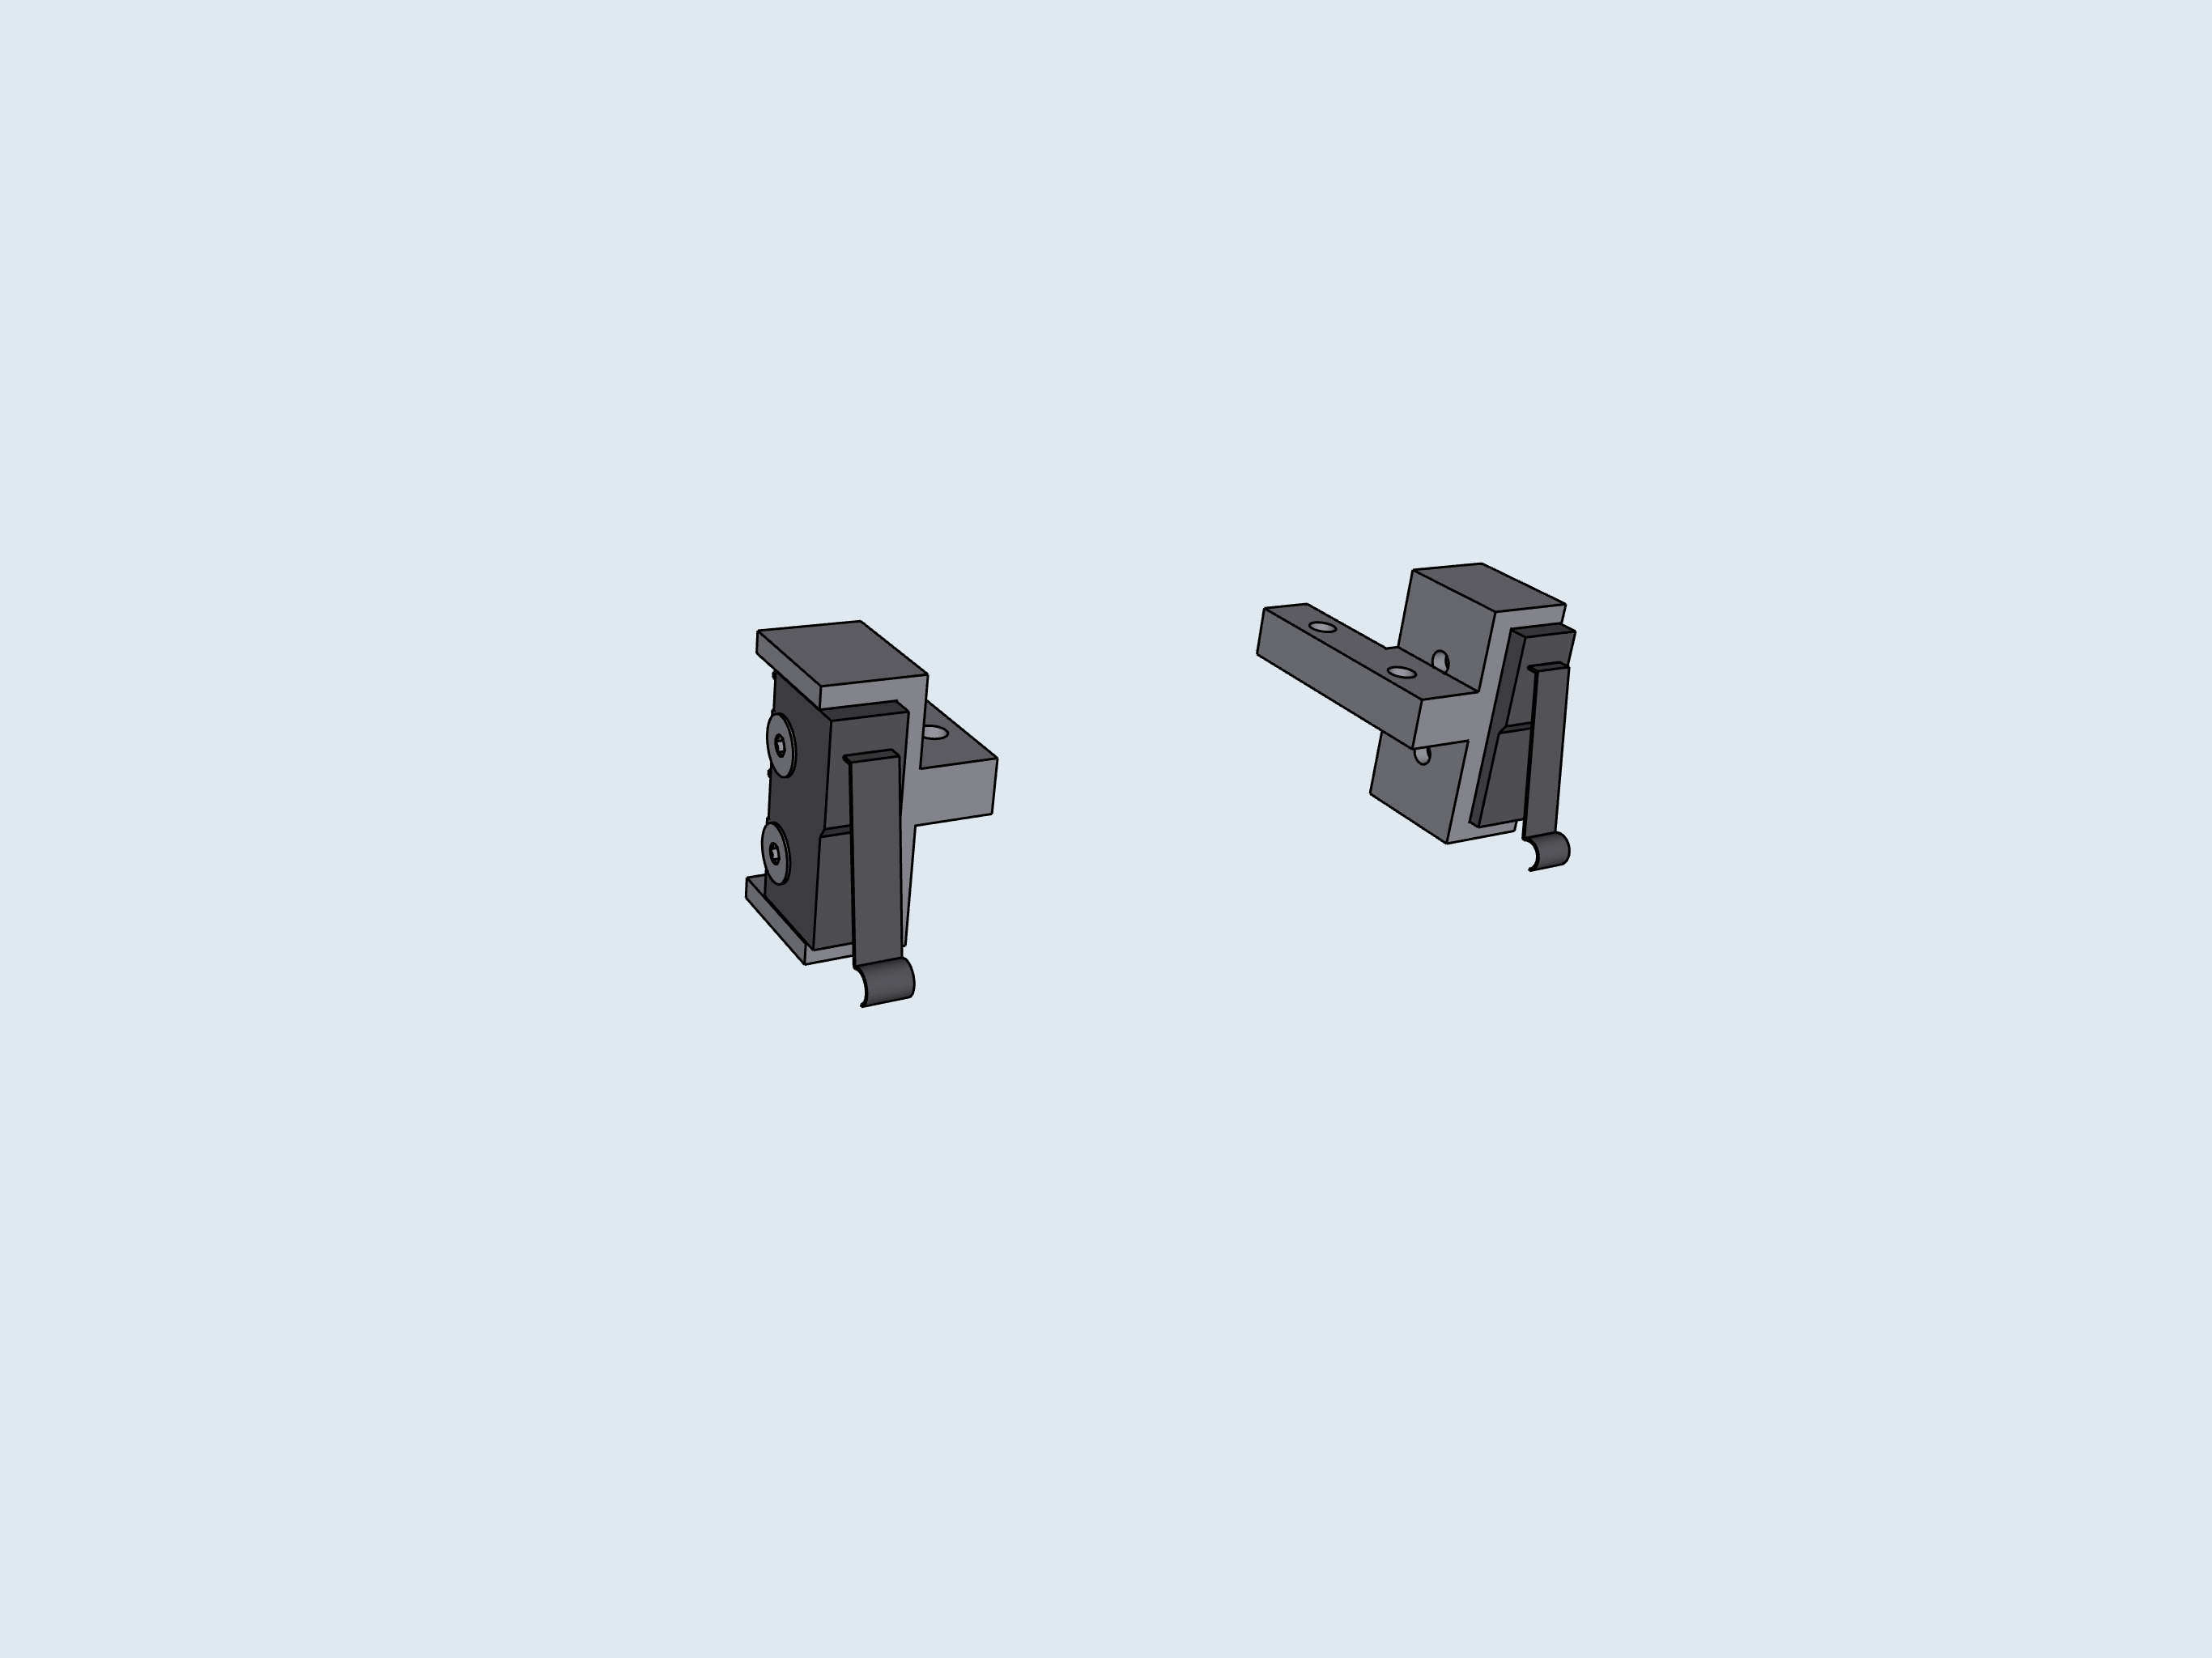
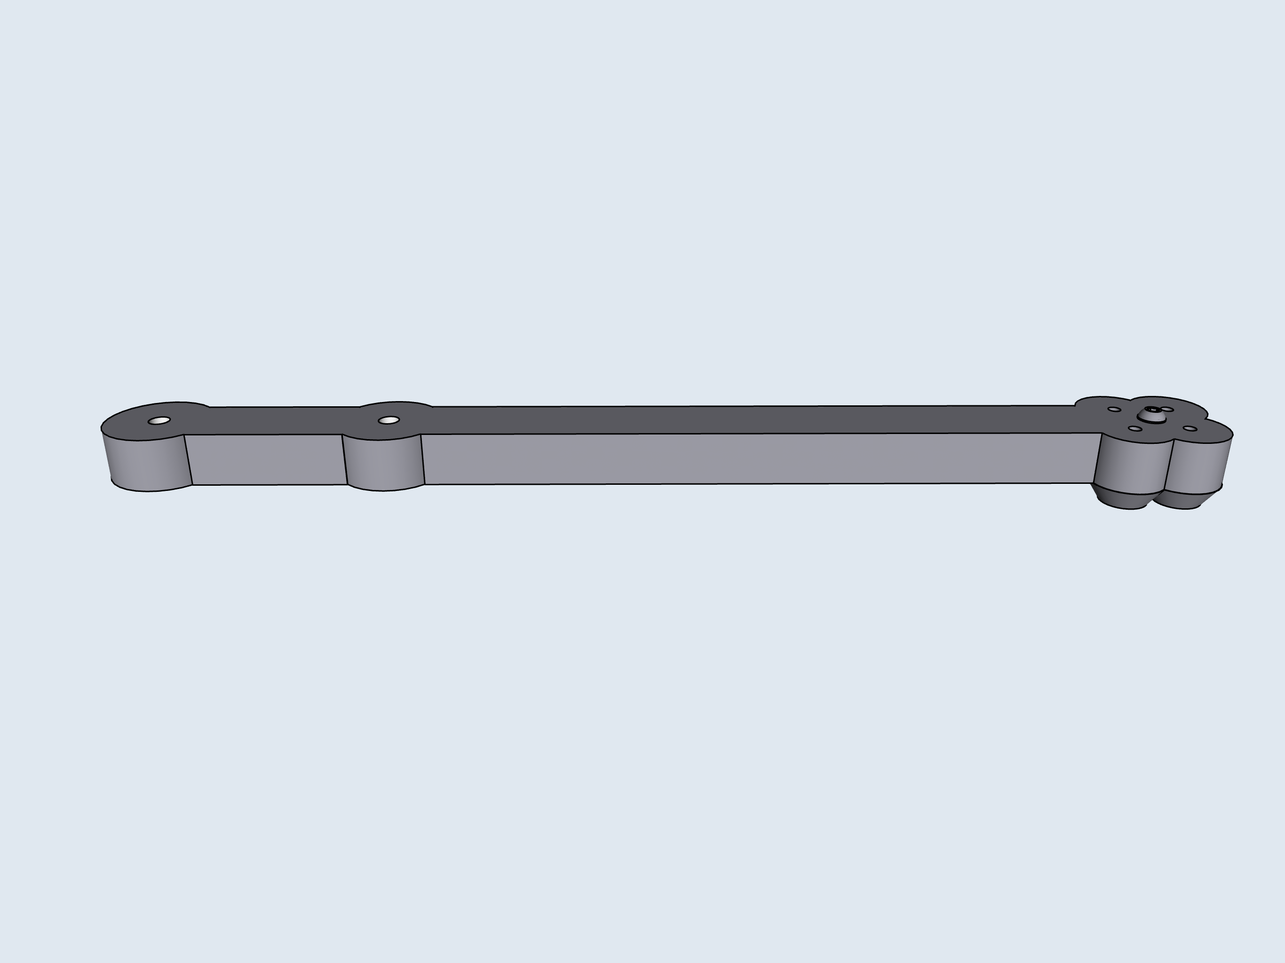
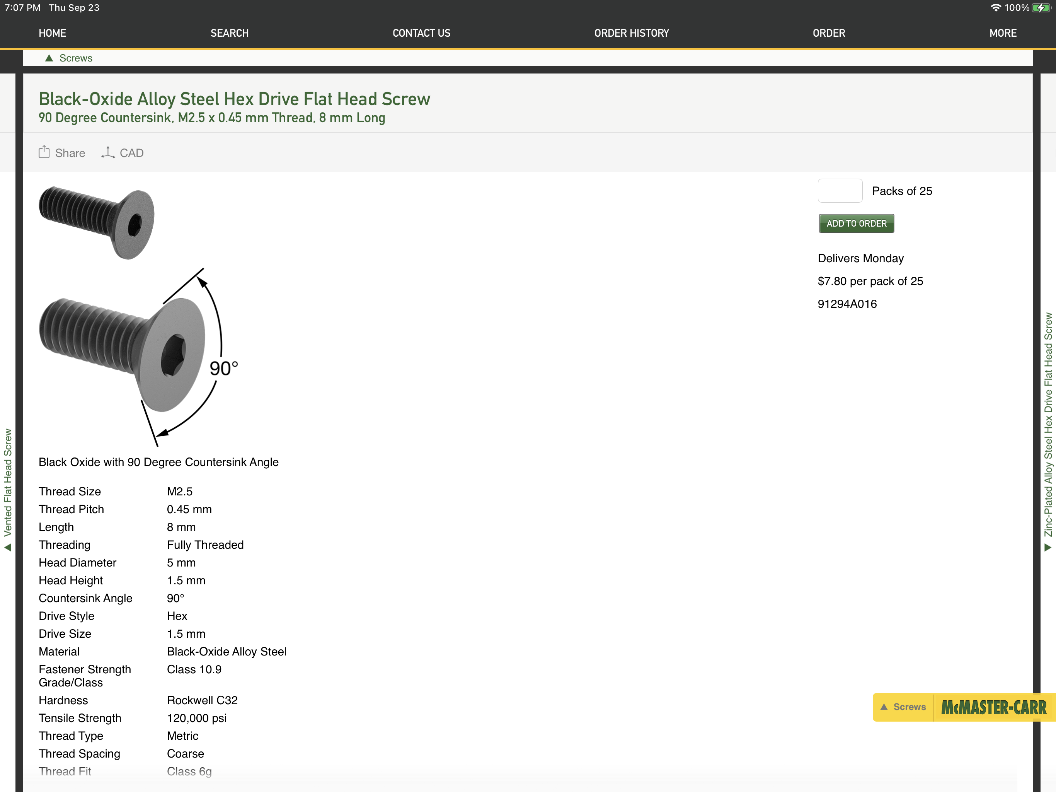
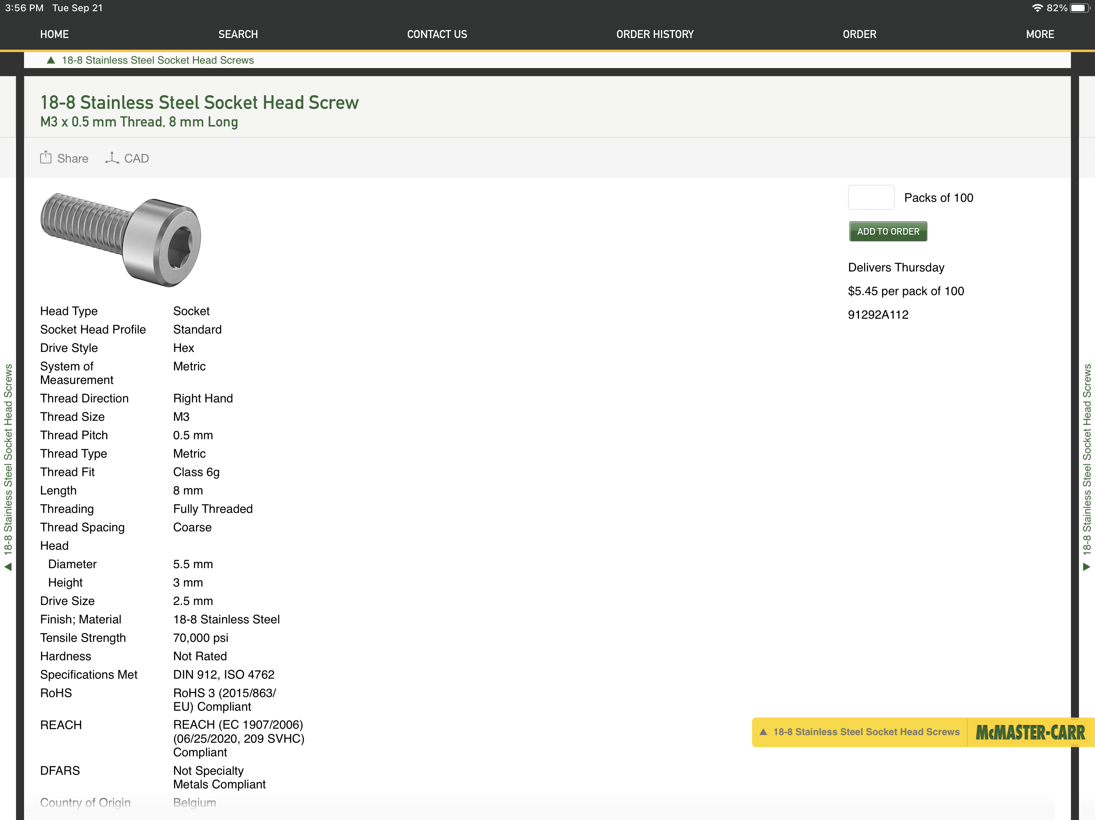
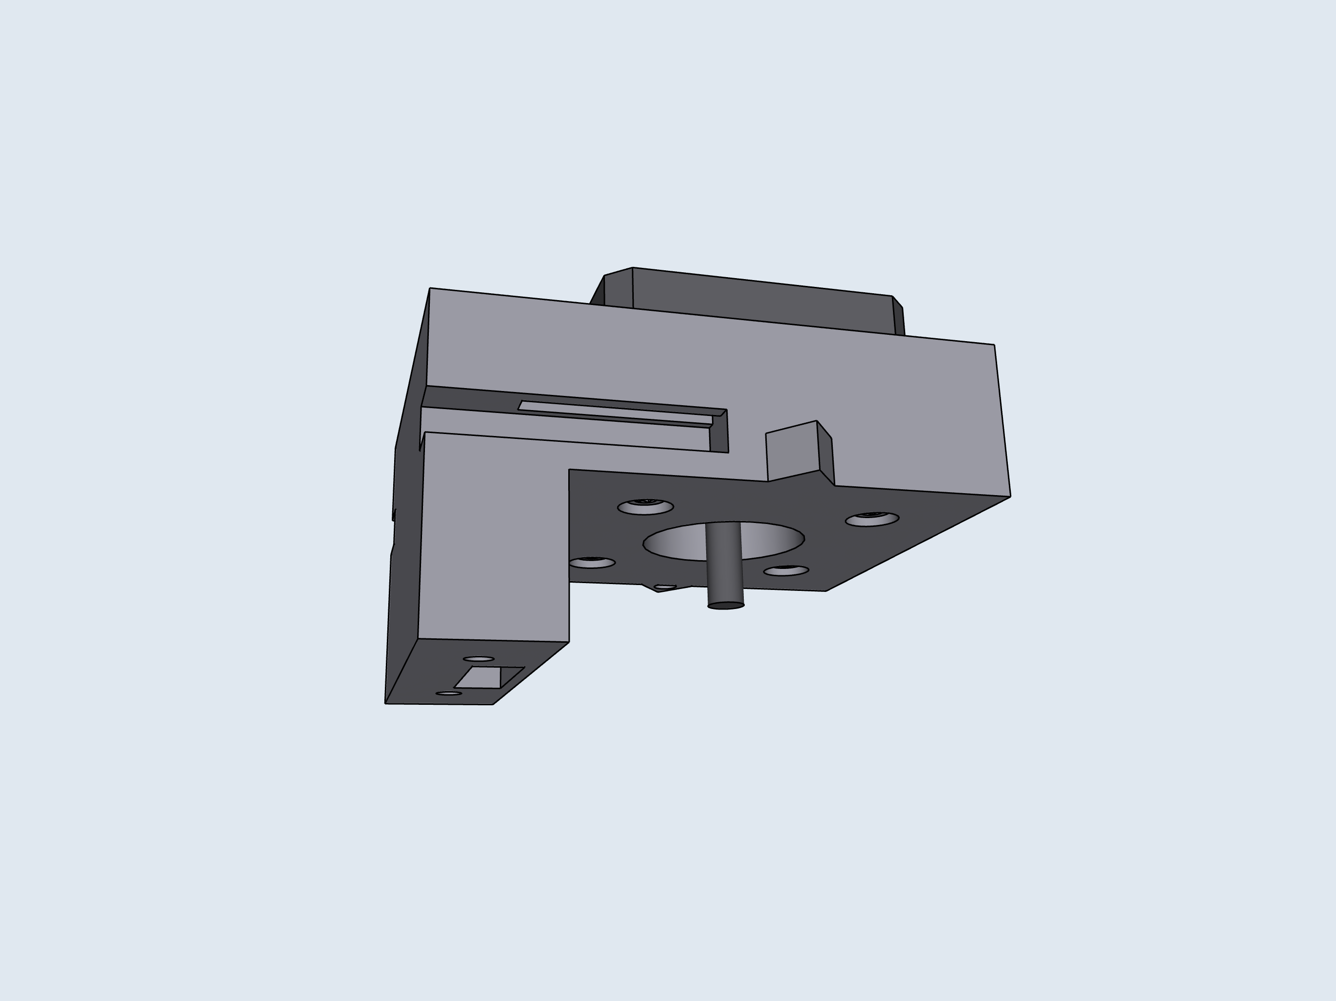
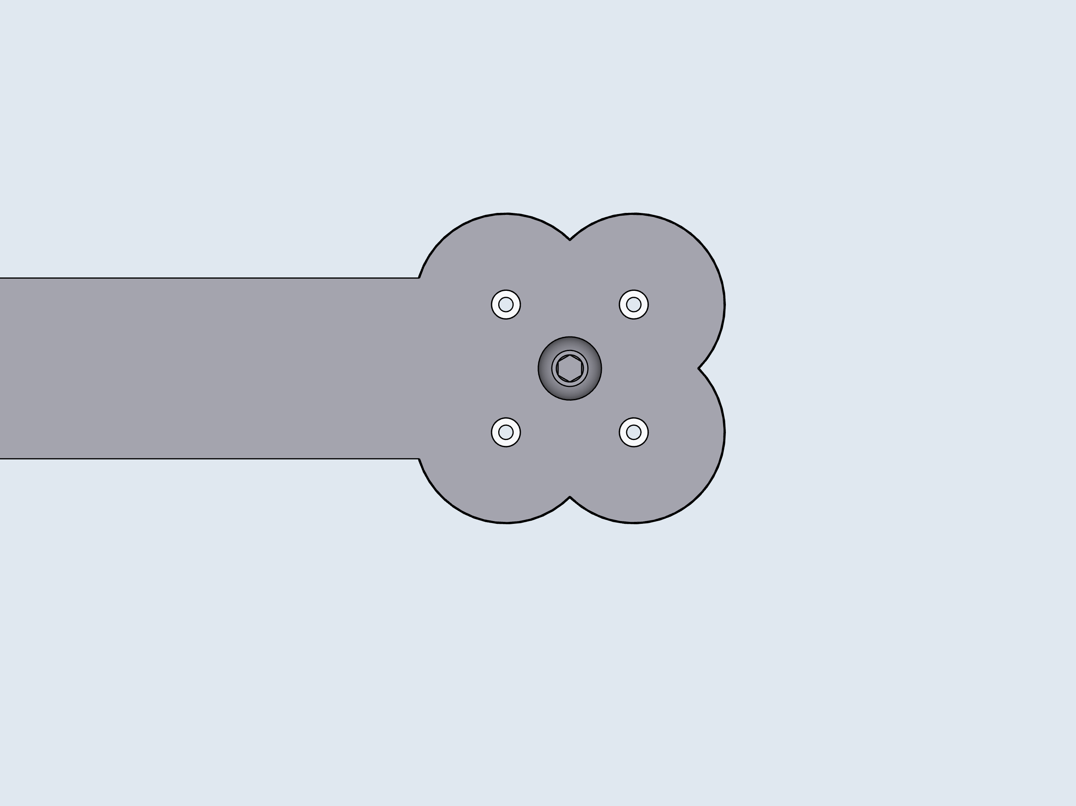
5
C: Motor Mounts
2
1
P1
P2
Pump Order
P3
P4

Slide 5
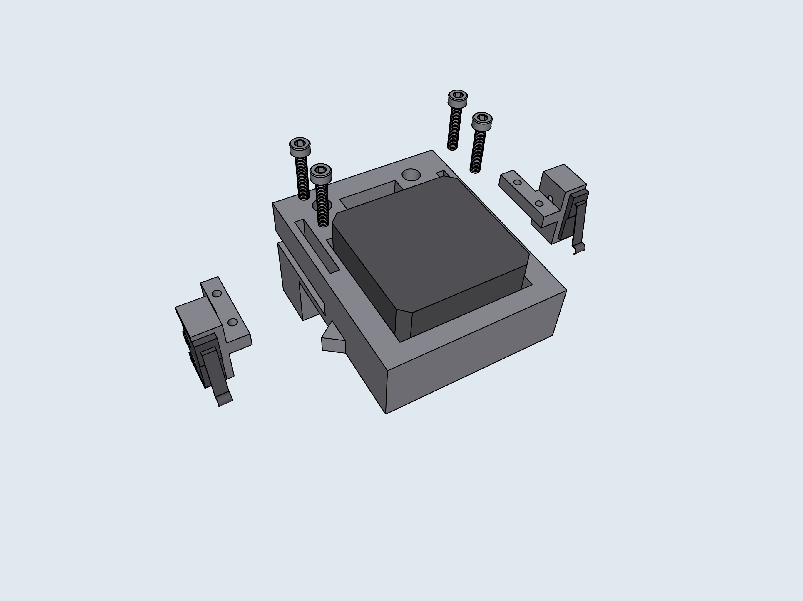
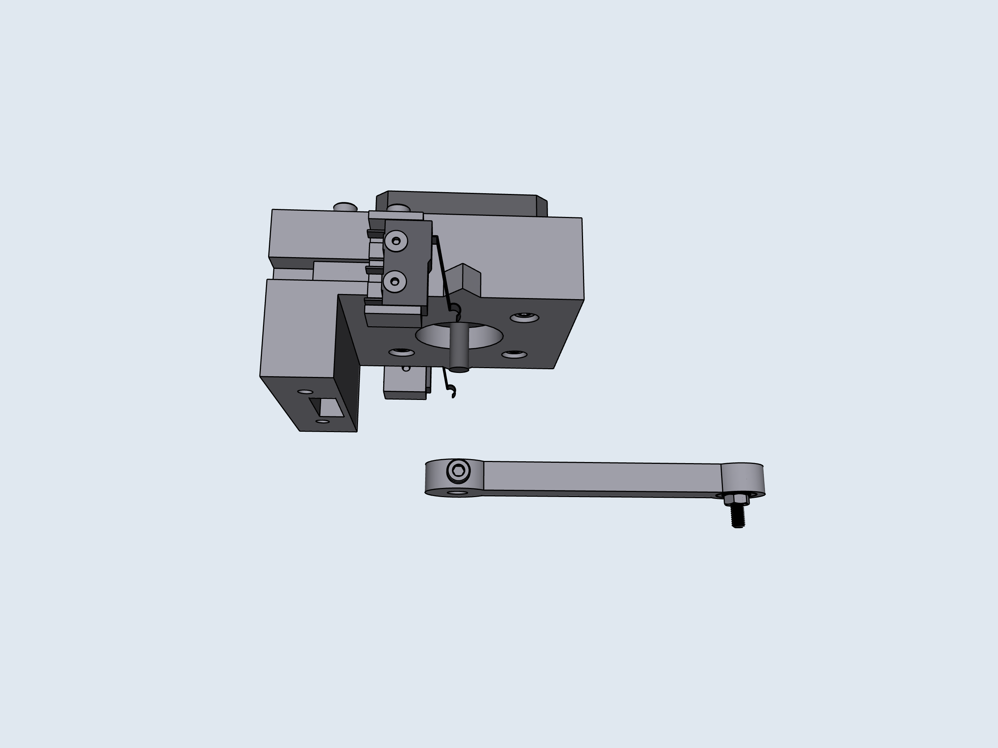
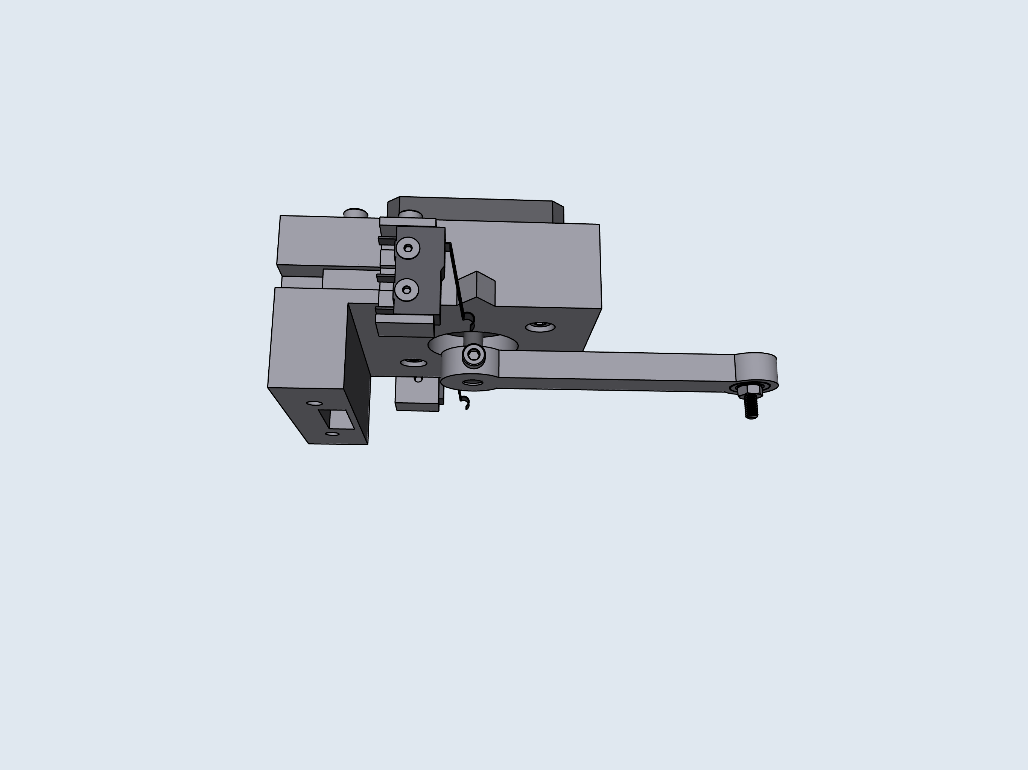
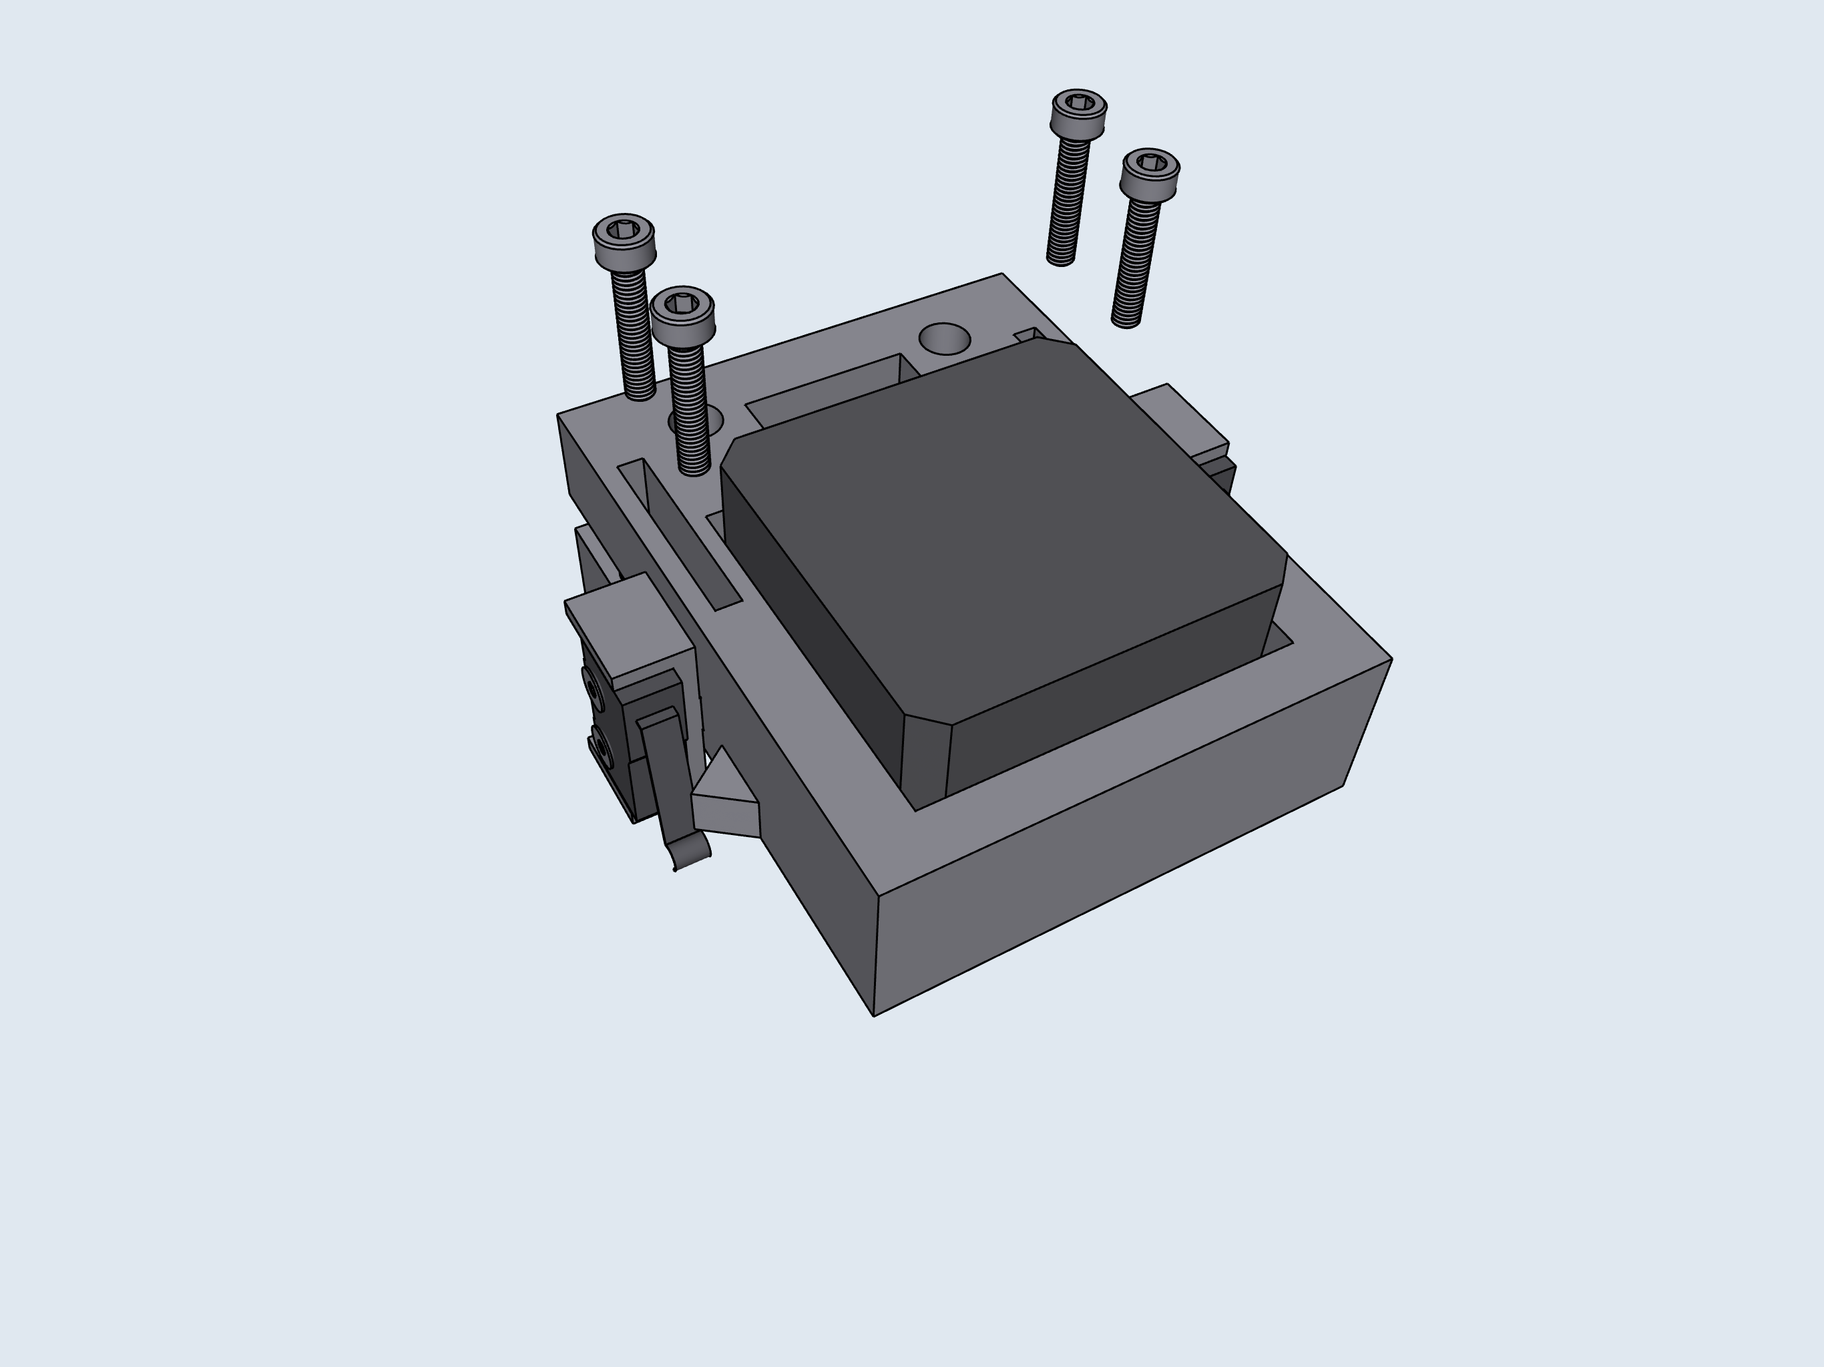
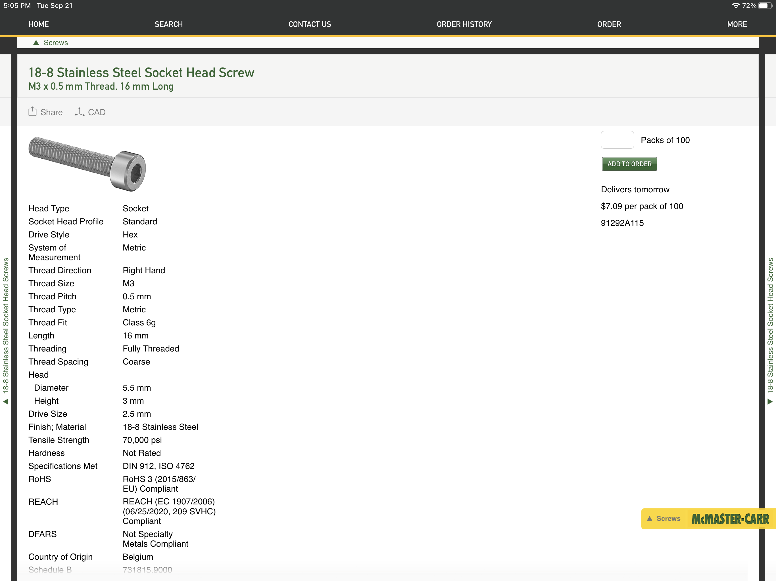
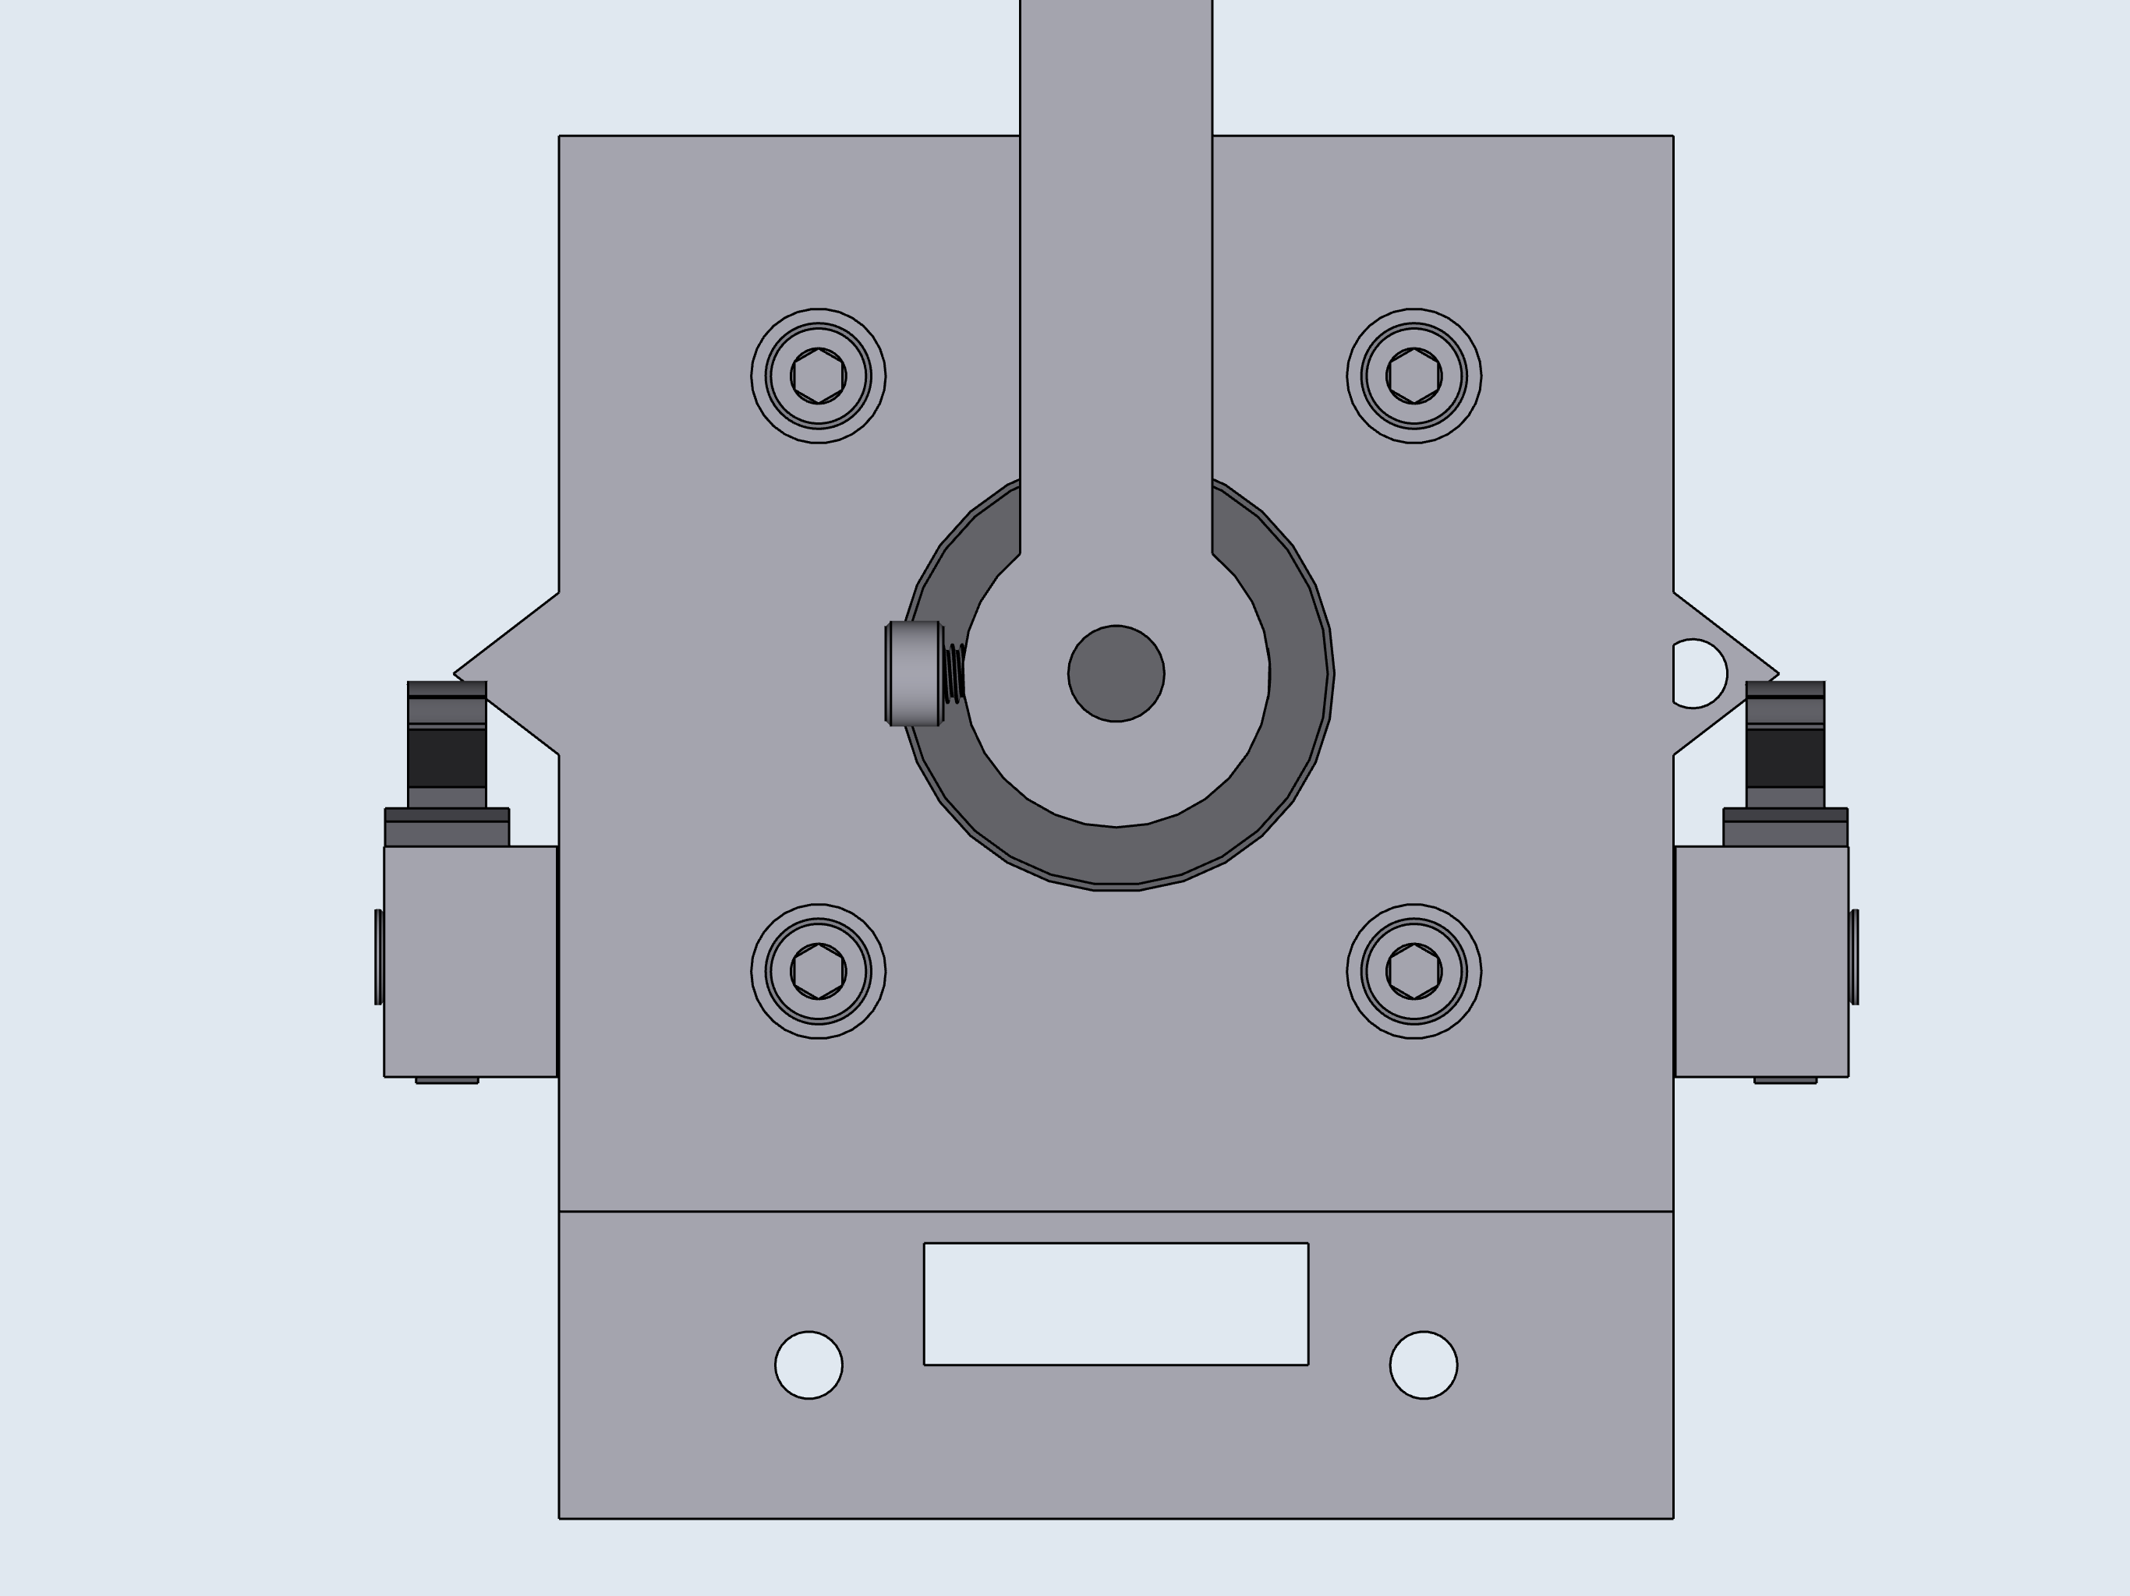
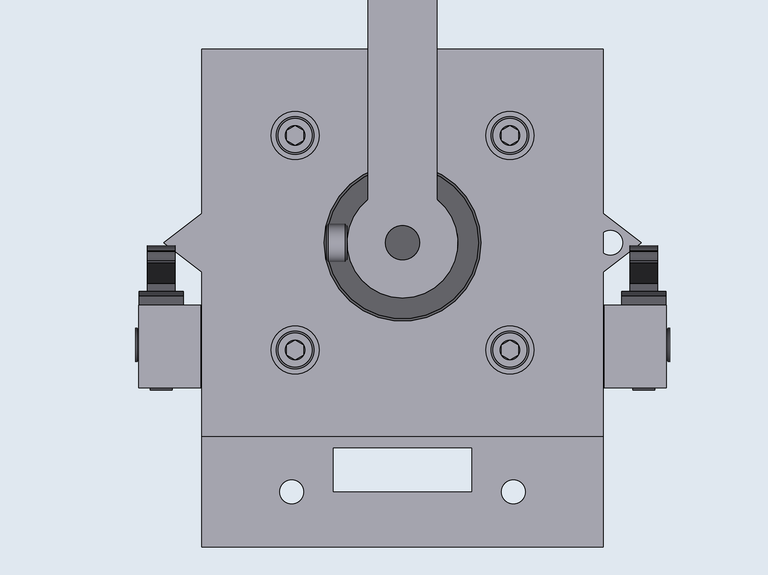
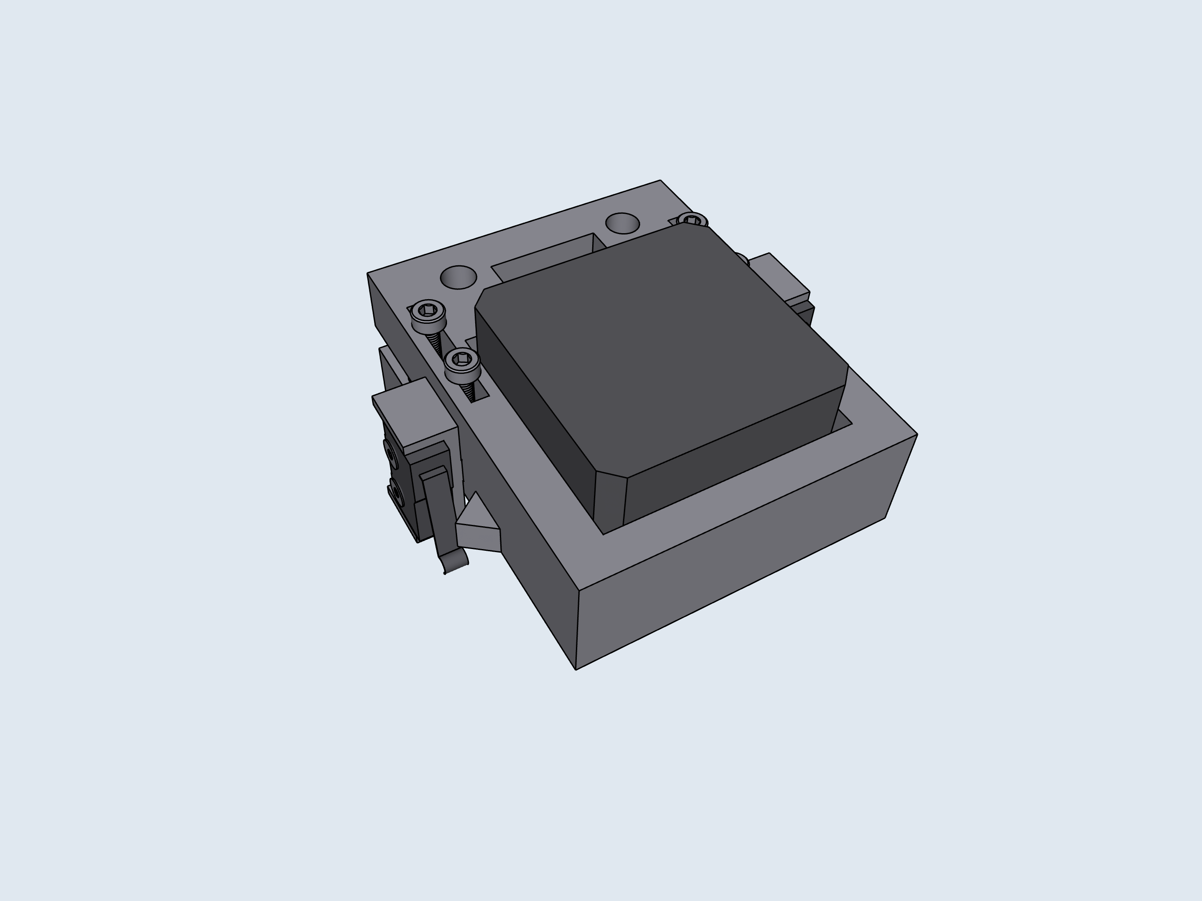
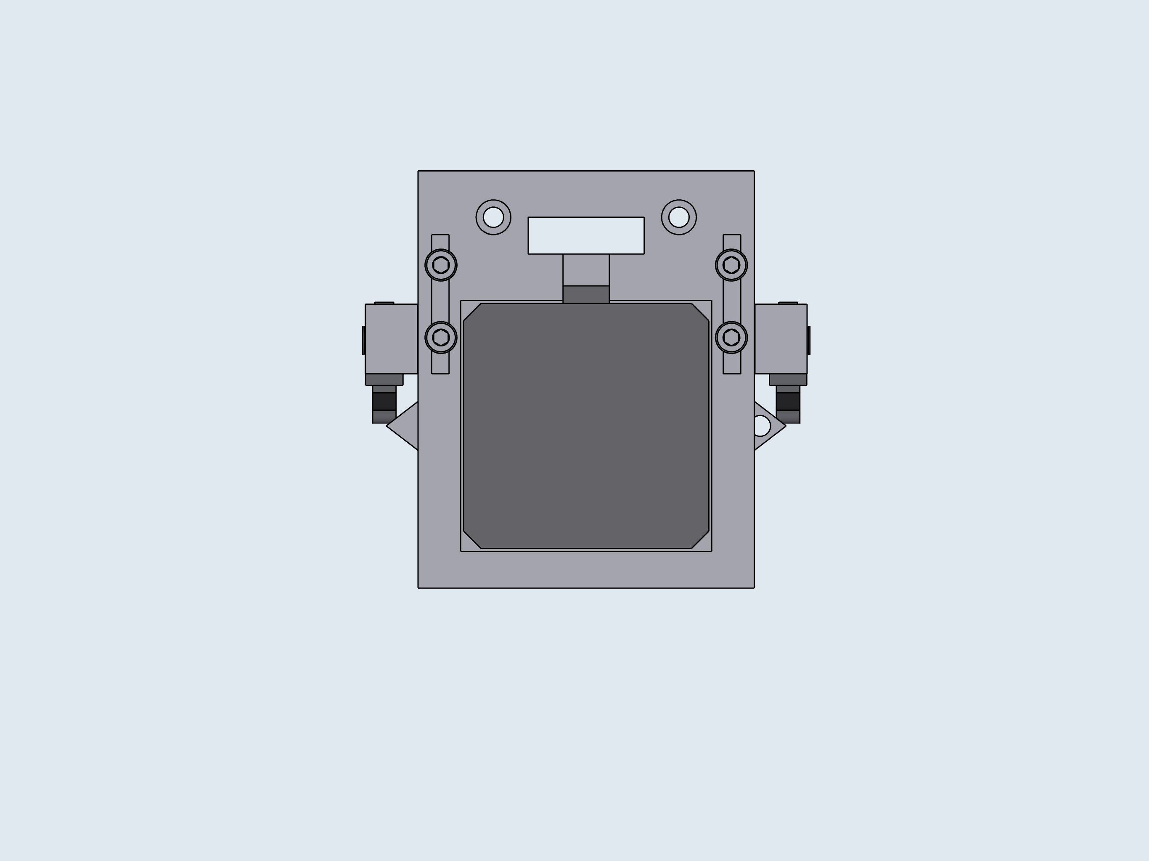
3
4
5

Slide 6
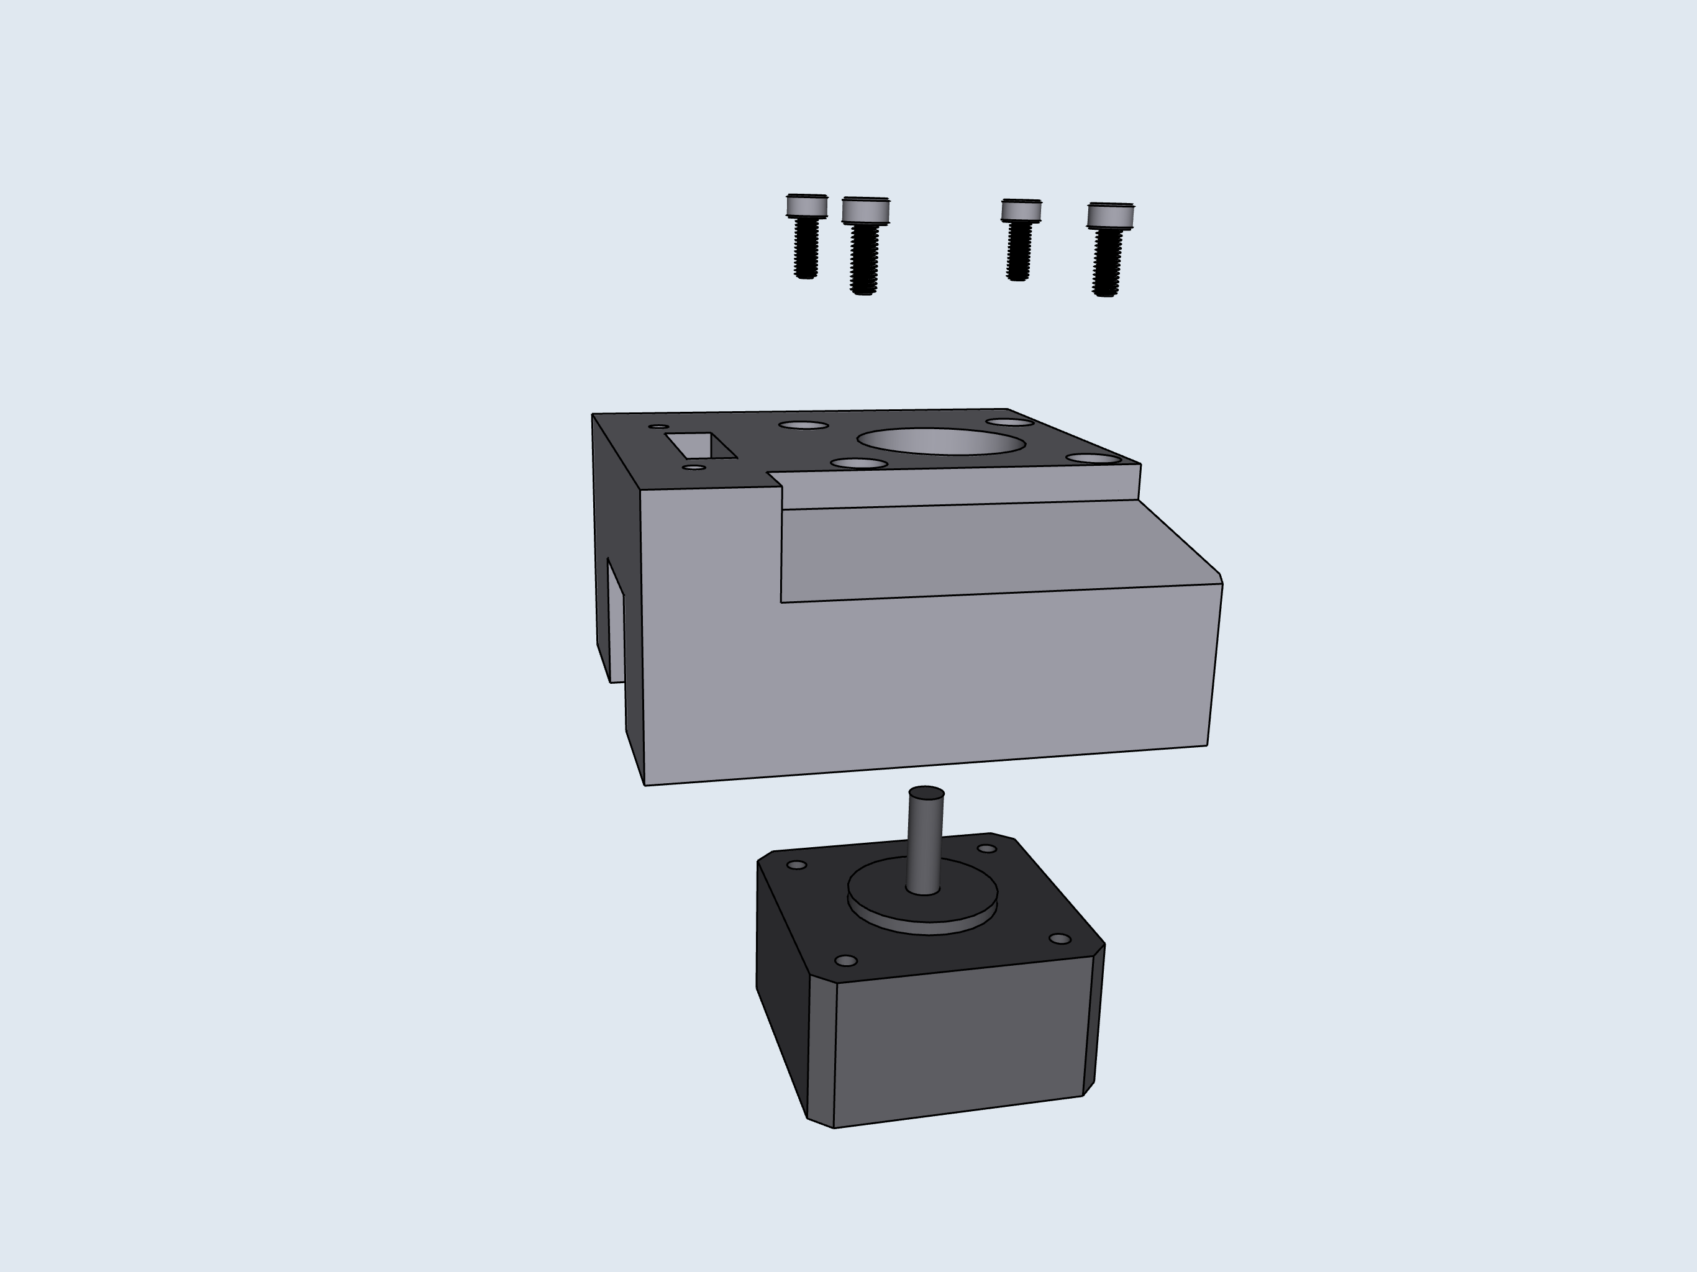
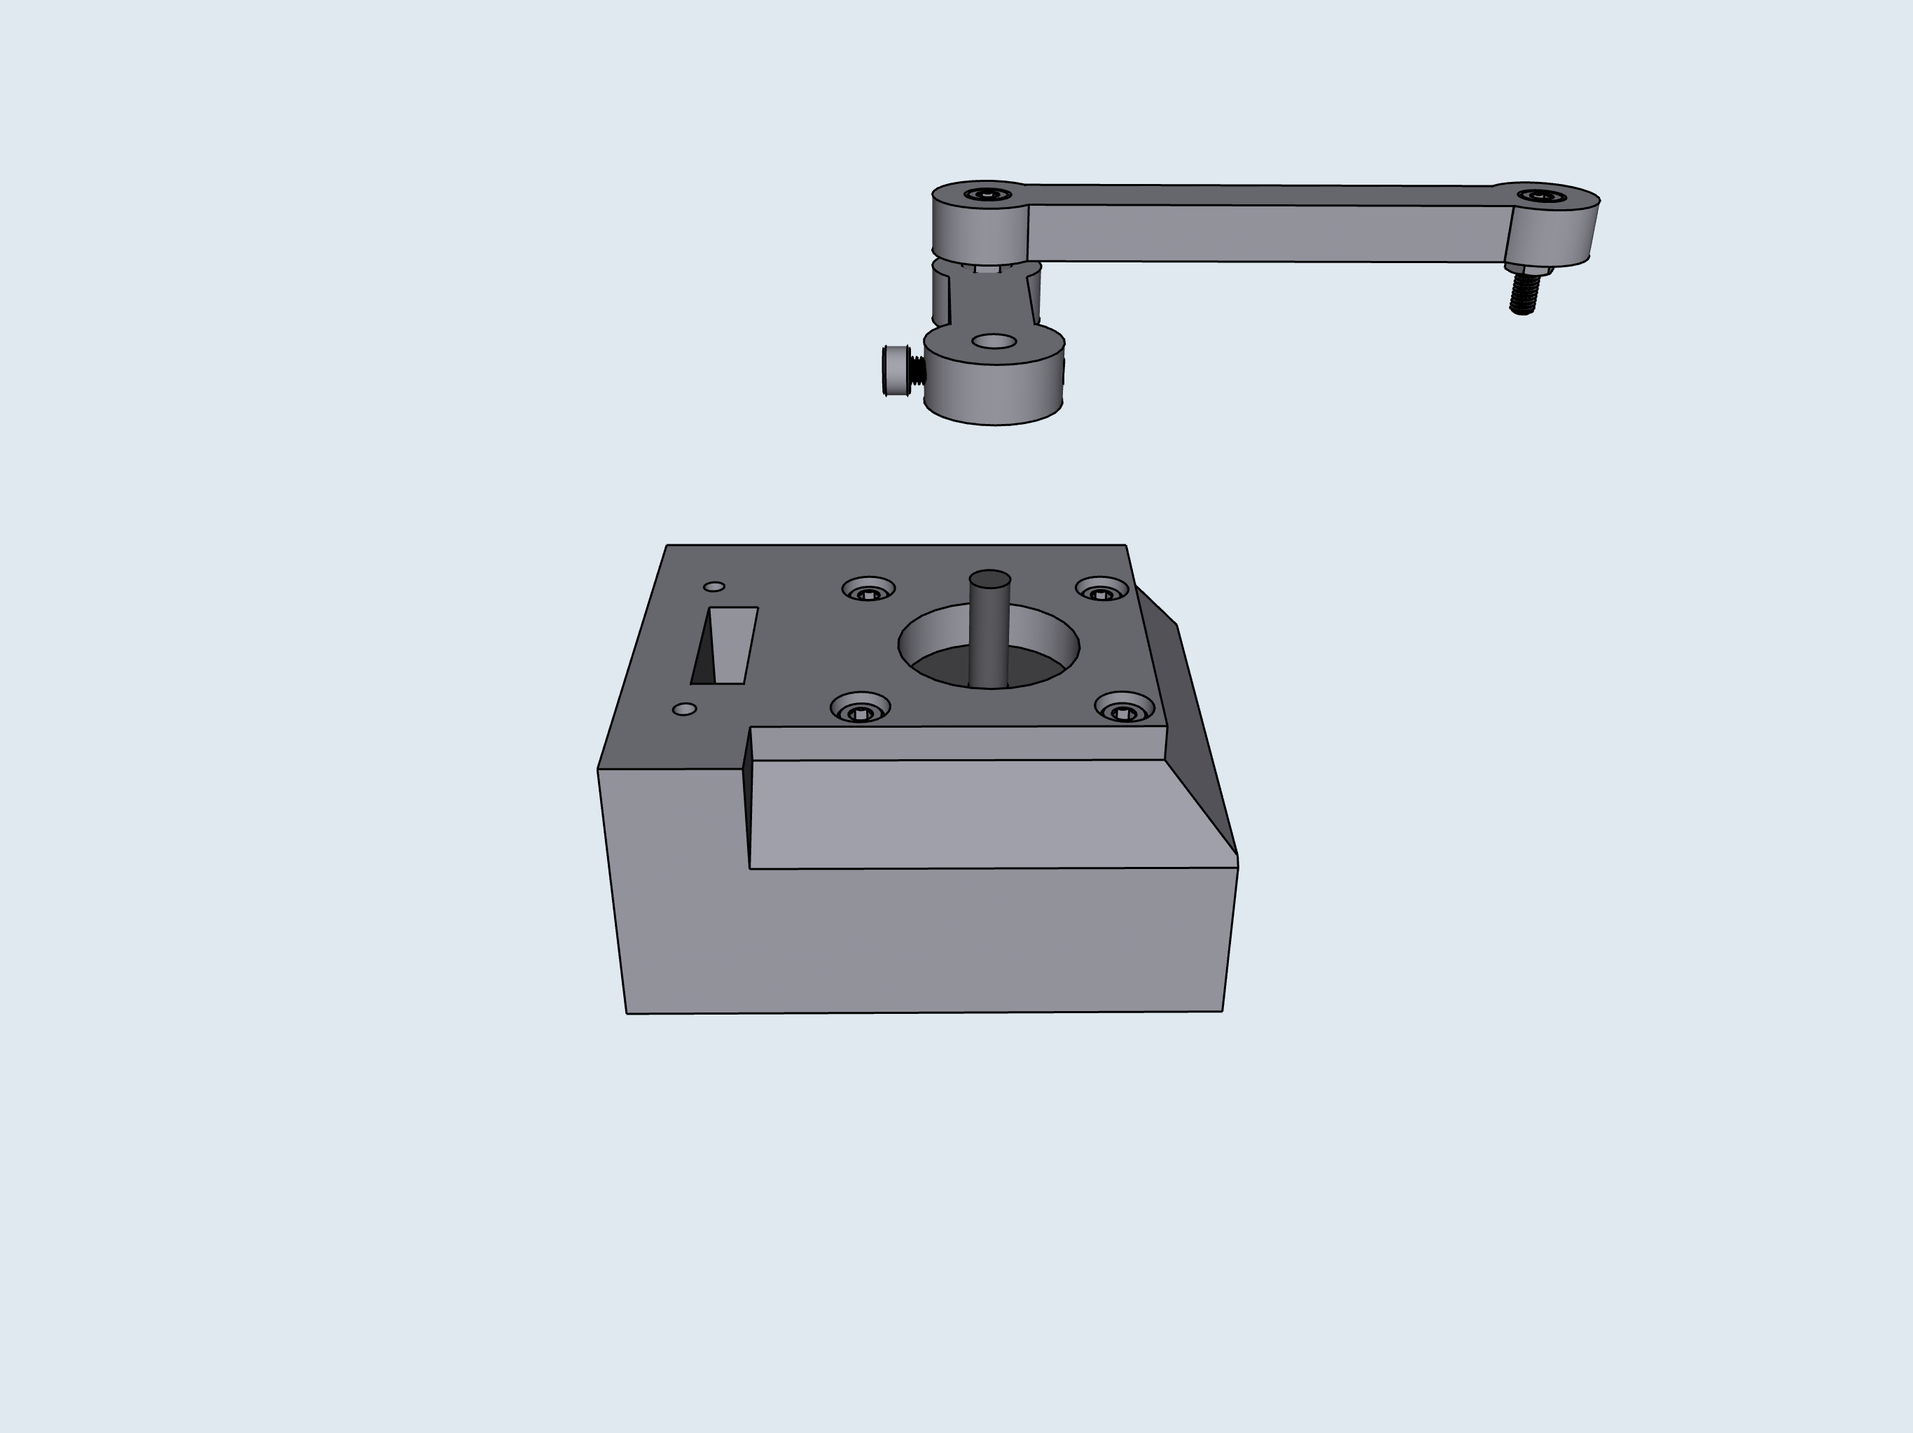
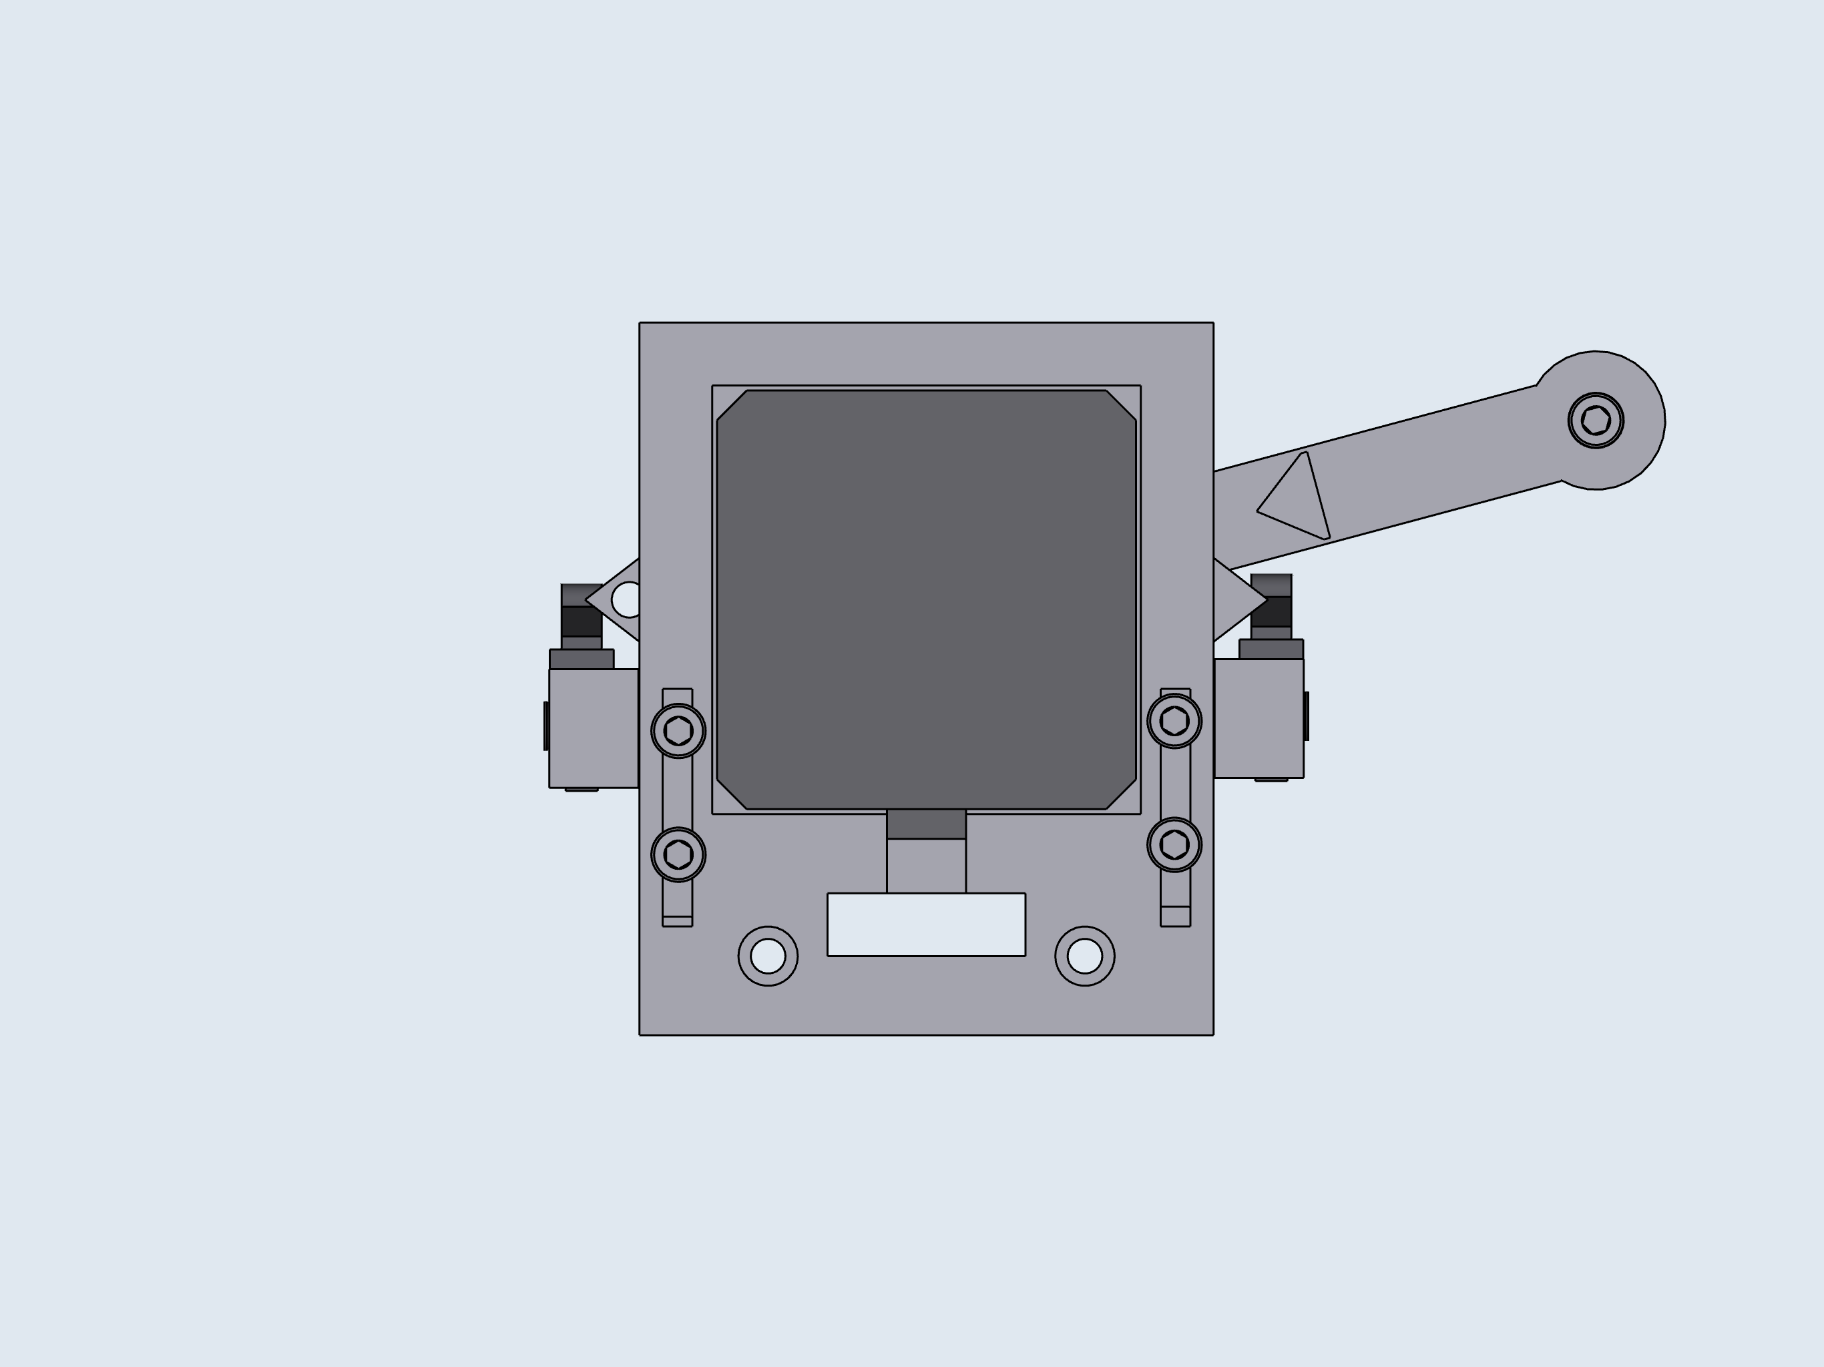
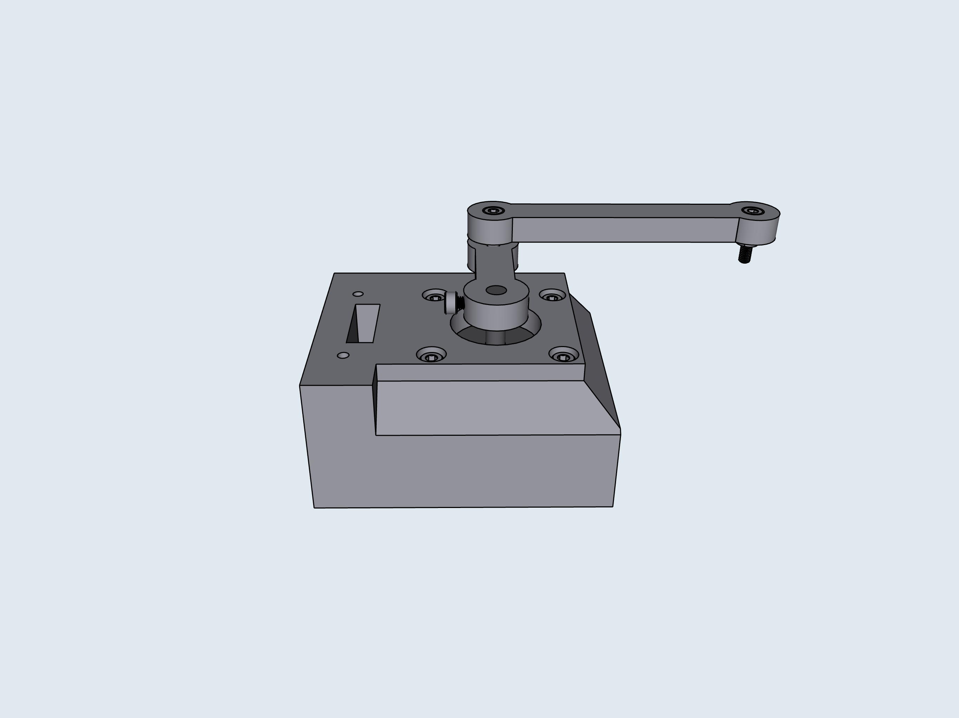
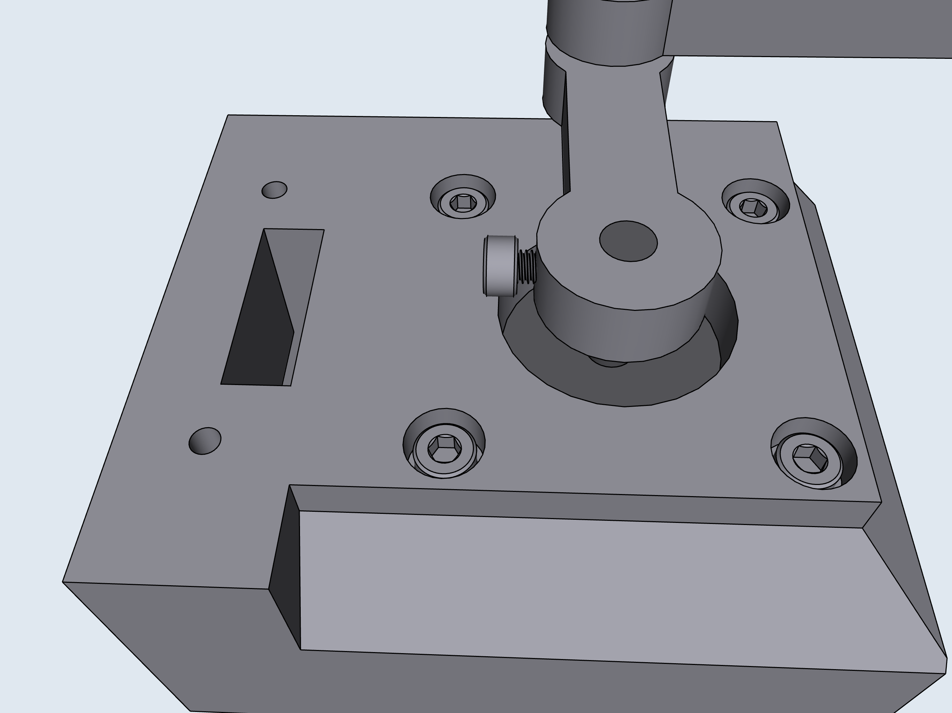
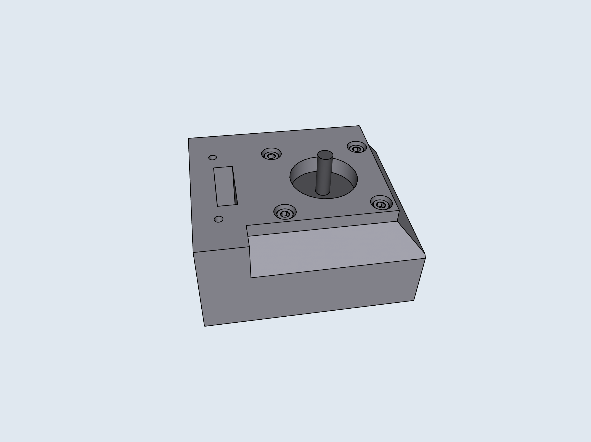
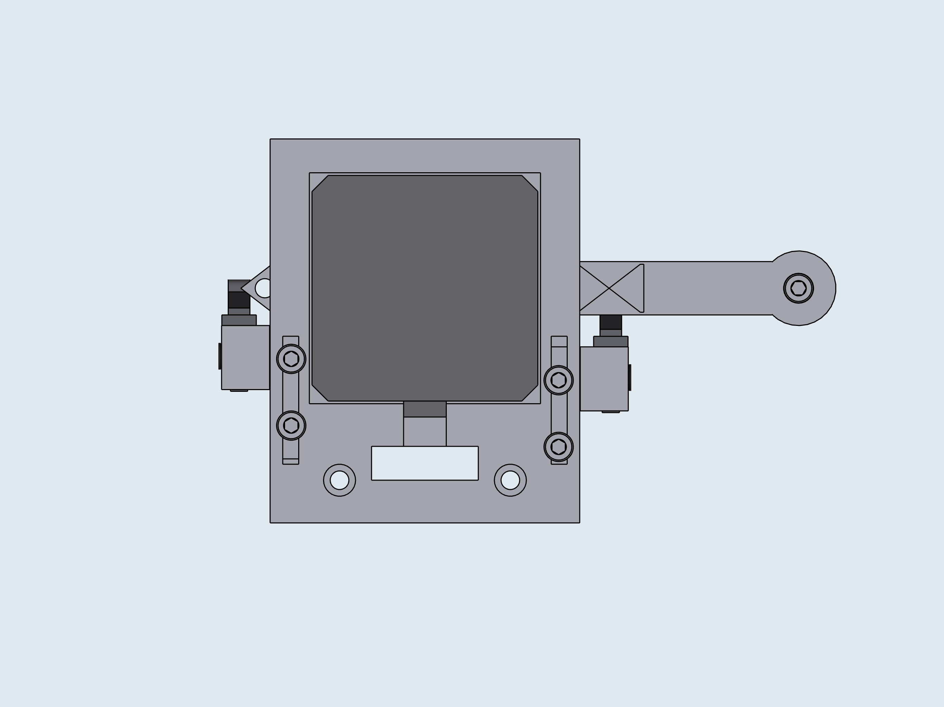

5
6
7
Limit switch position can be adjusted and fixed in place by tightening top mount screws.
8
Adjust limit position so that the limit switch triggers when the arrow on the arm is aligned with the arrow on the base.
*Click*
Once aligned, tighten screws.

Slide 7
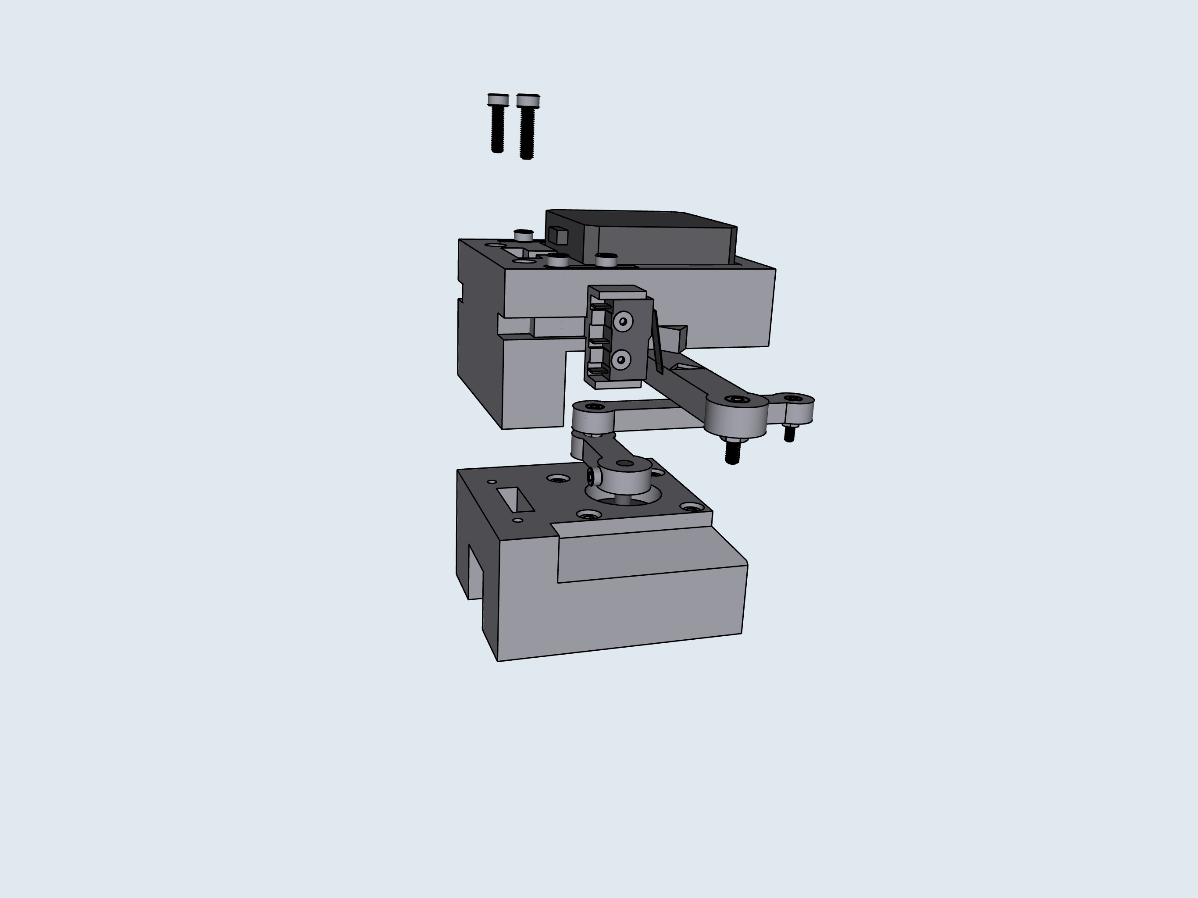
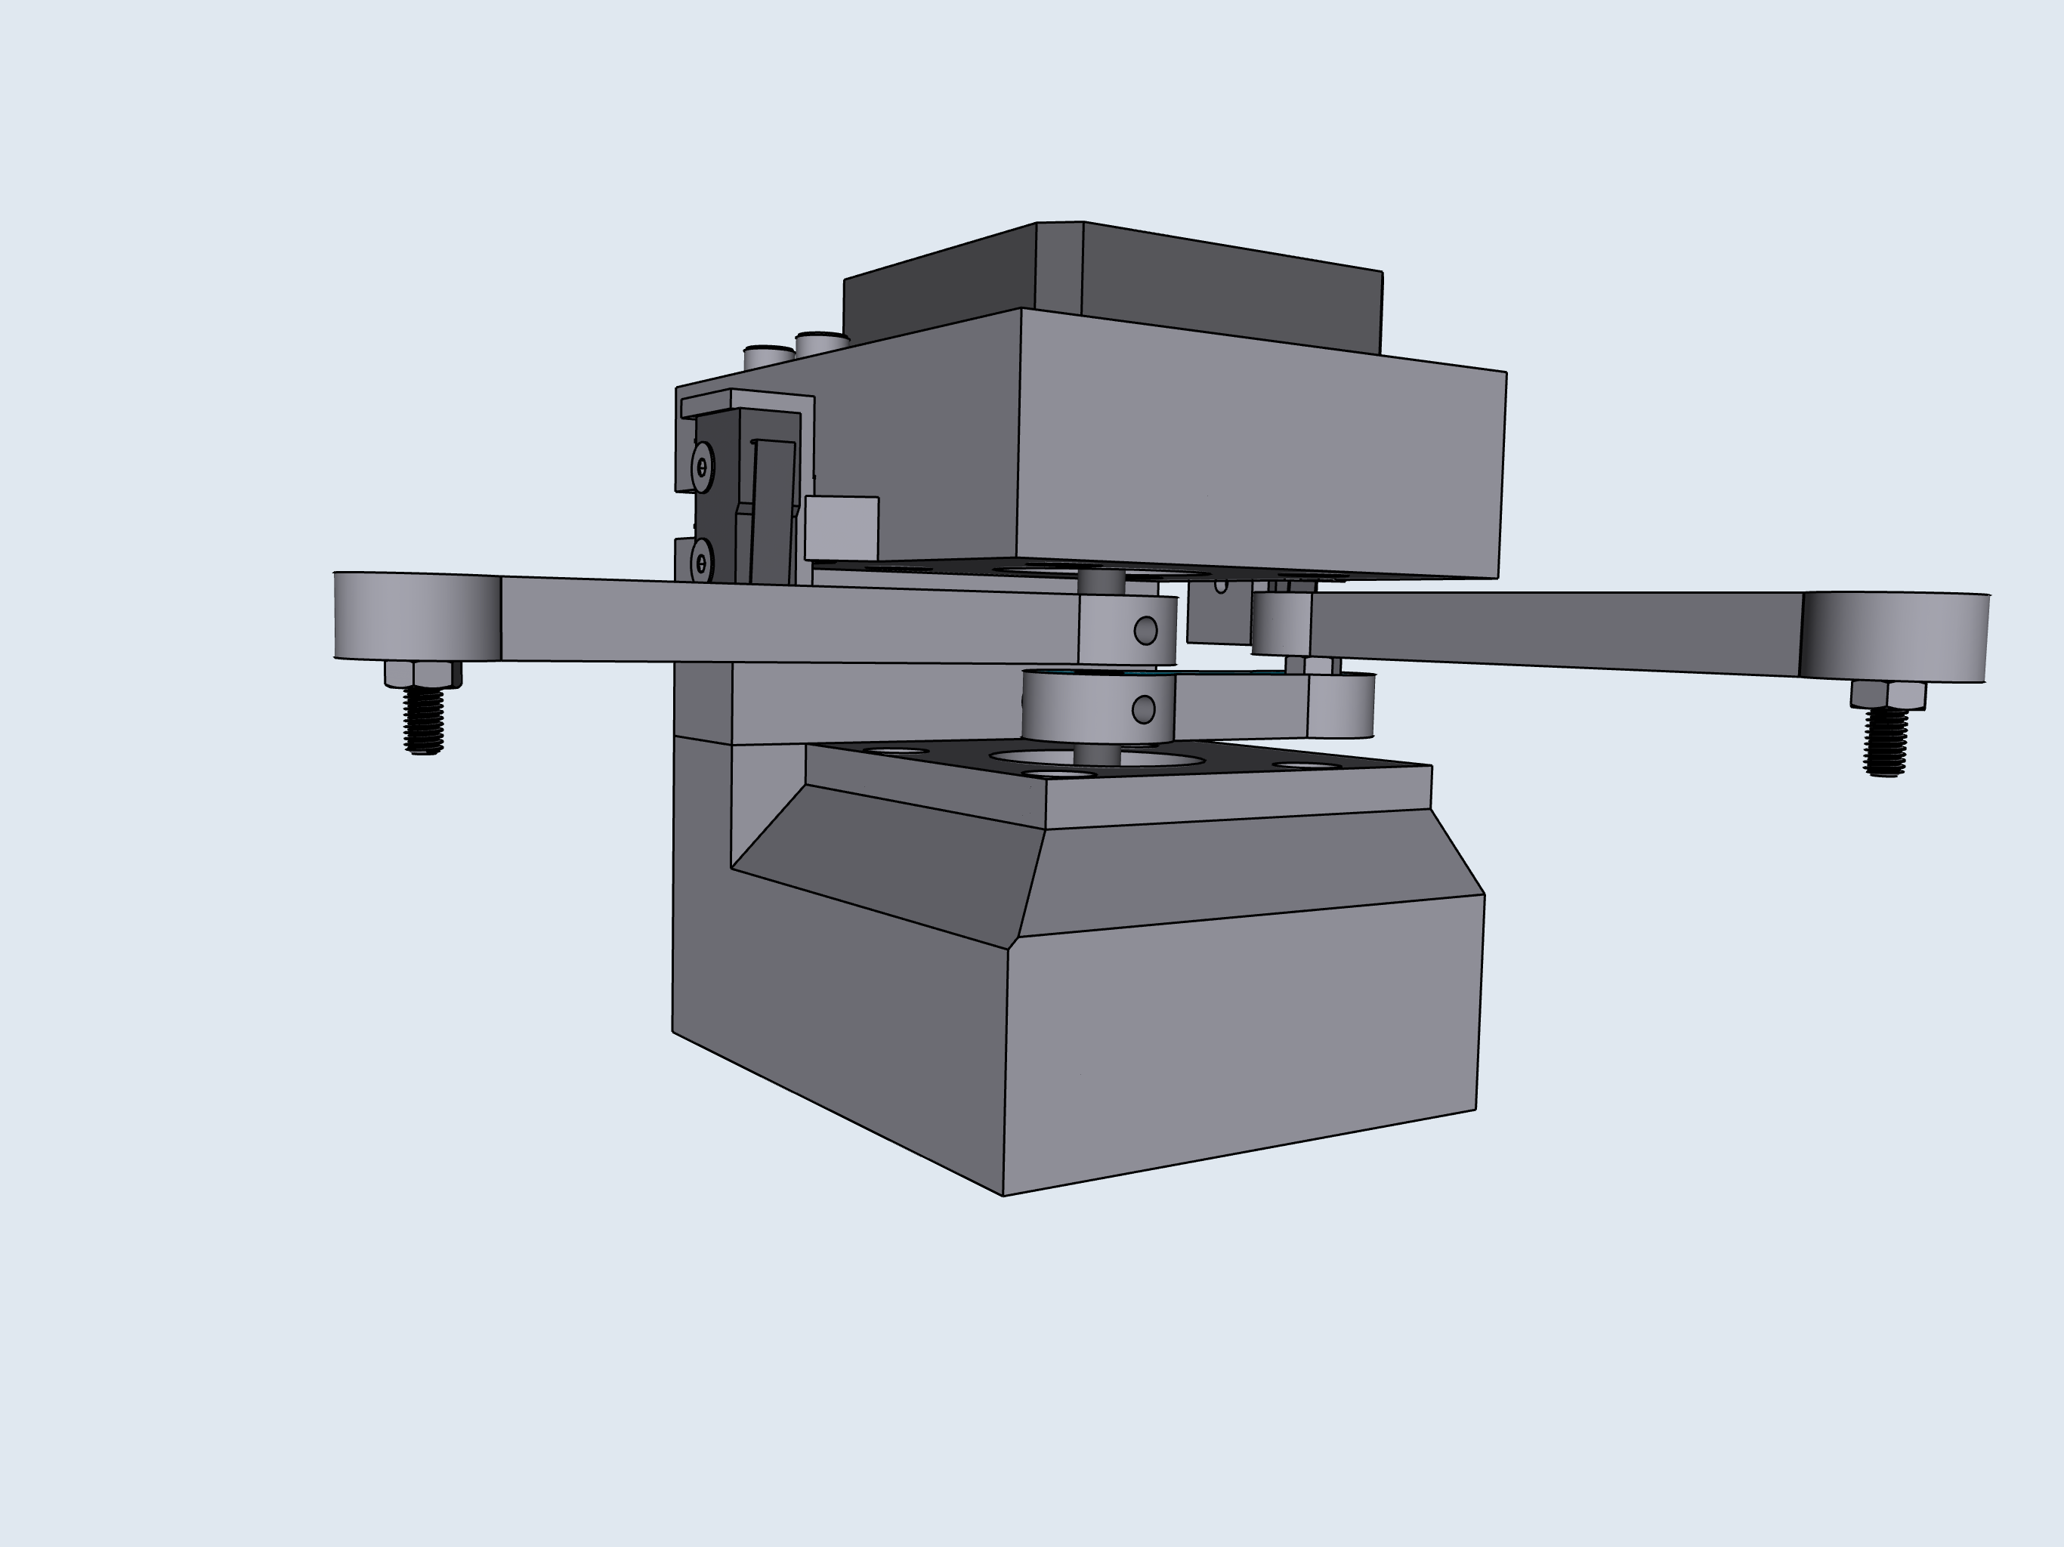
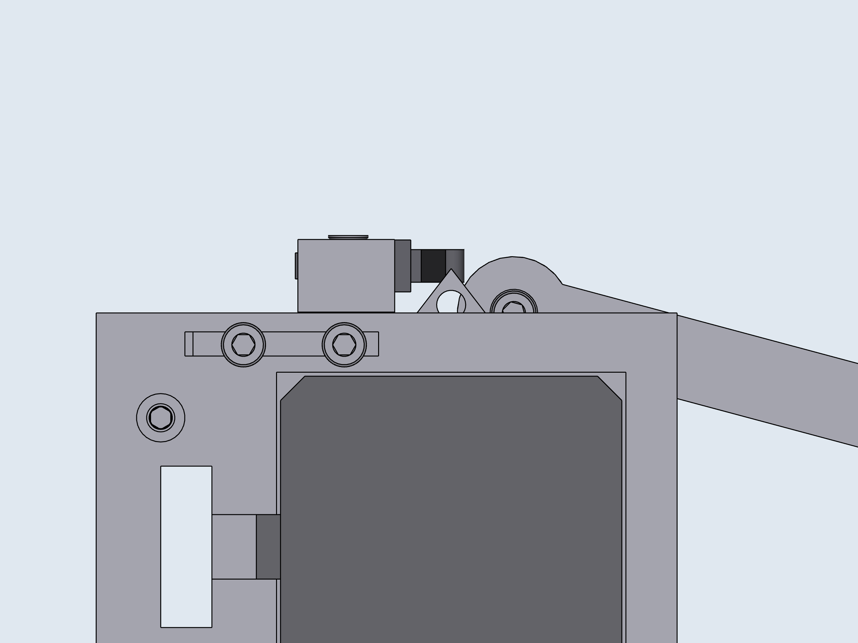
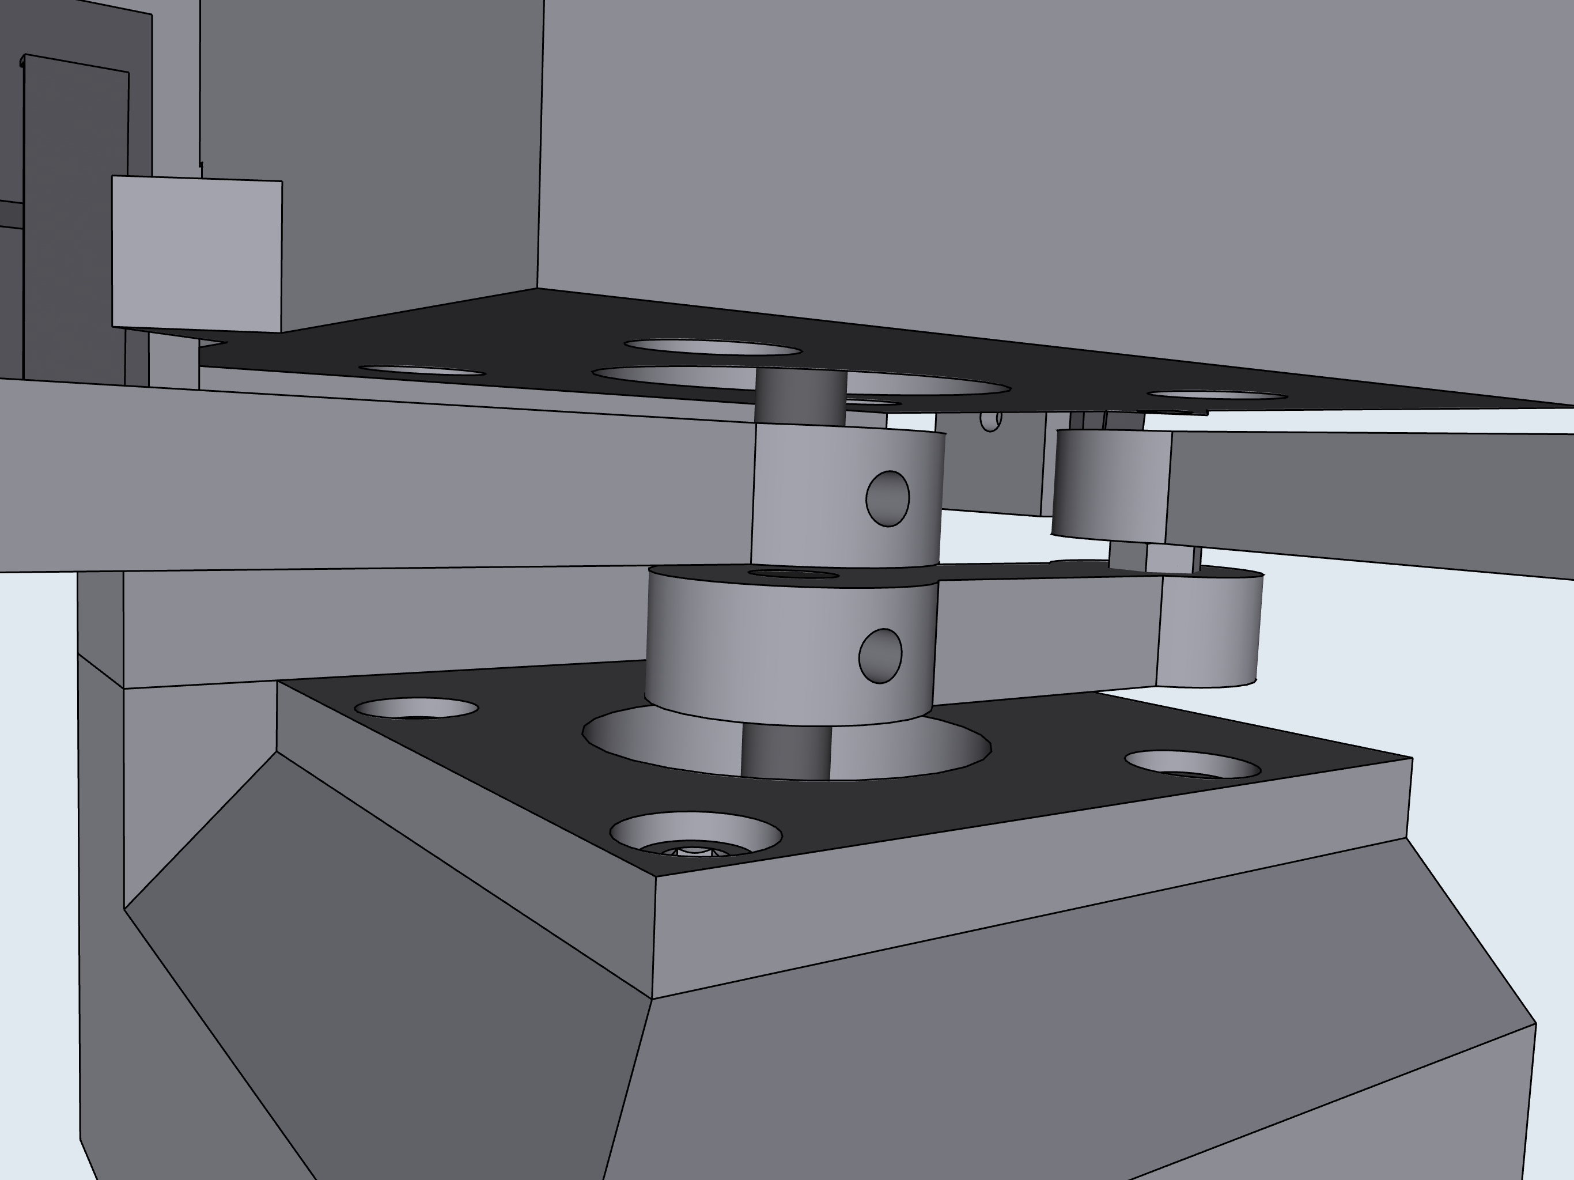



9
10
11
Adjust limit position so that the limit switch triggers when the screw on the arm is aligned with the circle within the arrow on the base.
*Click*
Loosen the M3 screws tightening the legs to the stepper motor shaft. Raise or lower the legs until the gap between them is the same height as the M3 nut. Retighten the M3 screws.
Once aligned, tighten screws.

Slide 8







12
D: Base
2
1
3

Slide 9










D: Base, Final Assembly
2
P4
P3
P2
P1
1
3

Slide 10







E: PCB Wiring/Assembly
2
Cut the through pins of the Pico and stepper drivers, so that they are in line with the power barrel leads.
1
Set the VREF of your drivers to match your stepper motor’s recommended current. Adjust with the screw potentiometer, and a multimeter
P4
P3
P2
P1
3
Pumps
Upper Stepper Motor
Solder in the electrical components. Make note of the orientation of the Darlington Array, and the Pico.
Purge Button
Lower Stepper Motor
Rear Limit Switch
Front Limit Switch

Slide 11




4
5
Before continuing, make sure that all hardware is wired correctly. Plug in the PCB to power supply, and the USB to a computer. Through PUTTY, type into the serial terminal, “hardware check”. The Sidekick should home against each limit switch, park the nozzle at a right angle, and then cycle through energizing each of the pumps. When a pump is energized, it will make an audible clicking sound. Once the correct wiring is validated, continue to step 6.
6

Slide 12







E: Plate Holder
2
3
1

Slide 13







F: Pump Tubing
2
3
1
Note, one side of the clamp has a larger diameter. This is the side facing the washer. This allows the screws to clamp onto the tubing.
Repeat 4x for outlet…
and 4x for inlet.
A
B
Sleeve the 1/16” OD tubing into the clamped 1/8” OD tubing. Slide the smaller tubing down until you can feel the resistance caused by the clamping force. Once you feel resistance, do not push the tubing down any further! Finish tightening the screws to securely clamp down the nested tubing. This is a critical step in reducing dead space and ensuring accurate dispensing.
B
A
Note how the clamps have been fully tightened and are flush against each other. This ensures an airtight seal between the inner and outer tubing.

Slide 14





4
5
Side Profile
P1
P2
Pump Order
P3
P4
Inlets
Repeat 4x for each pump.

